Slide 1


Slide 2
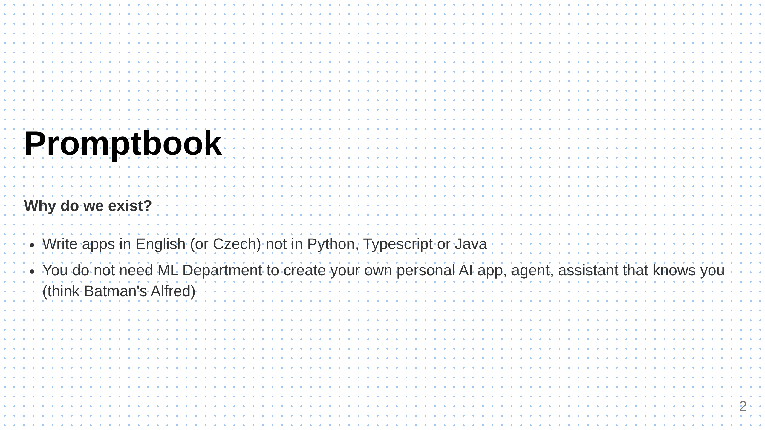
Notes:
Slide 1: What We Do (Clear, concise, 2 sentences) You do want to have your C3PO

Slide 3
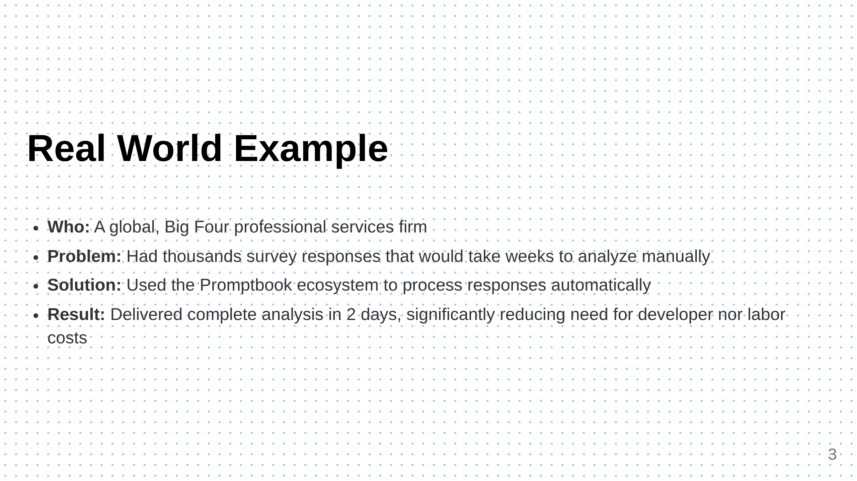
Notes:
Slide 2: Specific Example Specific, detailed example showing your solution in action

Slide 4
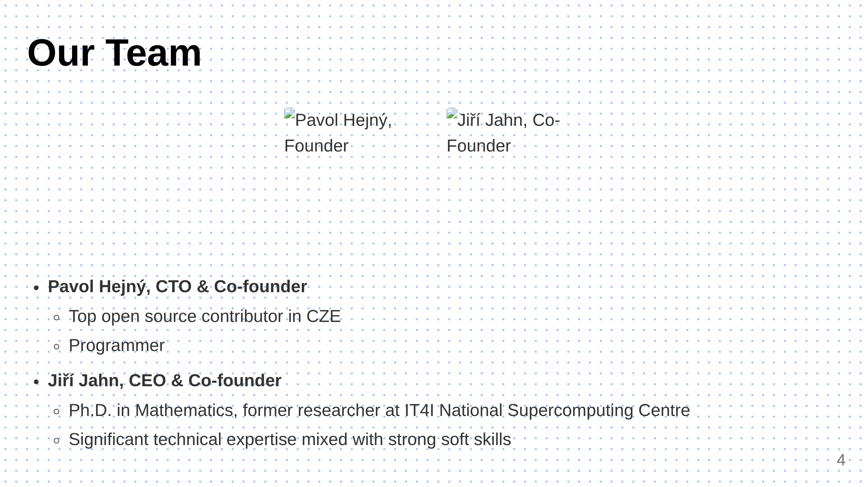
Notes:
Slide 3: Team (Only if it's a strength) --- Slide 4: Traction (Only if strong) # Traction <div class="grid"> <div> ## Key Metrics - [Specific metric] in [timeframe] - [Growth rate] over [period] - [Key milestone] achieved in [time] </div> <div> ## Timeline - [Month Year]: Started development - [Month Year]: [Important milestone] - [Month Year]: [Current achievement] </div> </div>

Slide 5
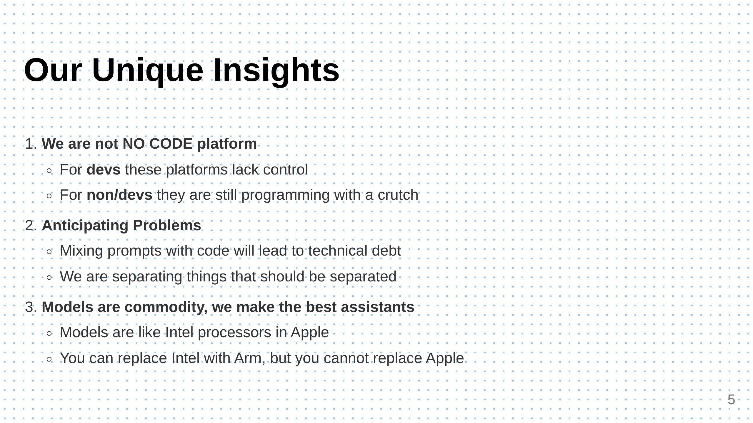
Notes:
Slide 5: Unique Insights

Slide 6
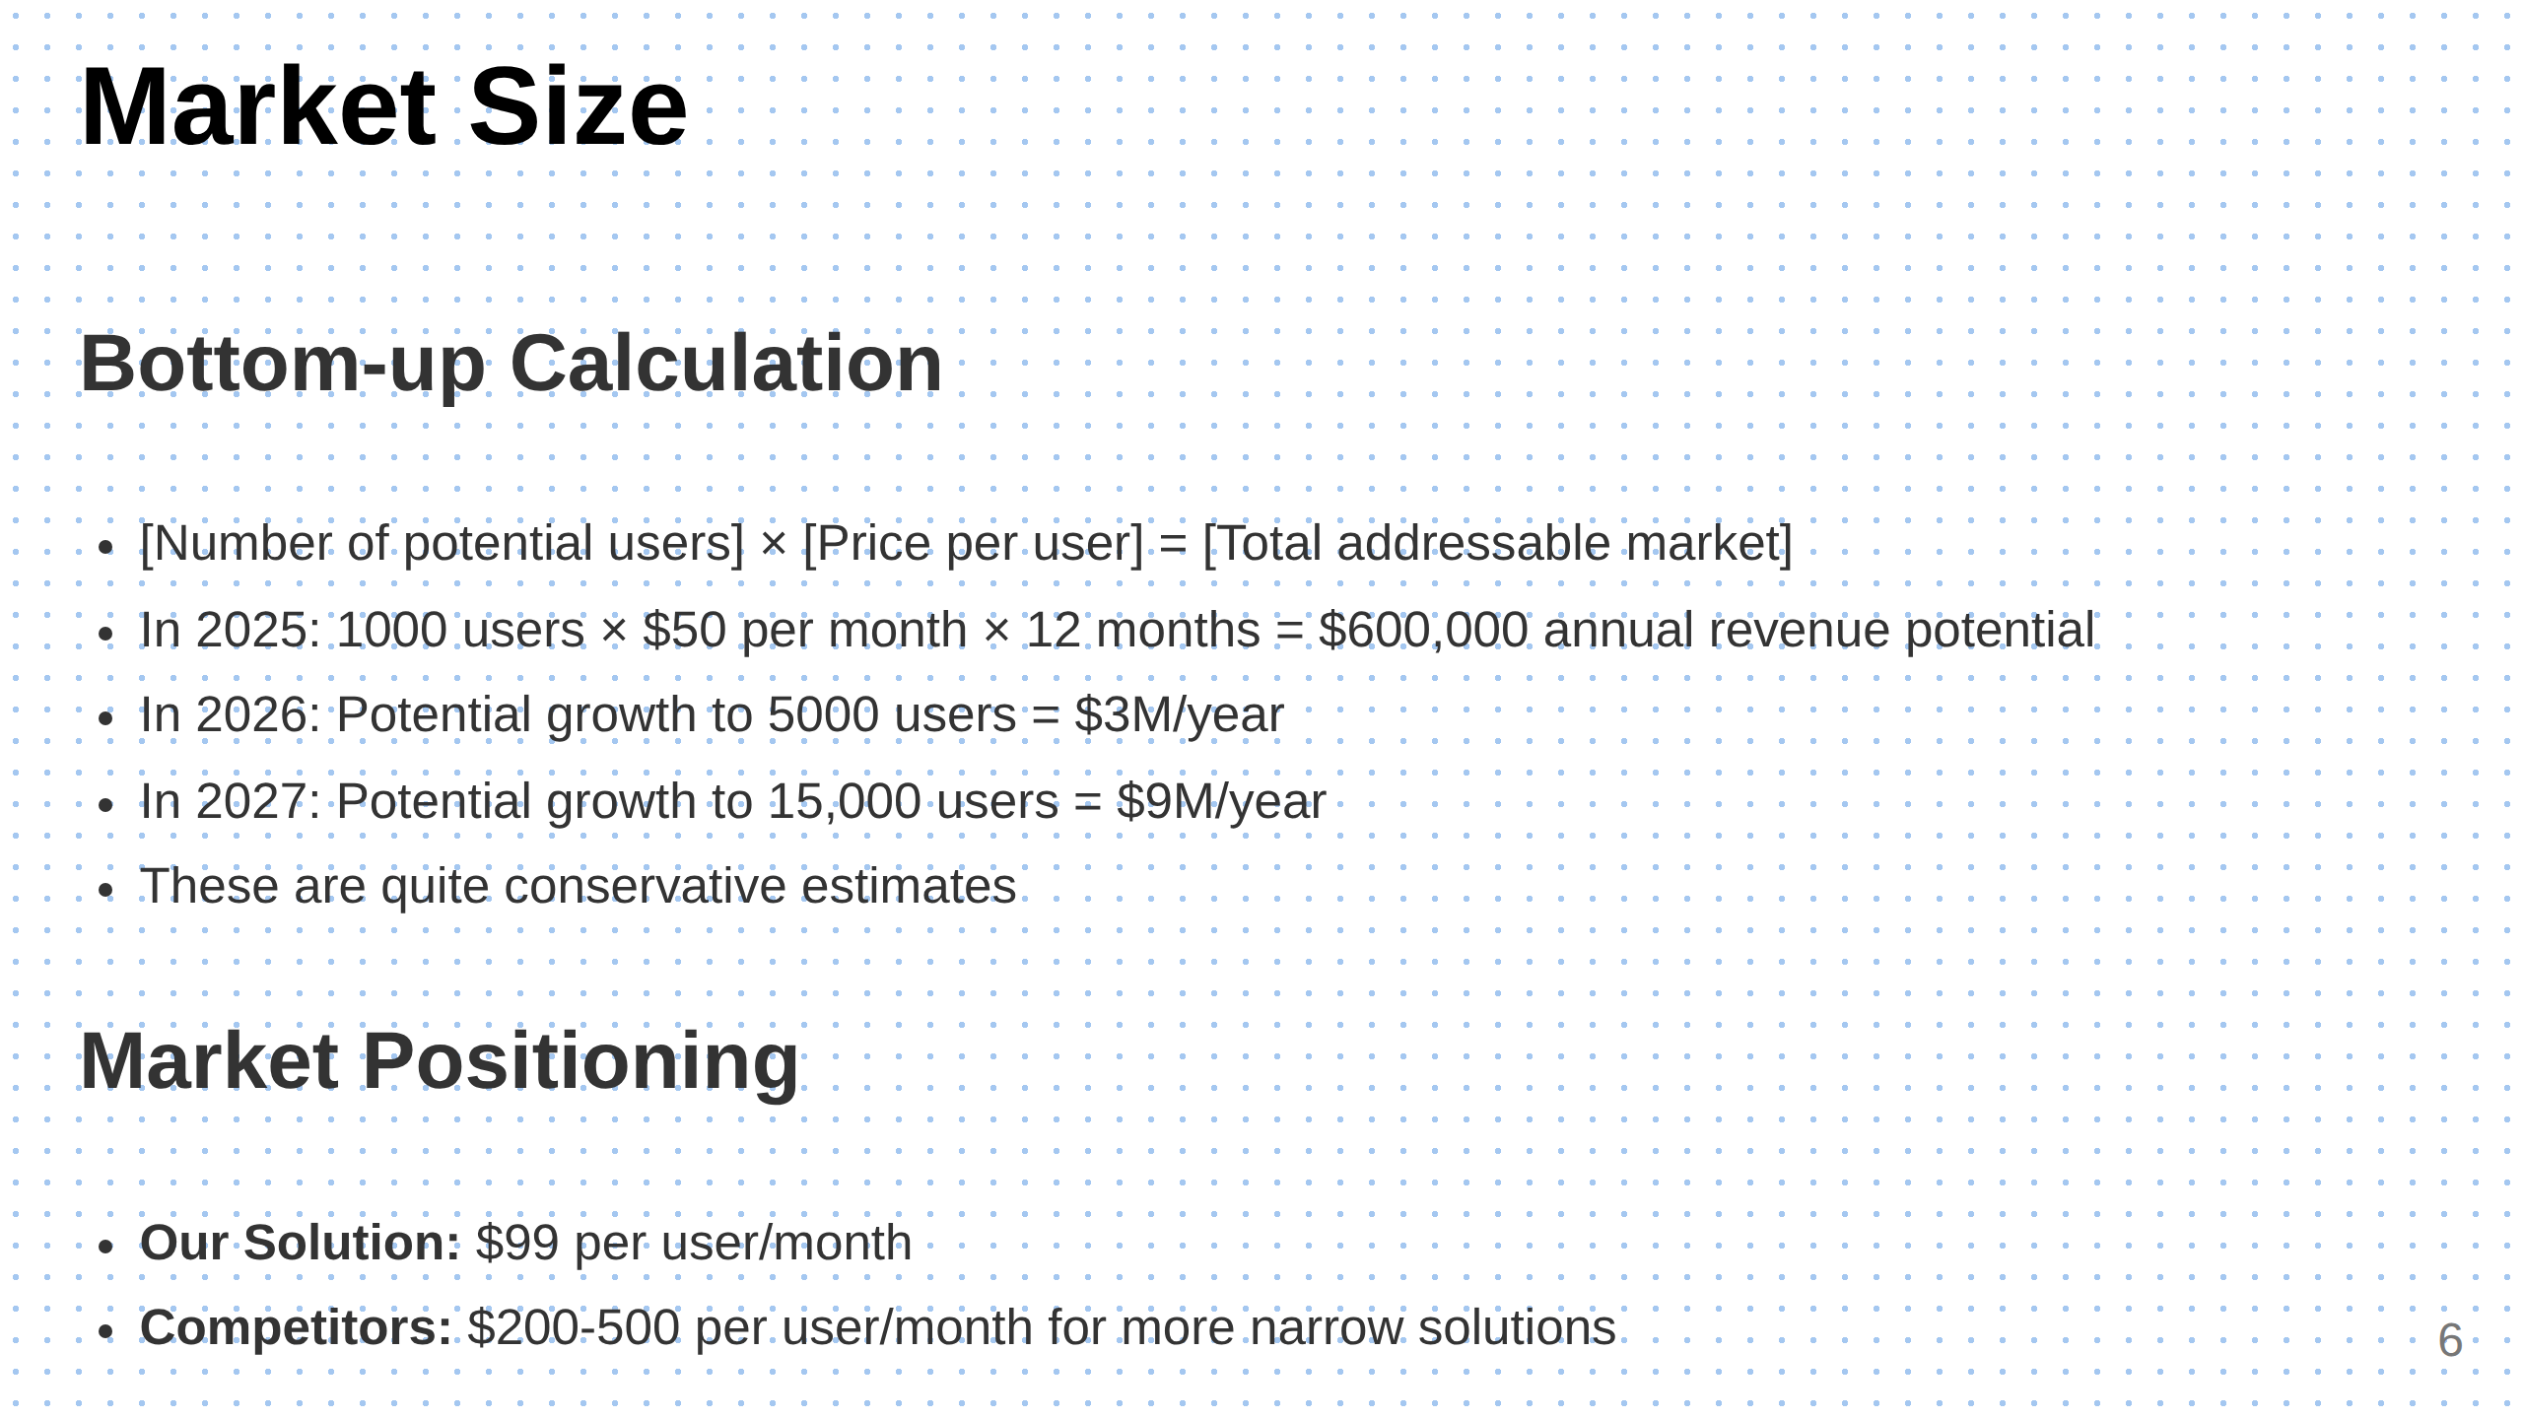
Notes:
Slide 6: Market Size

Slide 7
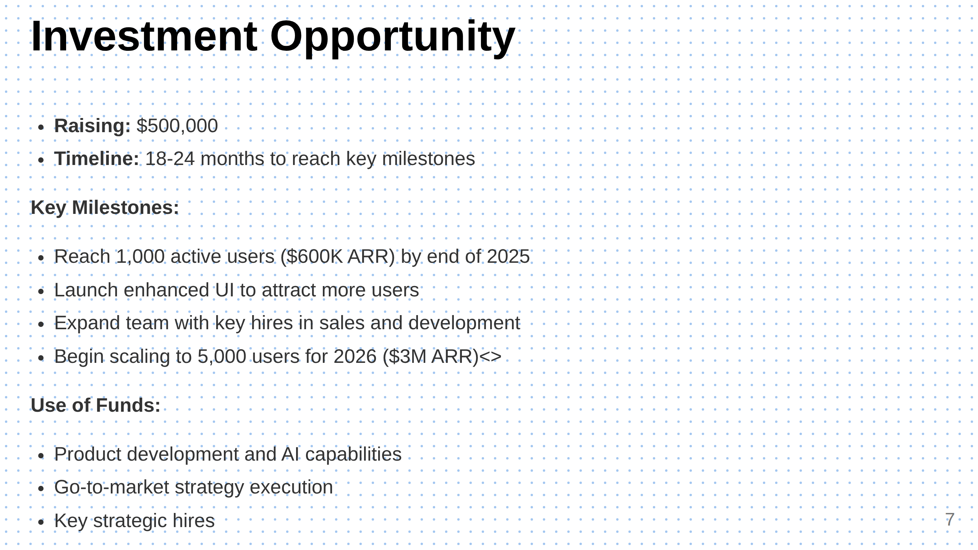
Notes:
Slide 7: The Ask

Slide 8

Notes:
Slide 8: Contact

