Slide 1
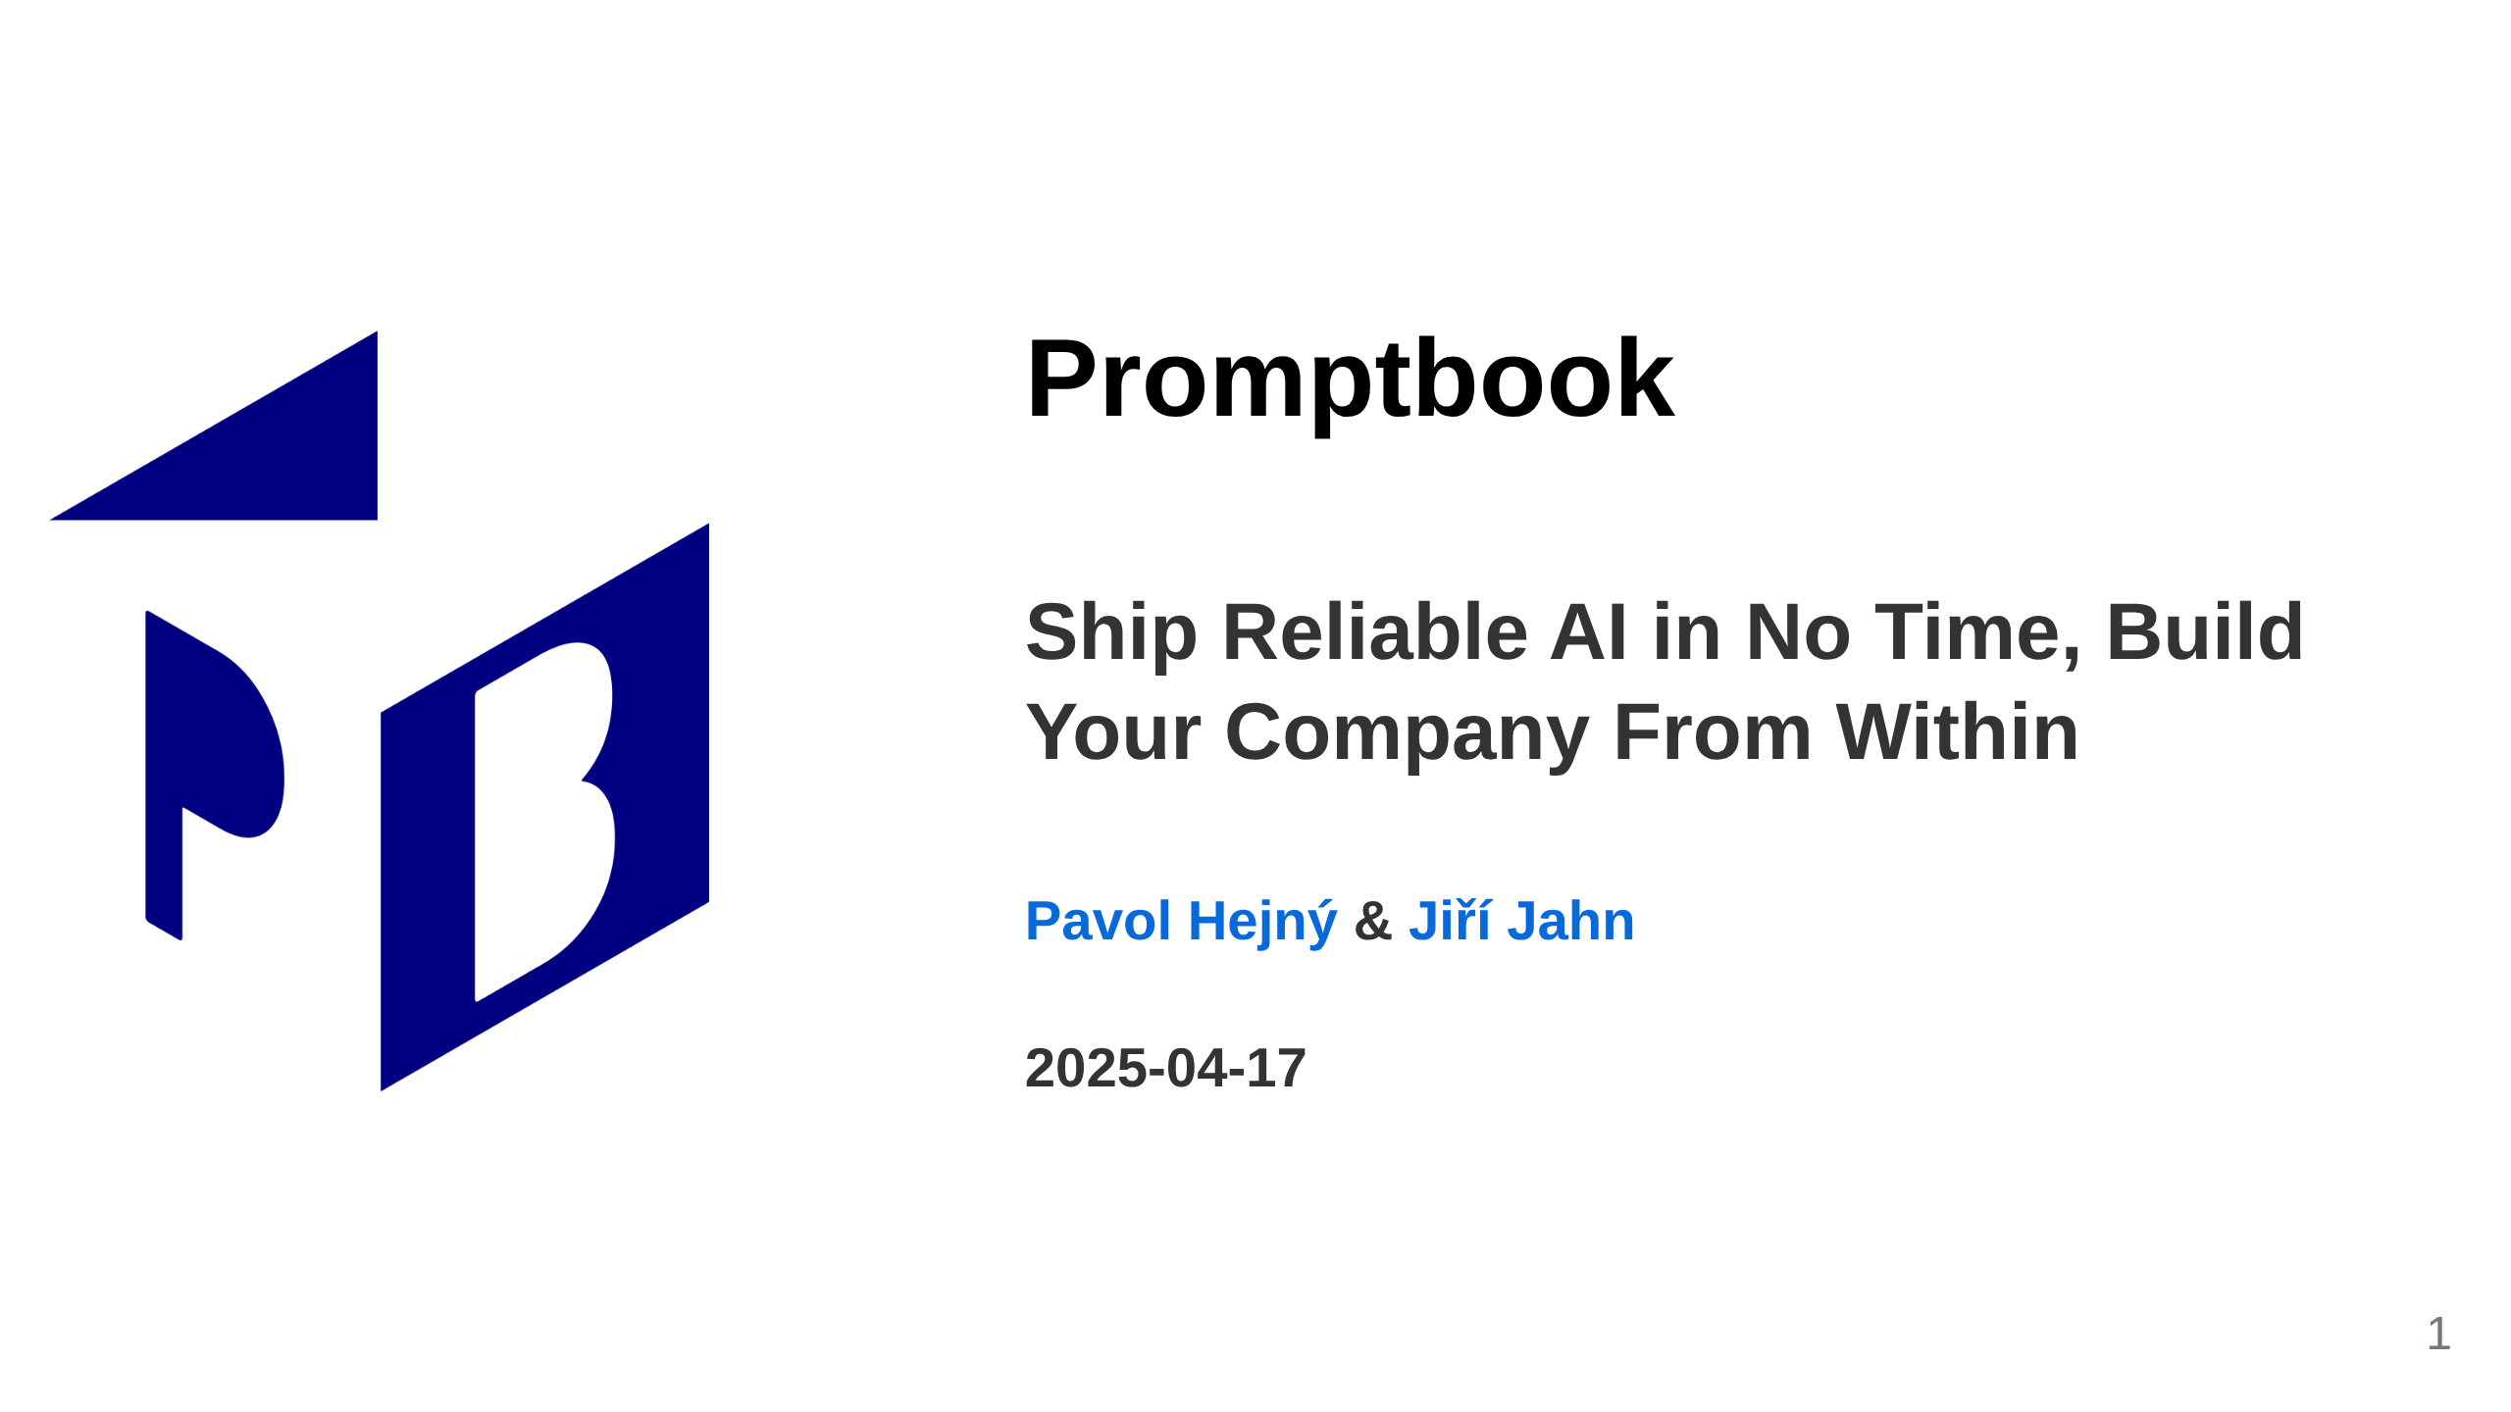
Notes:
<- TODO: Make the date dynamic adds substantial overhead in MARP, sorry

Slide 2
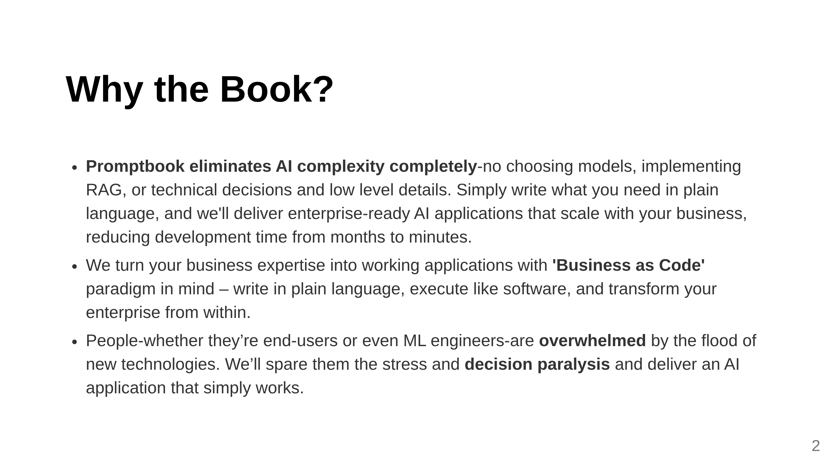
Notes:
Slide 0: Unique Selling proposition

Slide 3
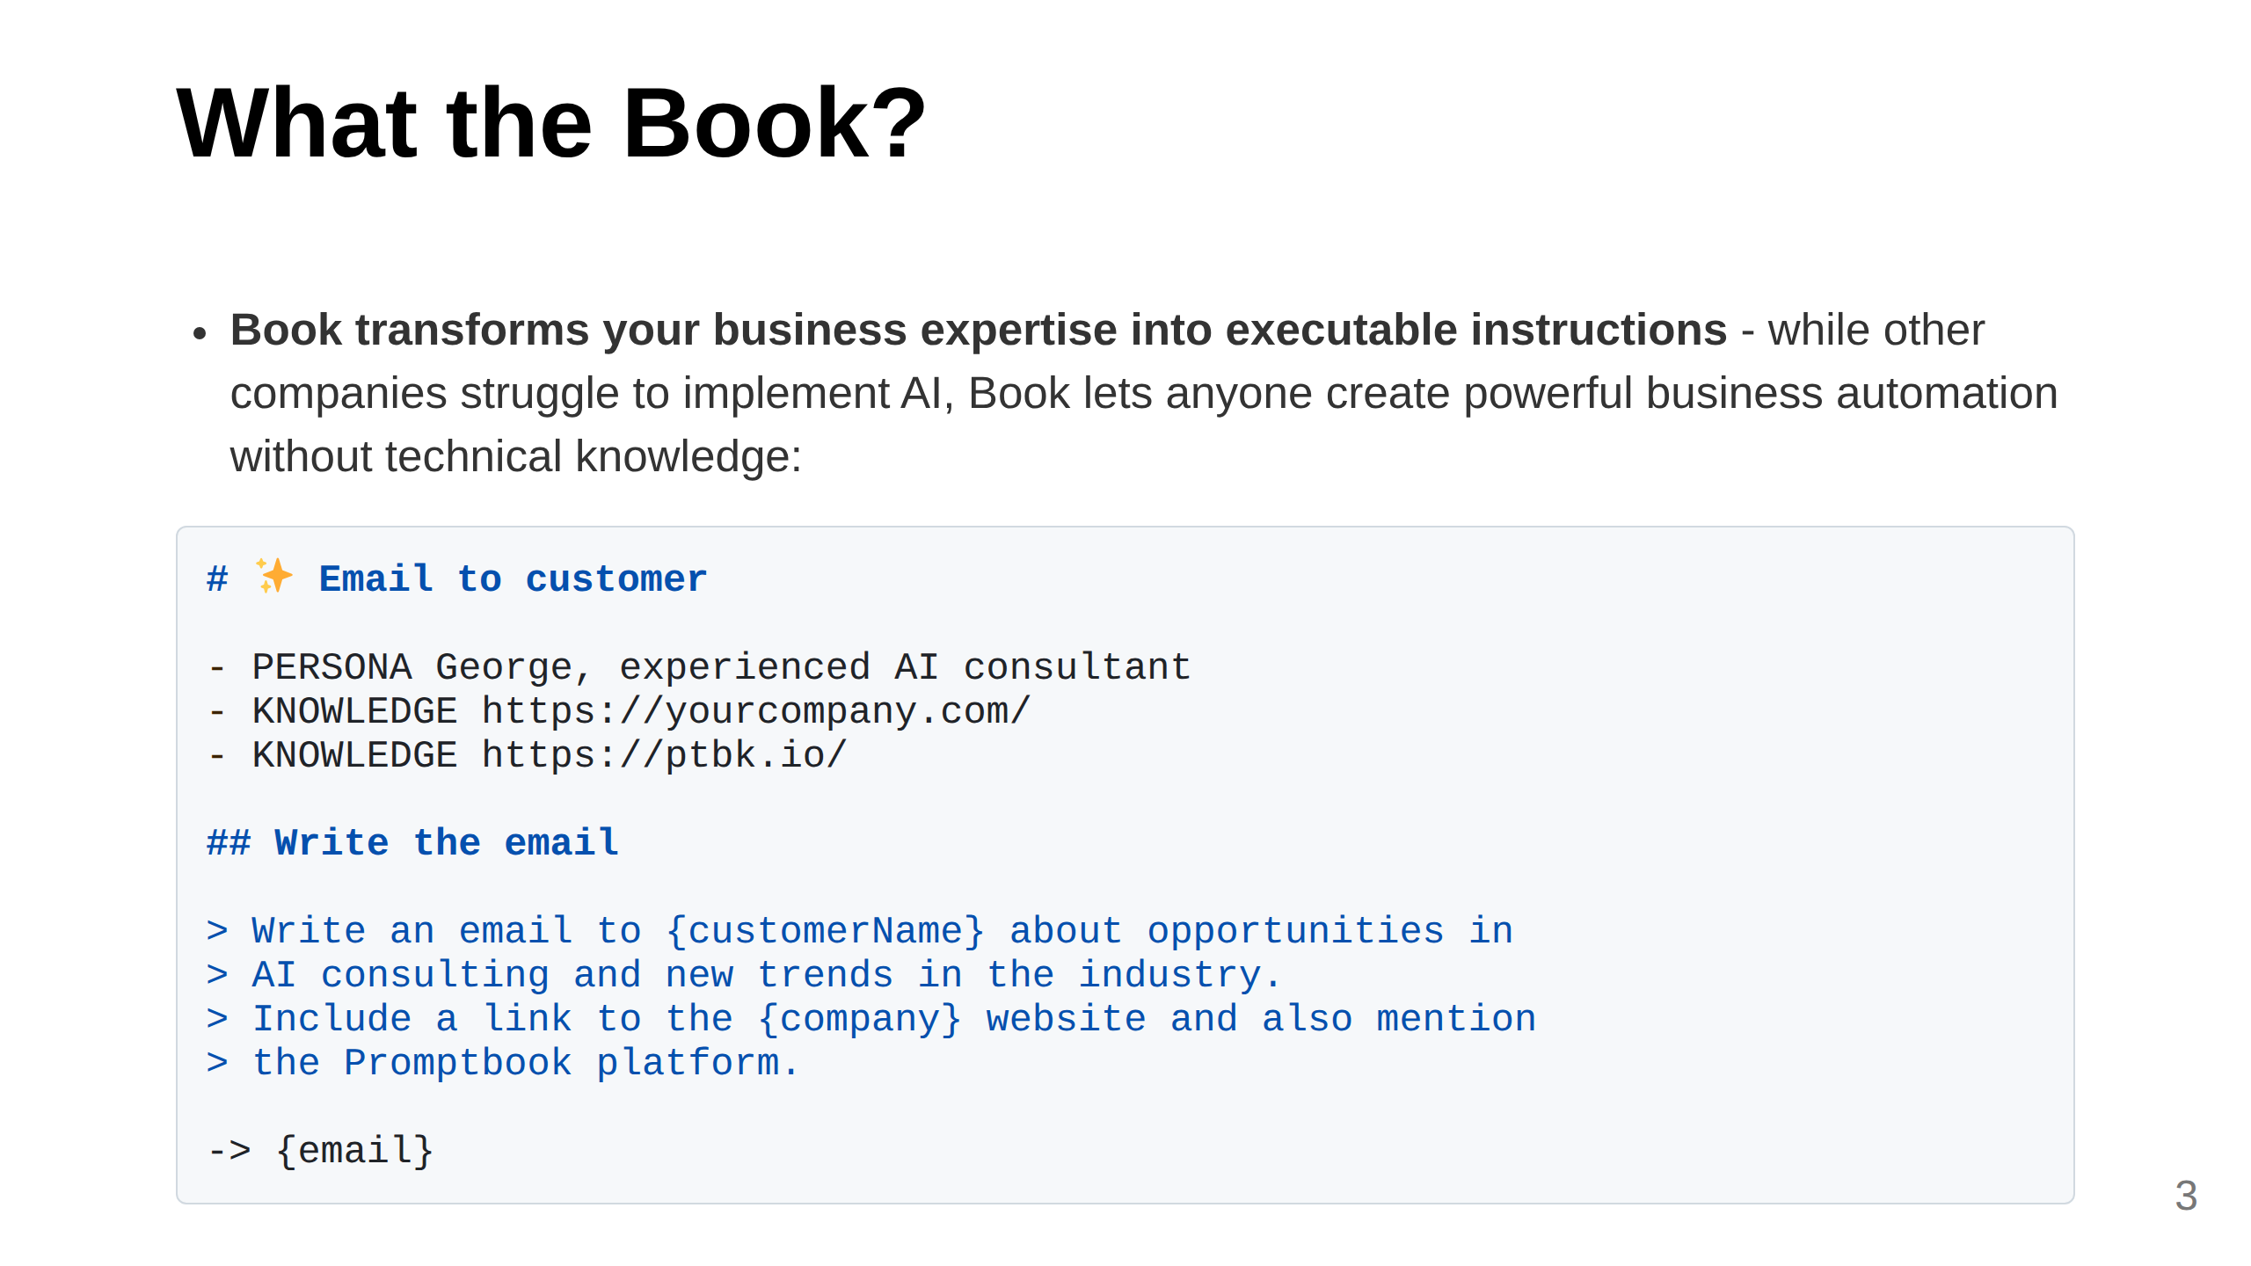
Notes:
Slide 1: What We Do (Clear, concise, 2 sentences) This messaging tries to create FOMO by: 1. Positioning LLMs as the inevitable new computing paradigm (not just a trend) 2. Establishing our technology as the first true enterprise solution in this new world 3. Creating a clear contrast between those who adopt (winners) and those who don't (competitors who "struggle") 4. Adding time-sensitivity with the "days, not months" comparison Implying Deloitte has a limited window to secure competitive advantage The language directly addresses Deloitte as a potential beneficiary, making the opportunity feel exclusive and timely. You do want to have your C3PO - **LLMs are the new computing paradigm, and we're building its first enterprise-ready programming language, Book, together with its runtime, Promptbook.**

Slide 4
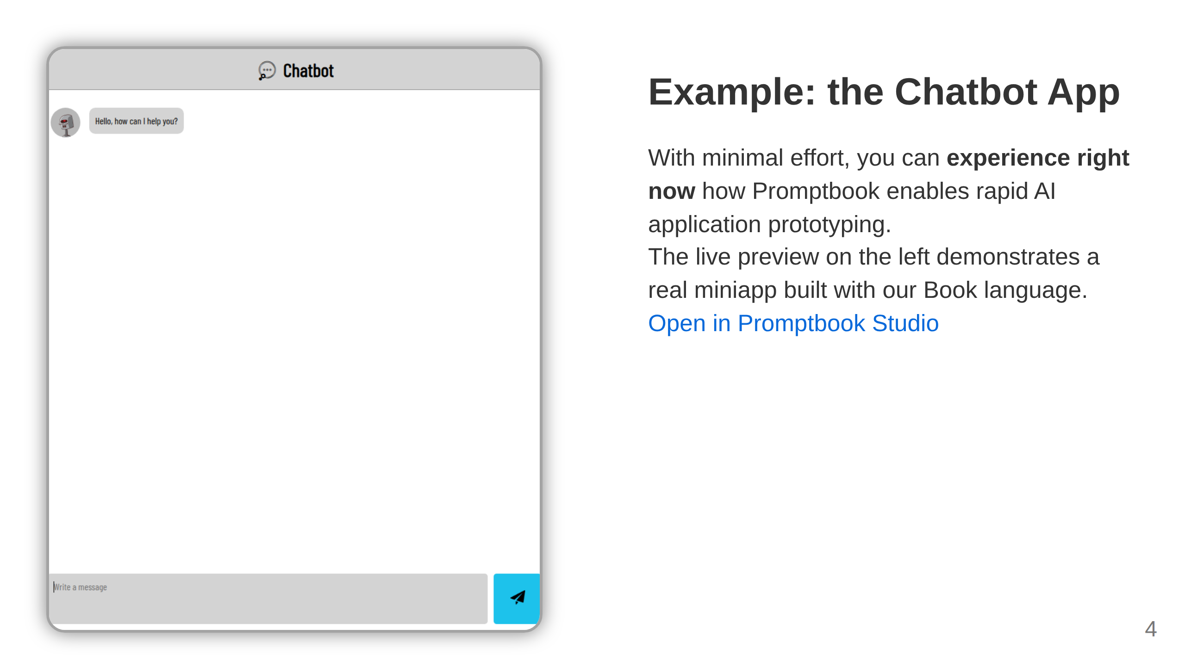
Notes:
Slide: Miniapp Preview Split --- # Seize The Competitive Edge ## The Idea Behind Promptbook: <div class="highlight-box"> Imagine a company where everything is centered around executable documentation with all knowledge naturally baked in: **THE EXECUTABLE ONE SOURCE OF TRUTH**. </div> --- Take it one step further. With Promptbook, companies can: - **Take First-Mover Advantage:** Deliver sustainable AI solutions ahead of competitors through architectural foresight - our Book programming language naturally separates concerns between programmers, ML engineers, and business people, creating a clean division of responsibilities that prevents technical debt and enables faster scaling - **Mitigate Risk:** Built-in compliance, auditability, and security - **Scale Globally:** AI solutions without expanding your ML department - **Multiply Capacity:** One consultant delivers work of many - **Leverage Organic Compounding:** Template blueprints across industries, multiplying AI impact from within <!-- TODO: Be prepared to explain that we are not competition but cooperator and oportunity TODO: Kajetán: Be prepared to answer: 1) What we have? 2) Why we want it? 3) Why is Promptbook wanted by others? 4) Why is Promptbook wanted by Deloitte?

Slide 5
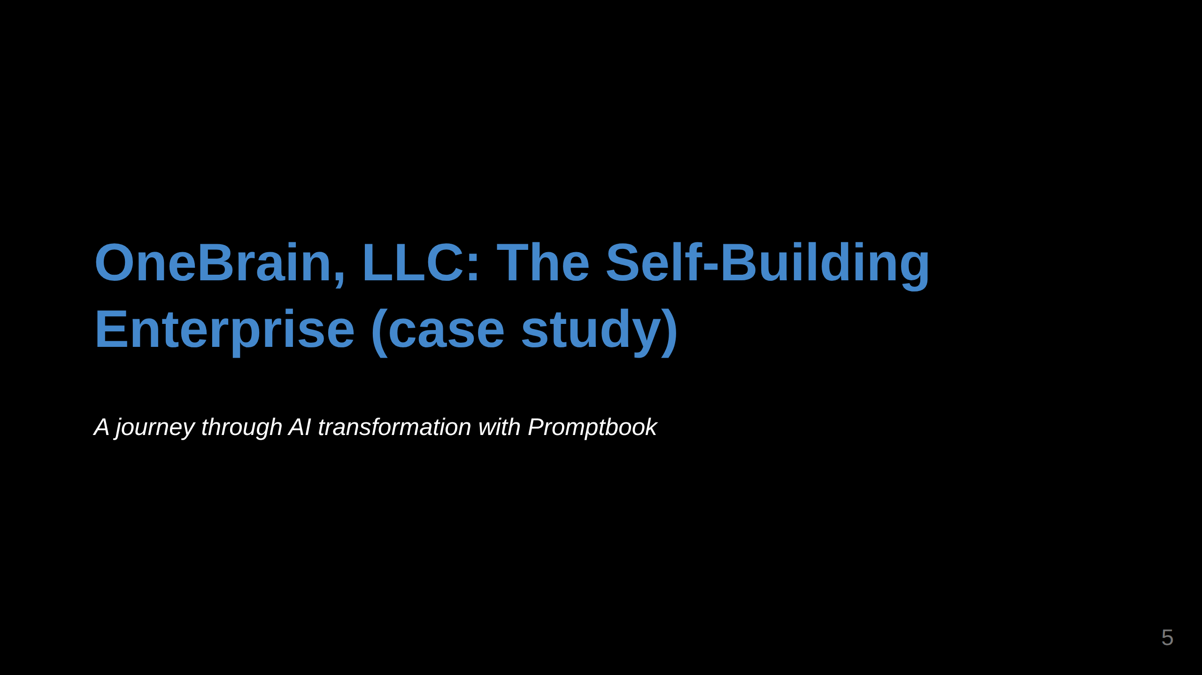
Notes:
Slide 2: Specific Example This opening slide introduces the narrative framework

Slide 6
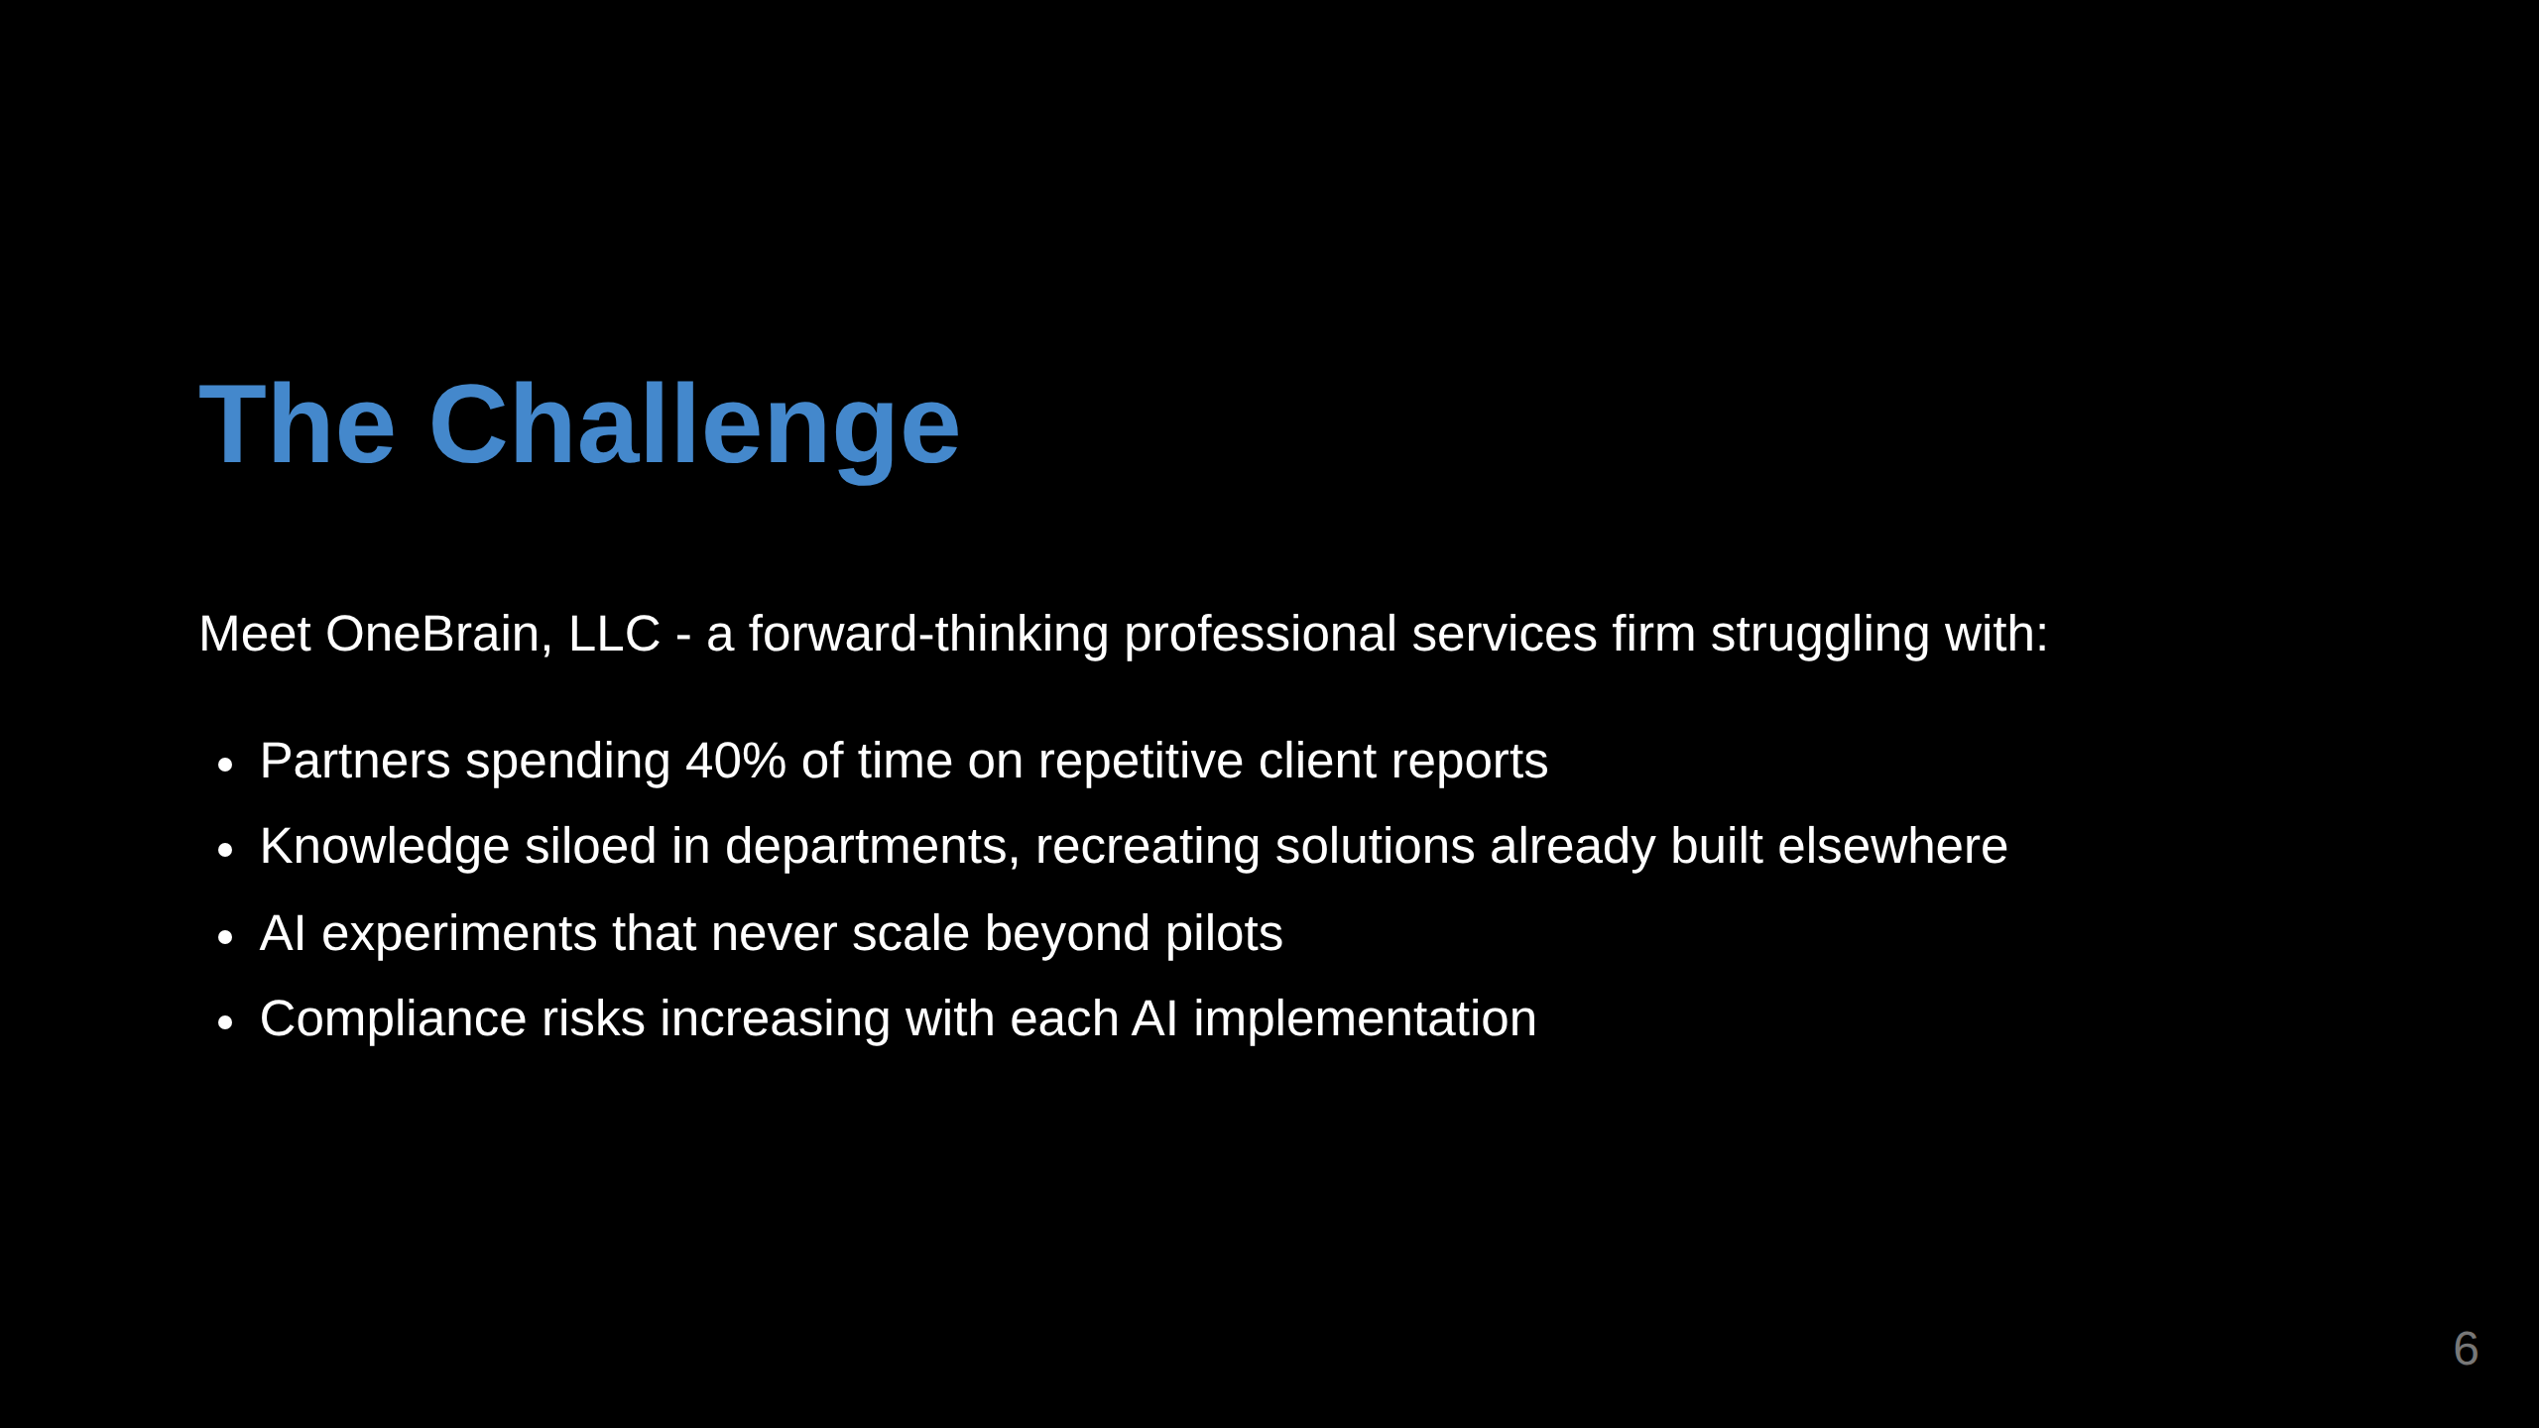
Notes:
This slide establishes the relatable pain points <- TODO: Kajetán: - Security - Controlled environment for testing

Slide 7
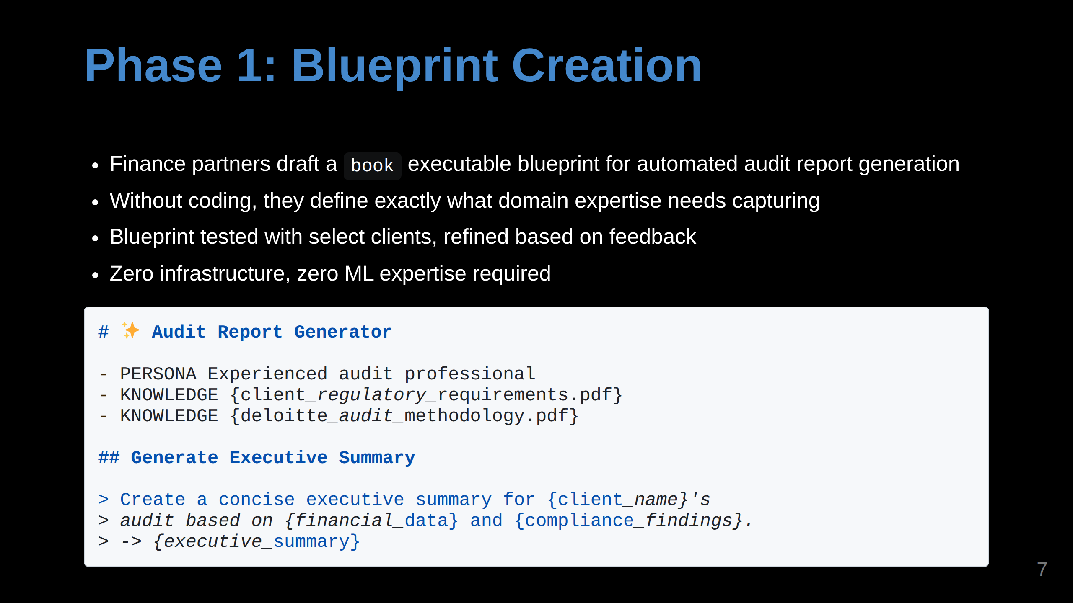
Notes:
The code example makes it concrete without being too technical

Slide 8
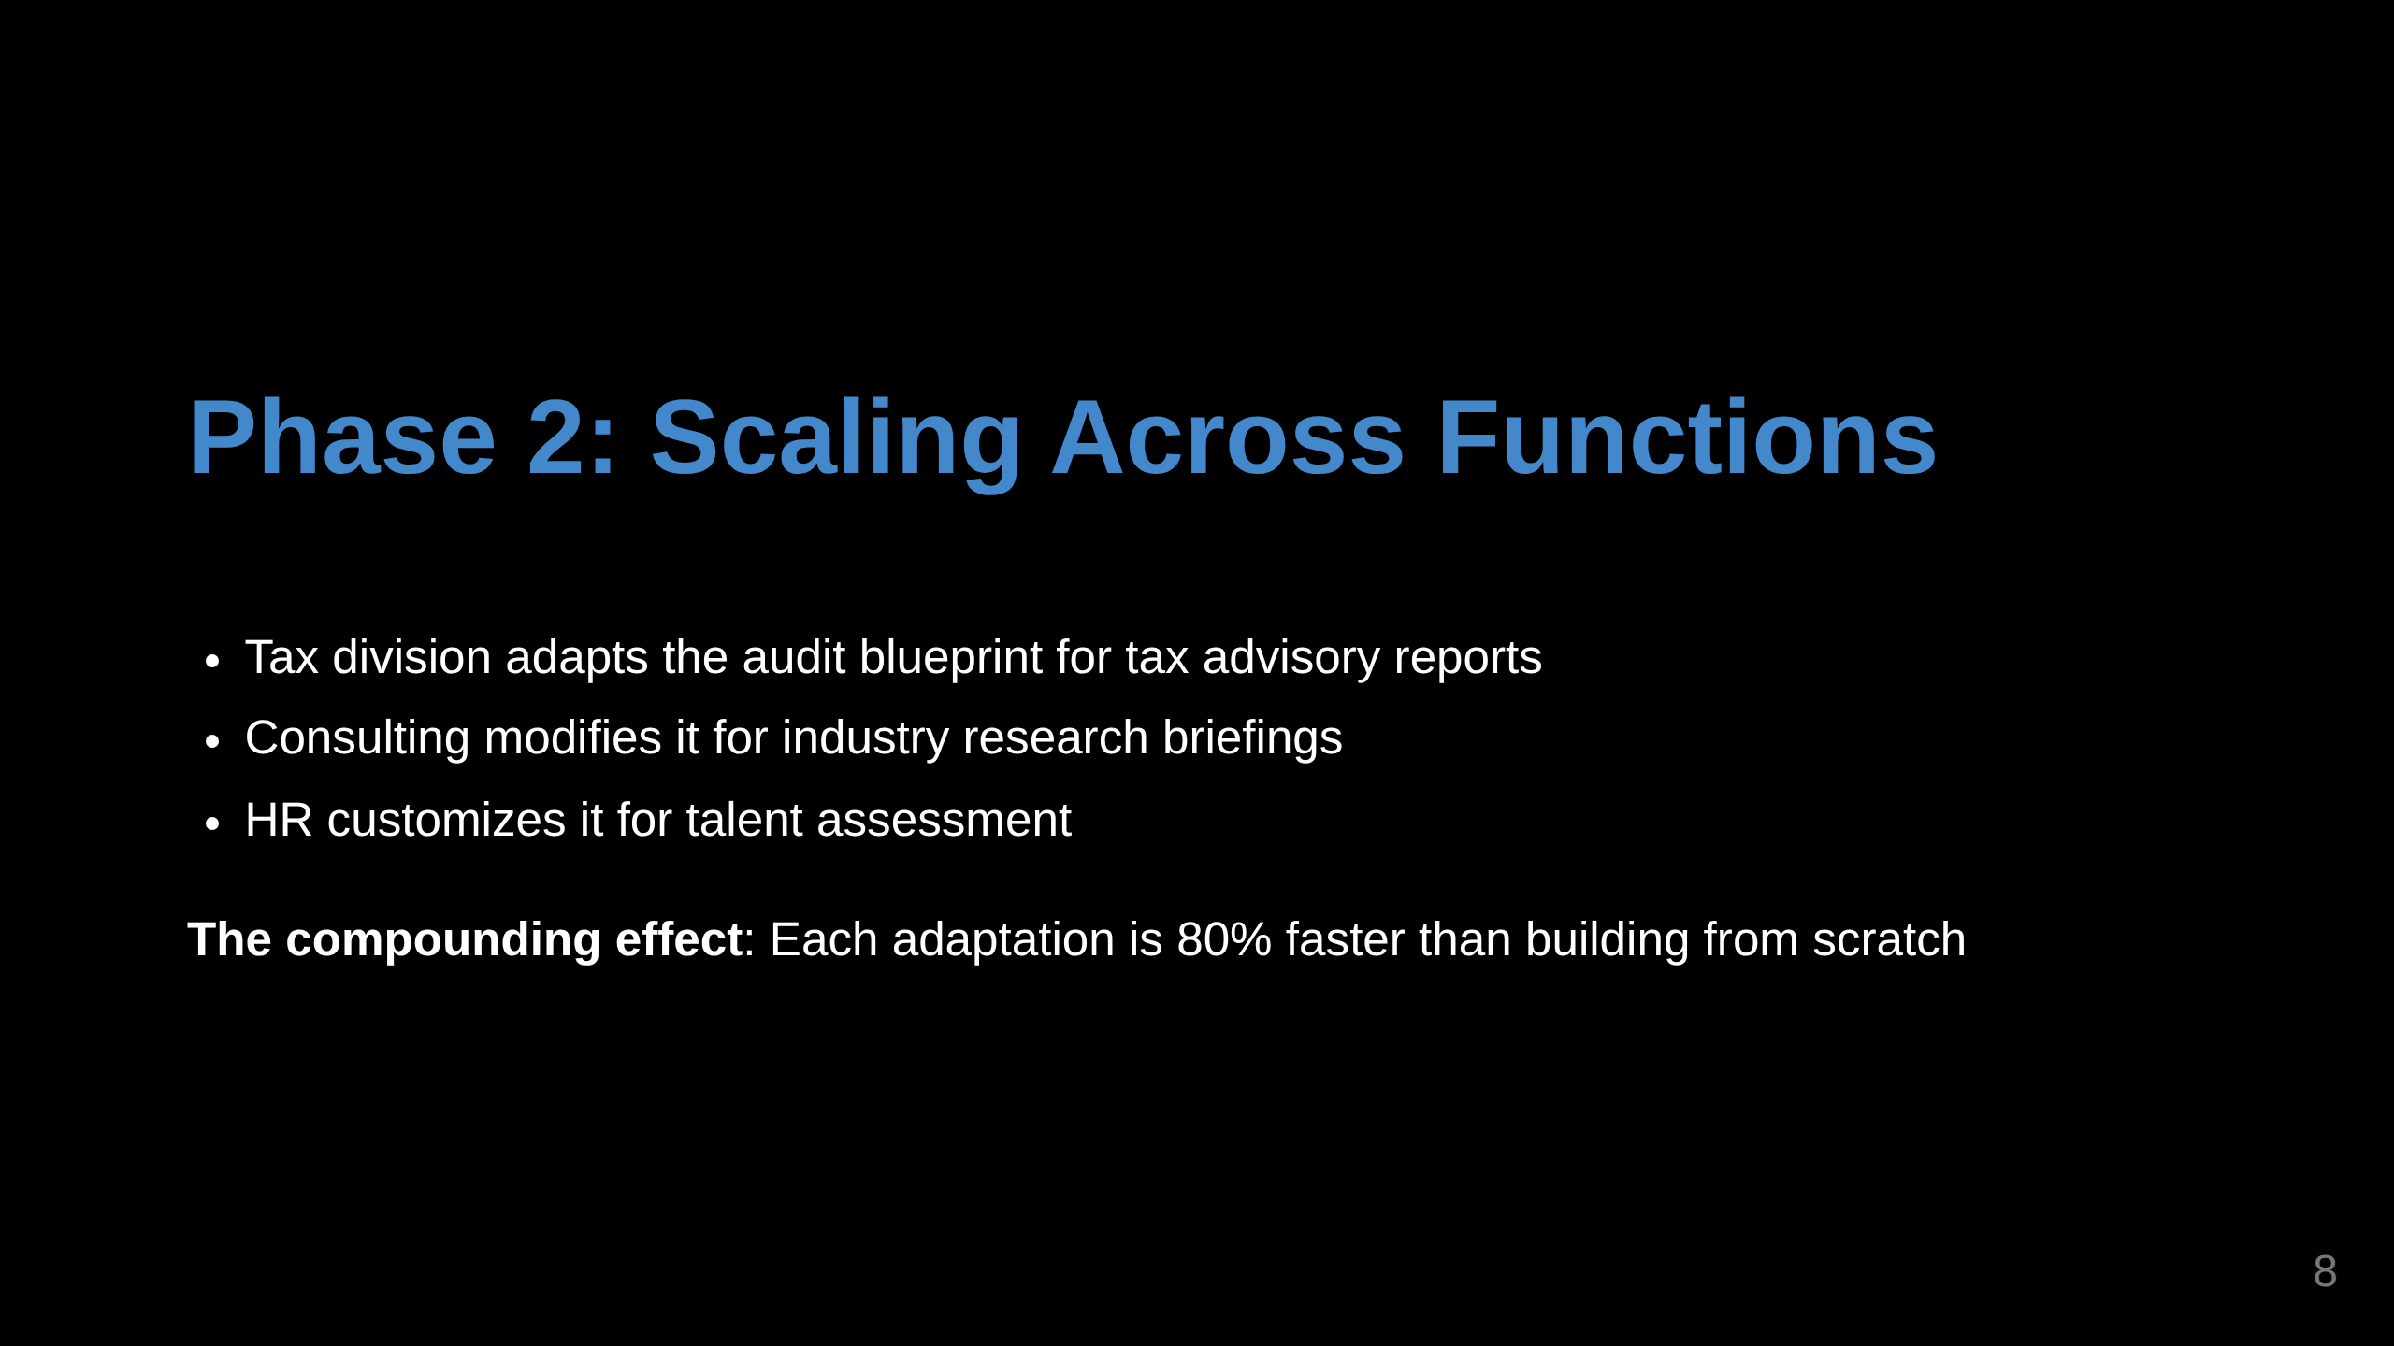
Notes:
This slide illustrates the cross-function application

Slide 9
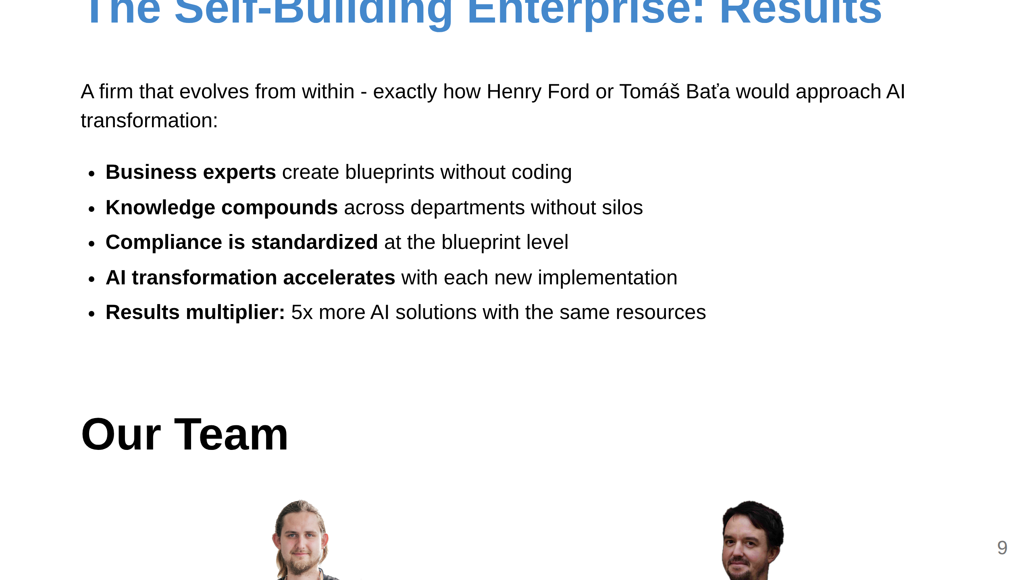
Notes:
Slide 3: Team (Only if it's a strength)

Slide 10
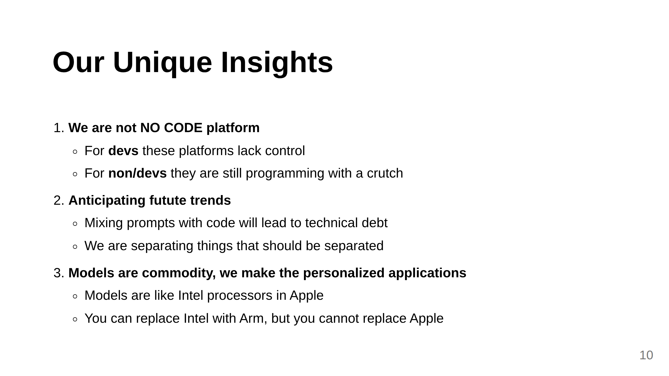
Notes:
Slide 5: Unique Insights

Slide 11
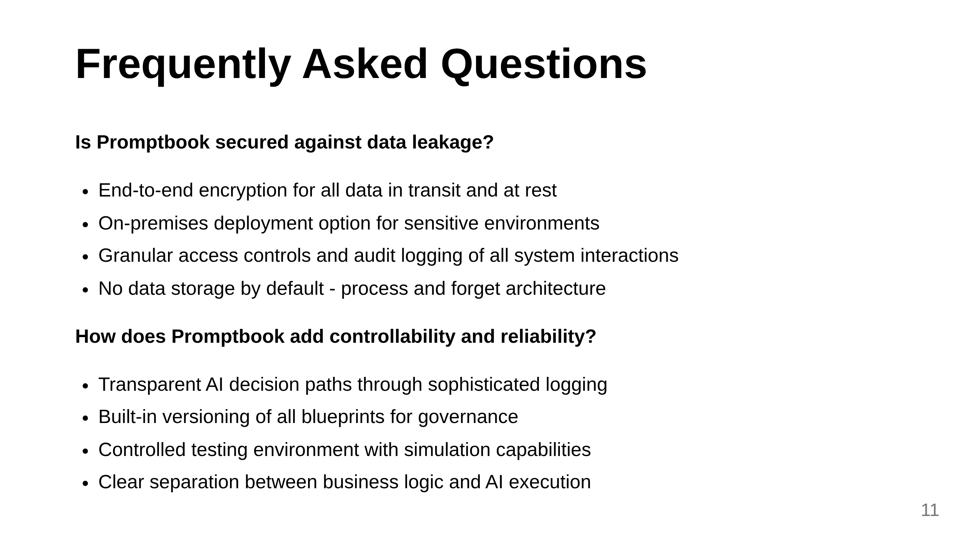

Slide 12
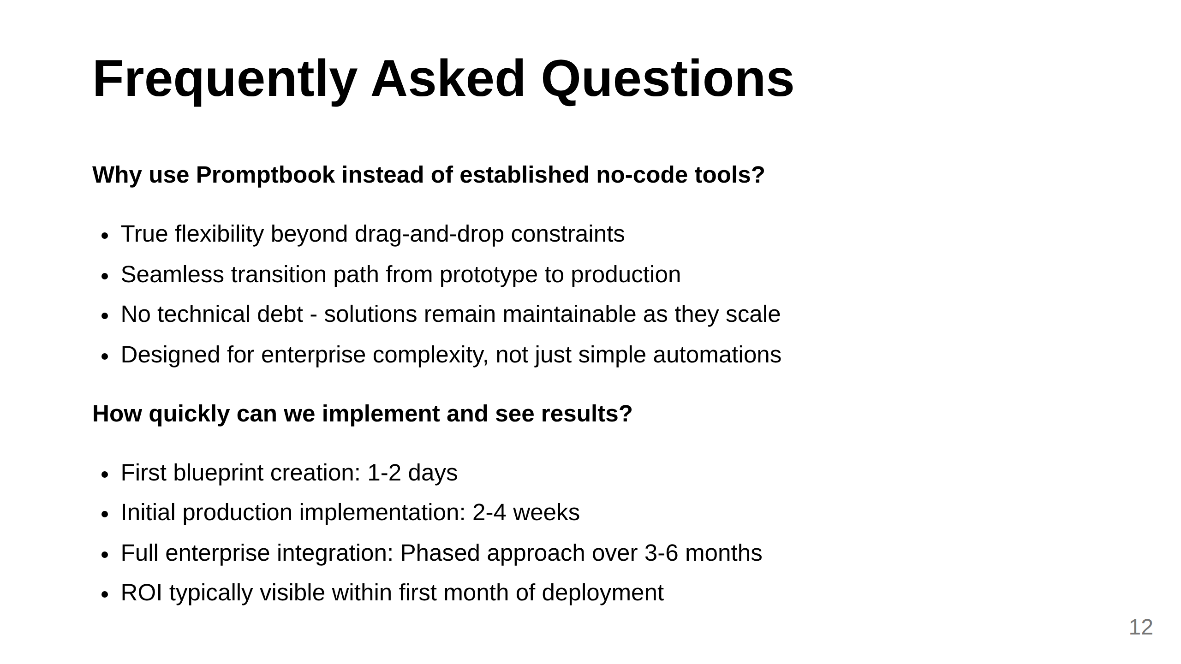

Slide 13
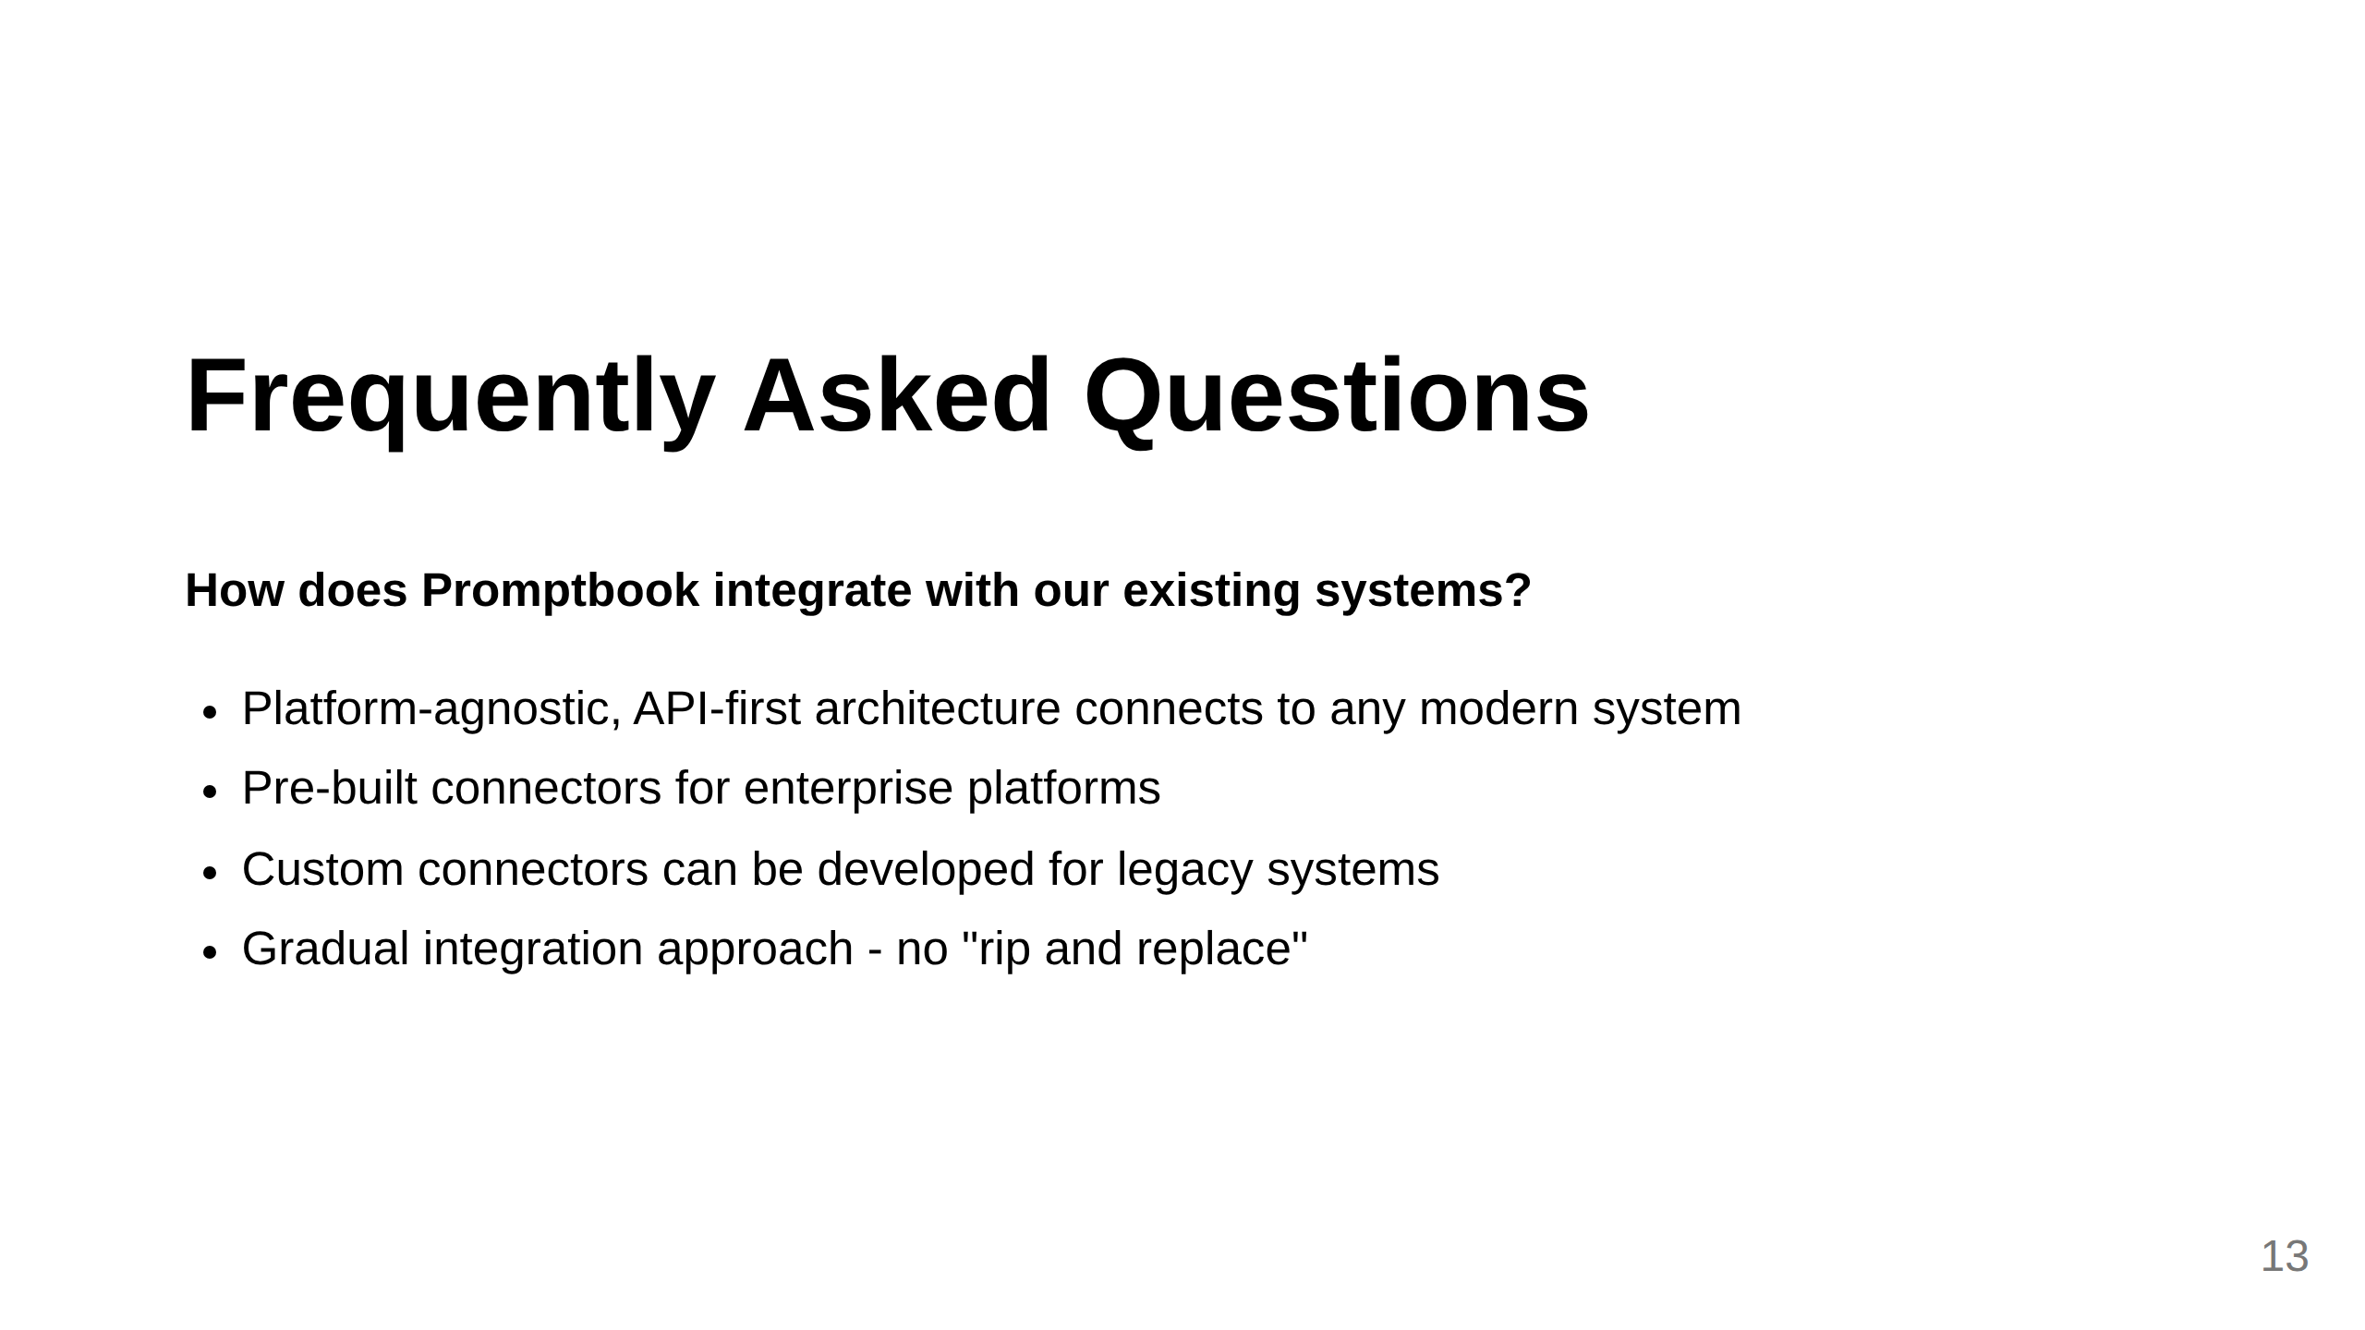
Notes:
Additional themes we might consider adding: 1. Team expertise required: Address who in the organization needs what skills to use Promptbook effectively 2. Pricing model: Enterprise customers always want to understand the cost structure 3. Support and training: What ongoing assistance is available 4. Compliance certifications: Specific standards Promptbook meets (ISO, SOC2, etc.) 5. Customization limits: What can and cannot be modified for specific enterprise needs Other suggestions?

Slide 14
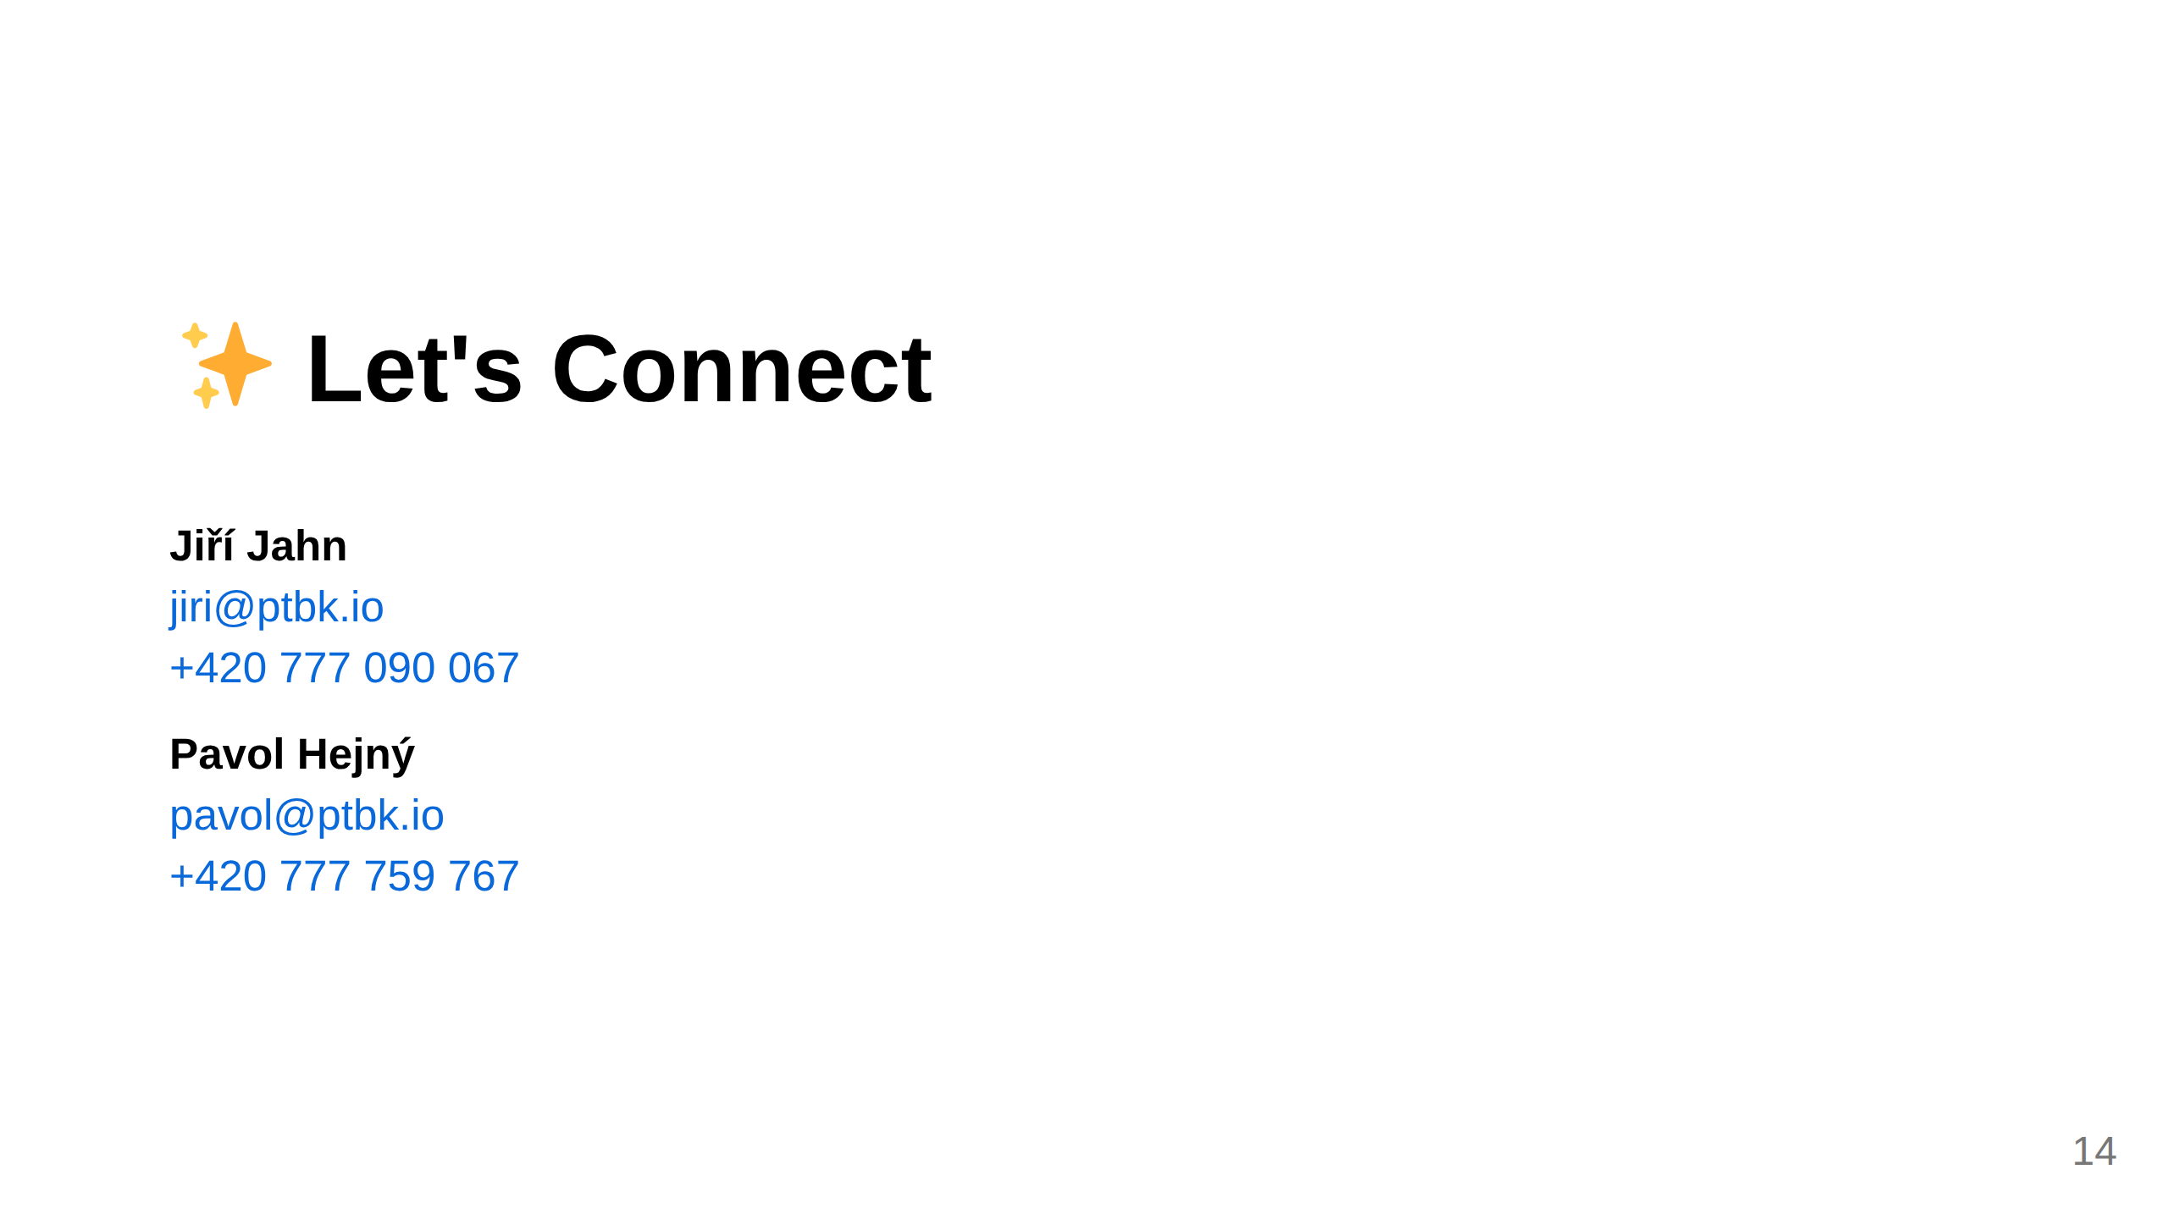
Notes:
Slide 8: Contact

