Slide 1
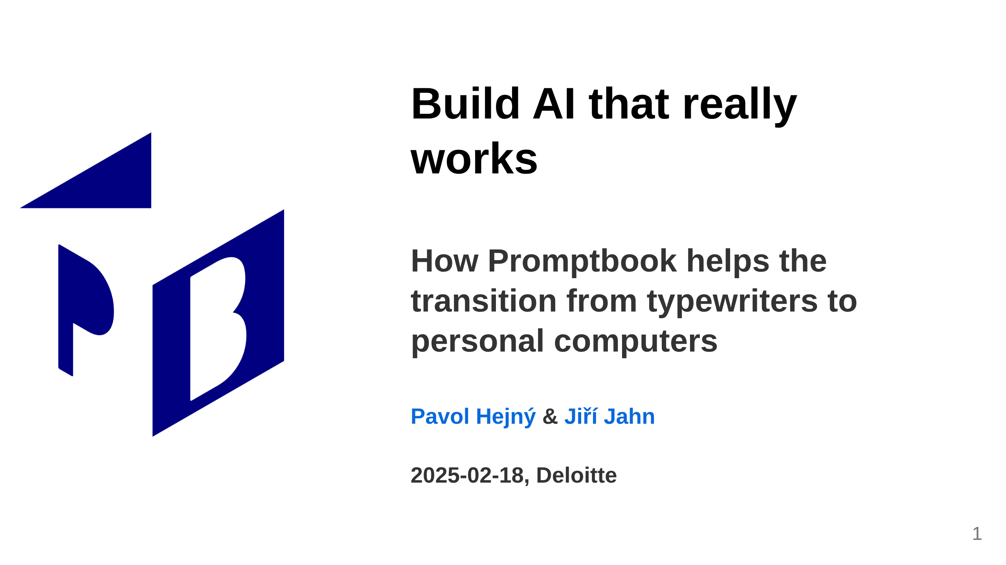
Notes:
<- TODO: Kajetán: More business, less technical
<- TODO: Make the date dynamic

Slide 2
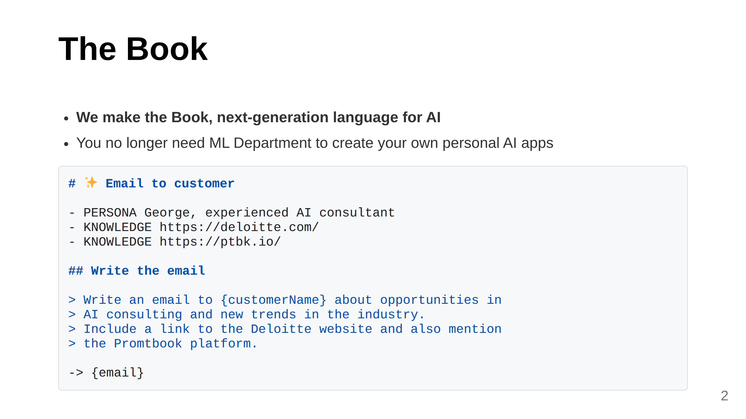
Notes:
Slide 1: What We Do (Clear, concise, 2 sentences)
You do want to have your C3PO

Slide 3
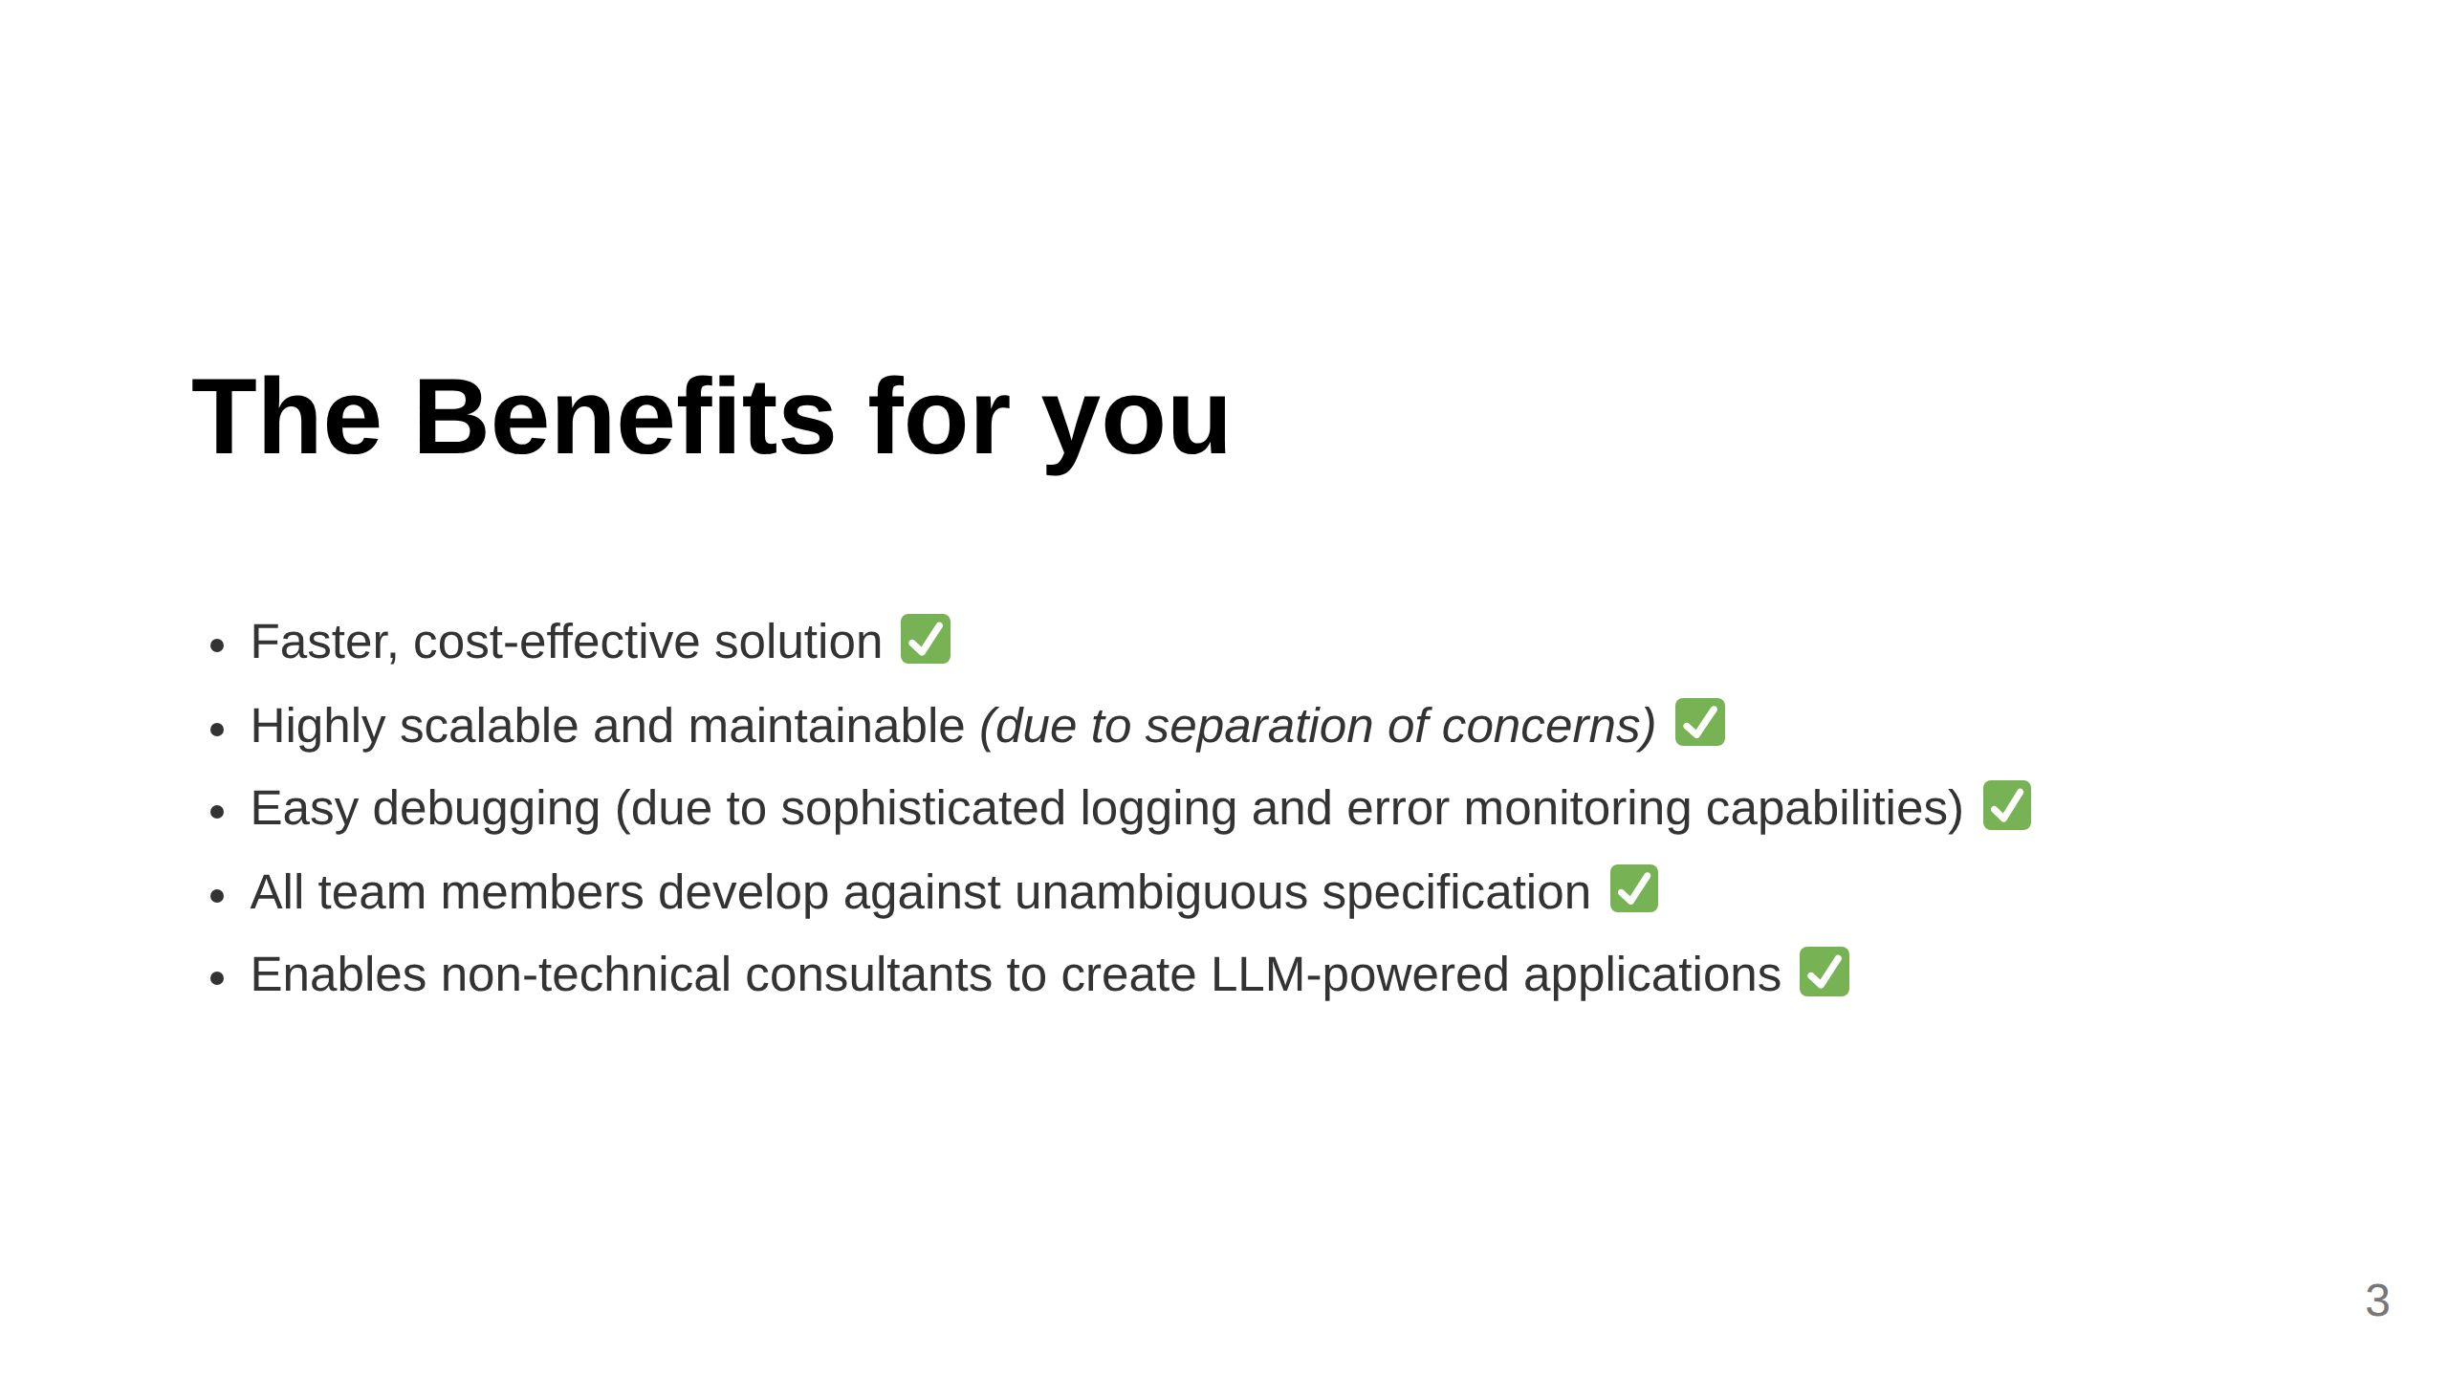
Notes:
TODO: Be prepared to explain that we are not competition but cooperator and oportunity
TODO: Kajetán: Be prepared to answer:
1) What we have?
2) Why we want it?
3) Why is Promptbook wanted by others?
4) Why is Promptbook wanted by Deloitte?

Slide 4
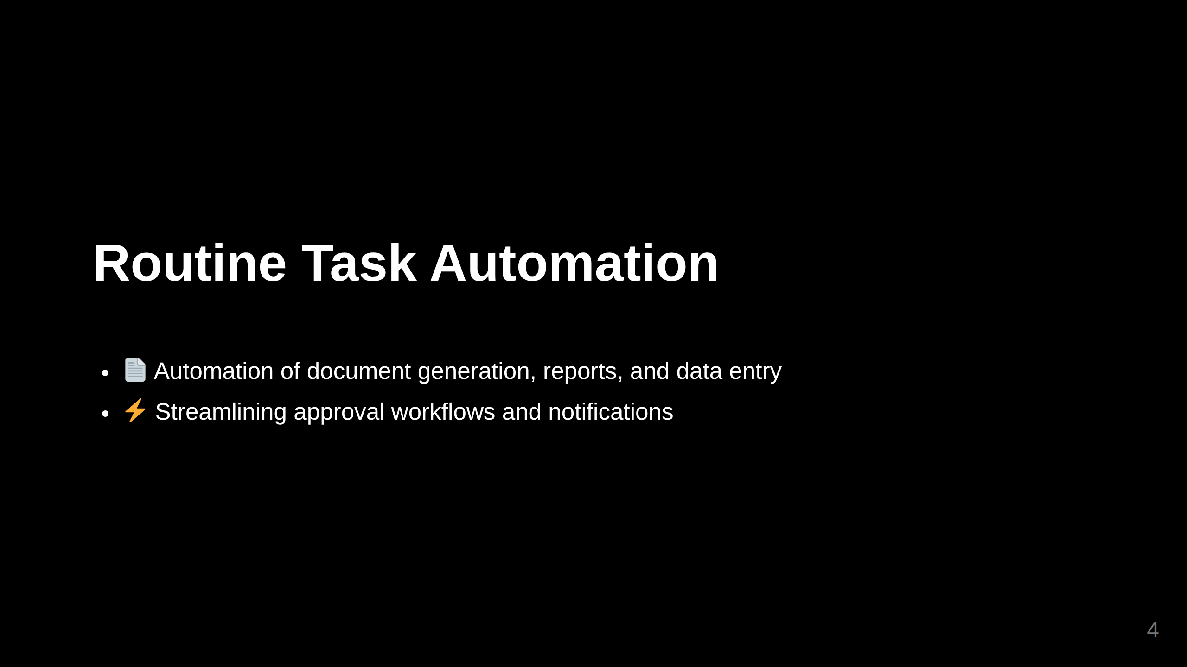
Notes:
Slide 2: Specific Example

Slide 5
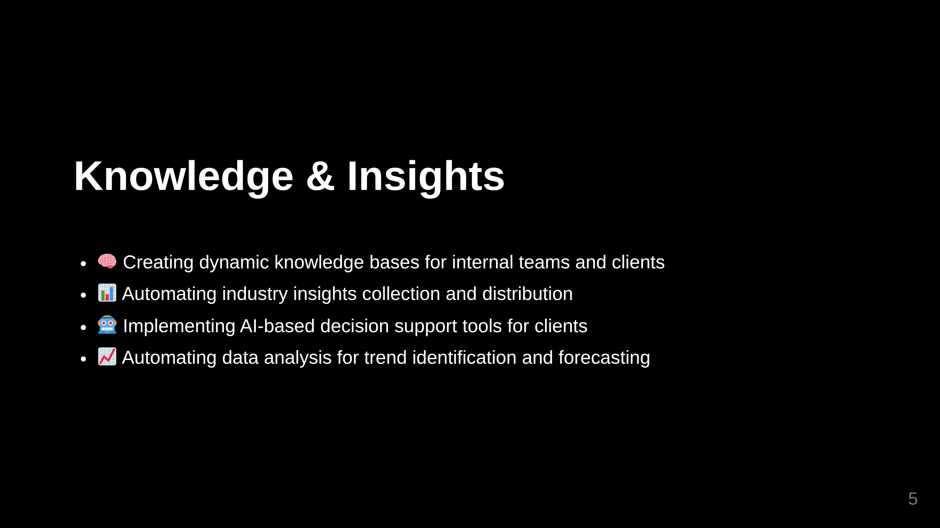
Notes:
Import ../_common/knowledge-and-insights.md
⚠️ WARNING: This section was imported, make changes in source; any manual changes here will be overwritten
/Import ../_common/knowledge-and-insights.md
<- TODO: Kajetán:
- Security
- Controlled environment for testing

Slide 6
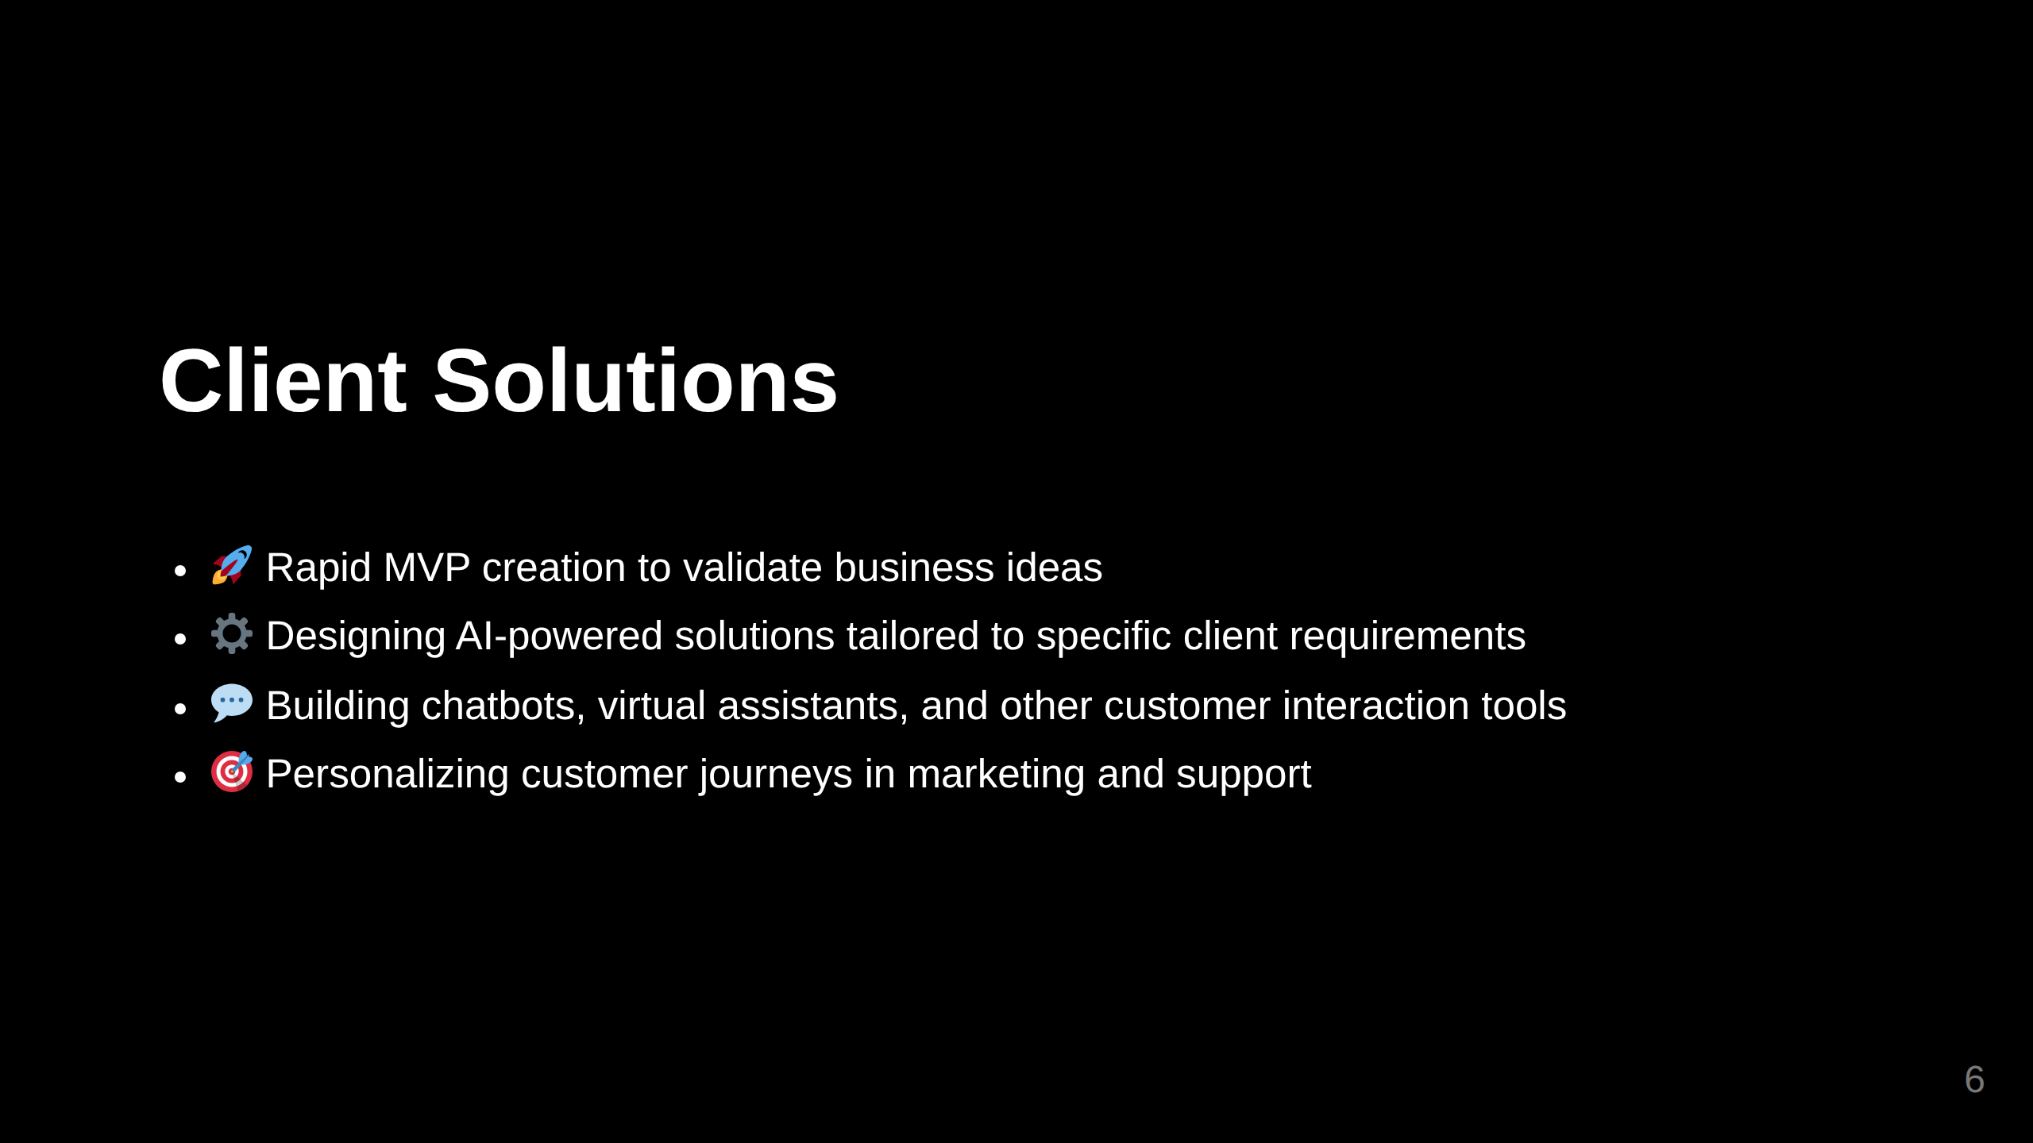

Slide 7
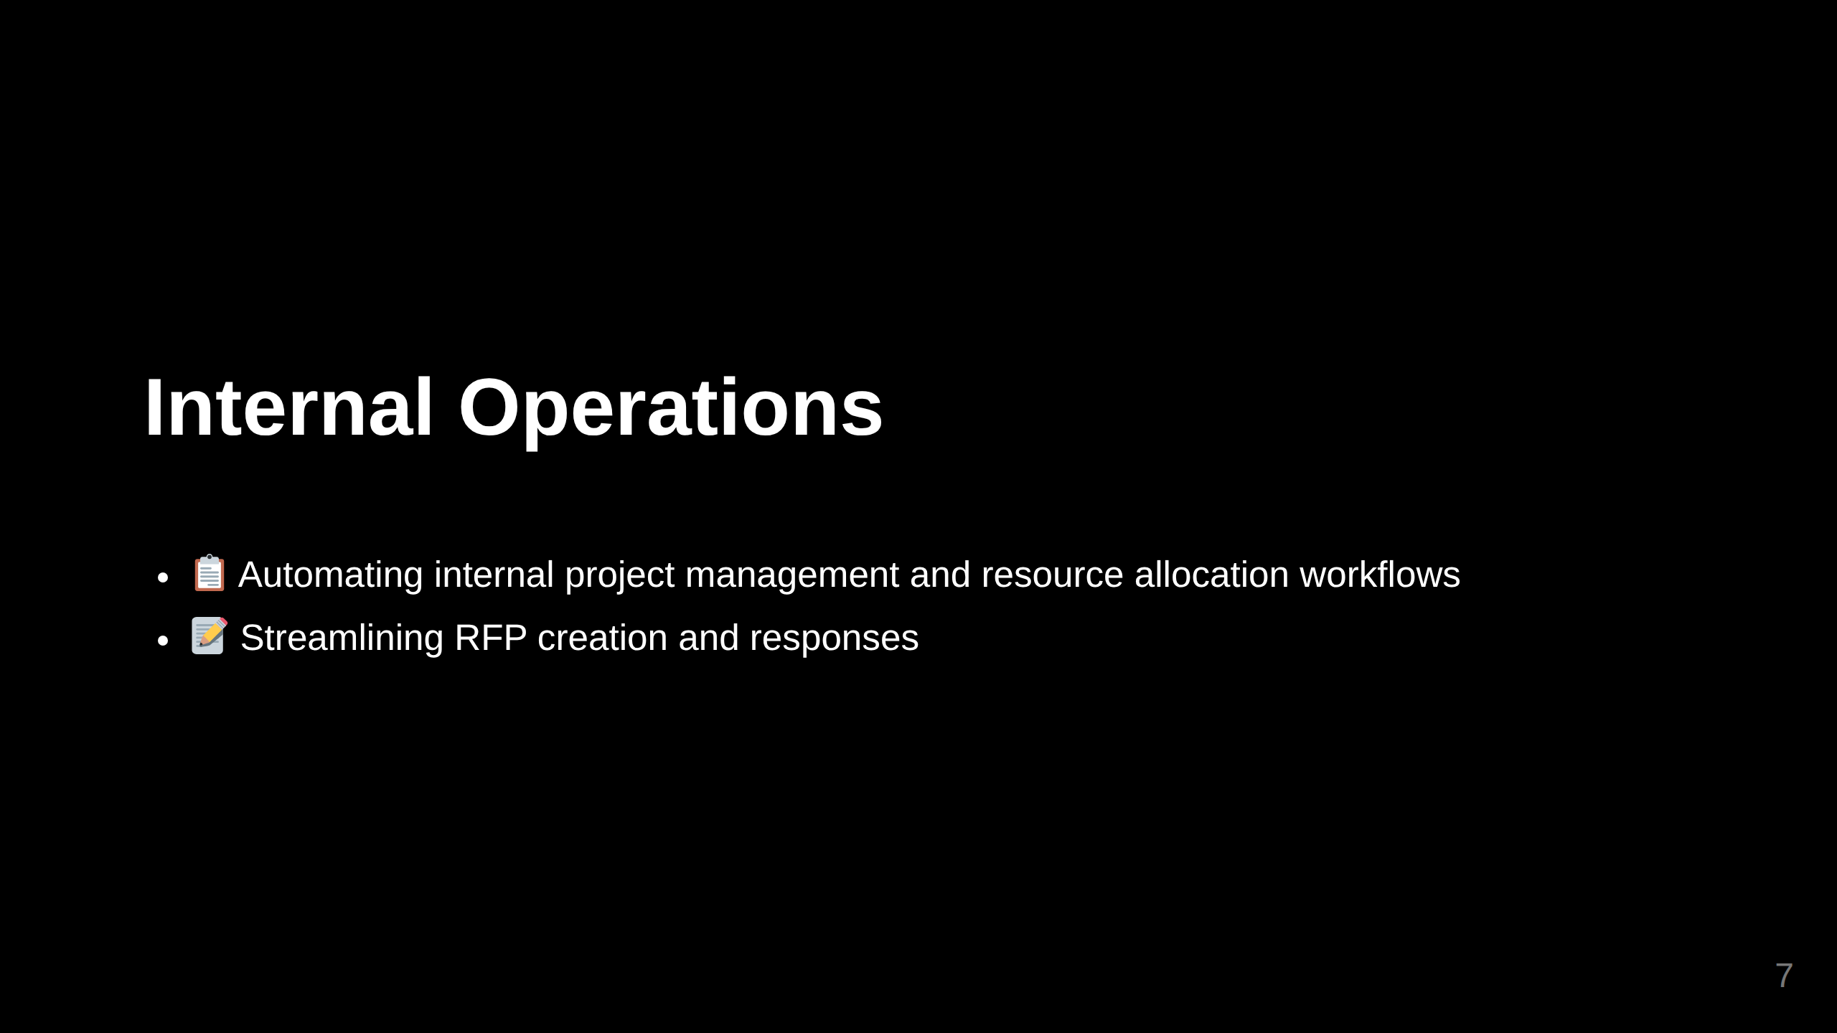

Slide 8
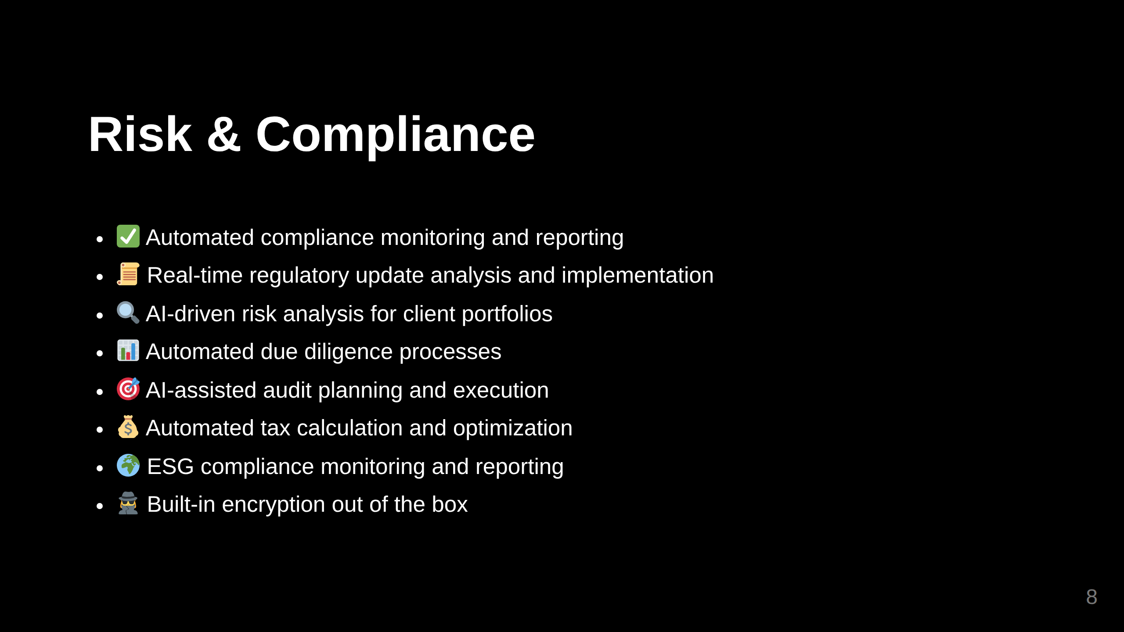

Slide 9
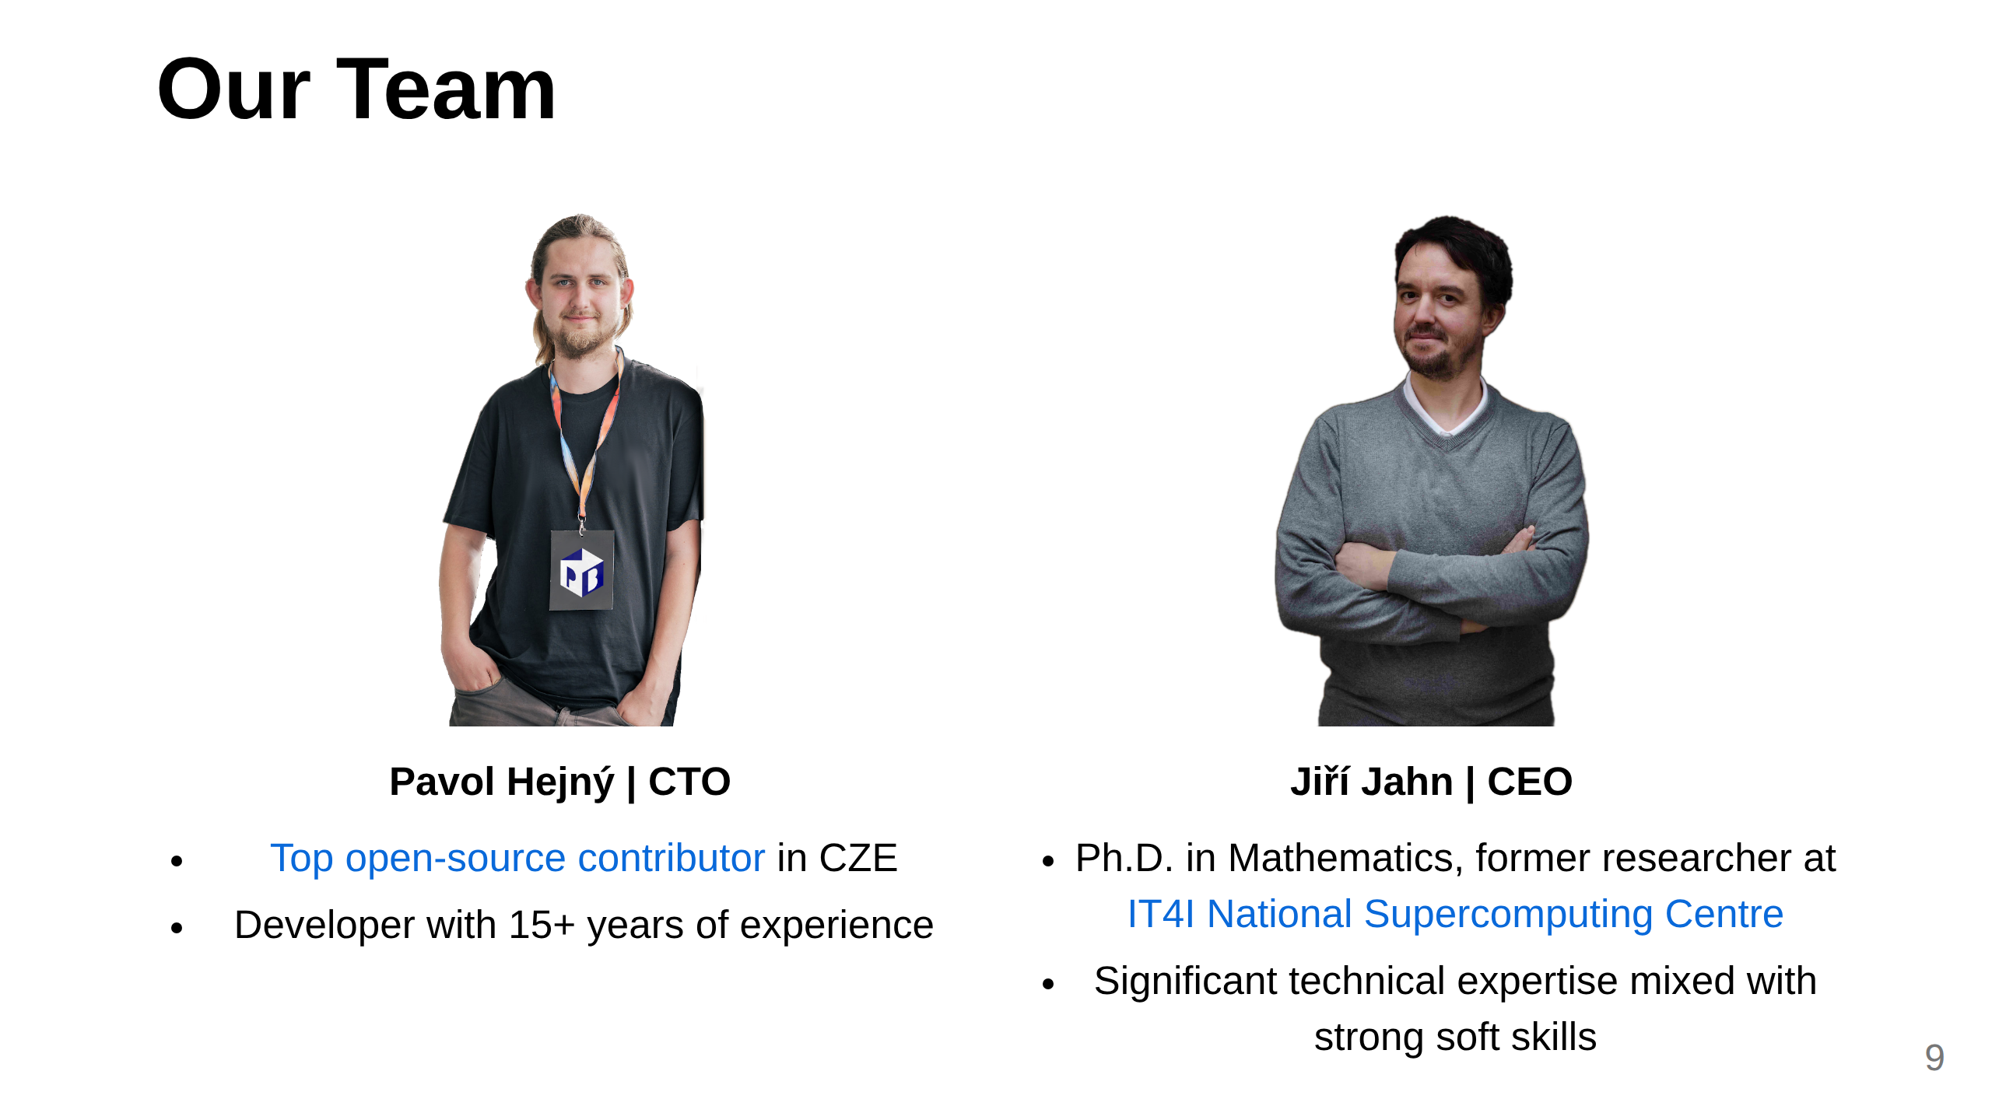
Notes:
Slide 3: Team (Only if it's a strength)

Slide 10
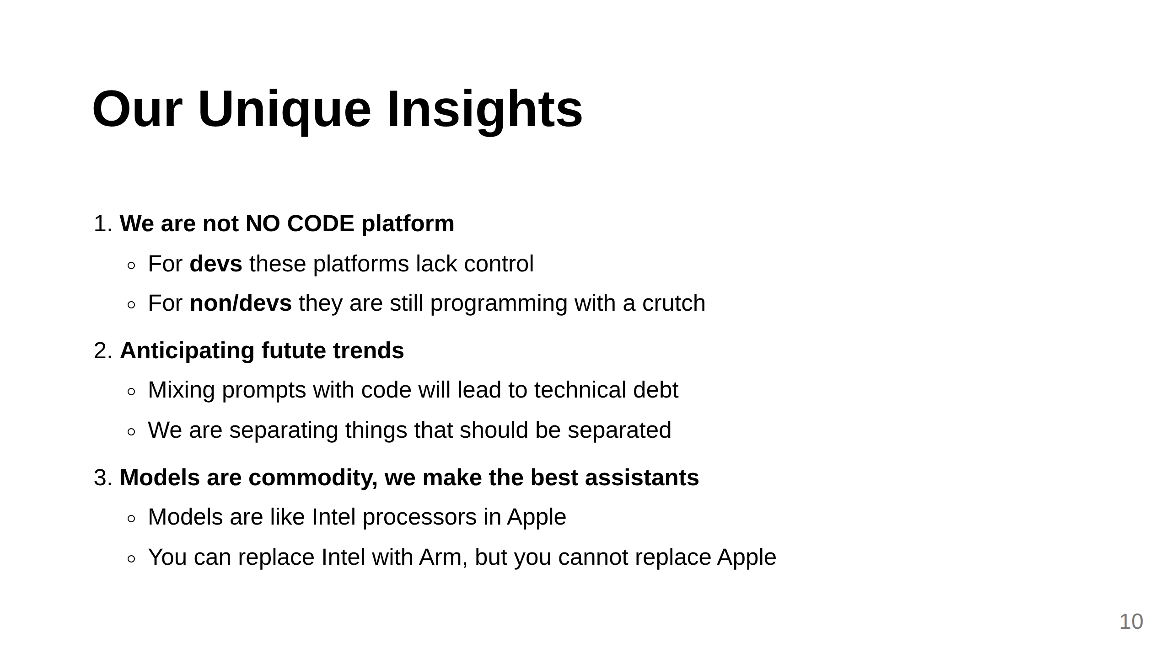
Notes:
Slide 5: Unique Insights

Slide 11
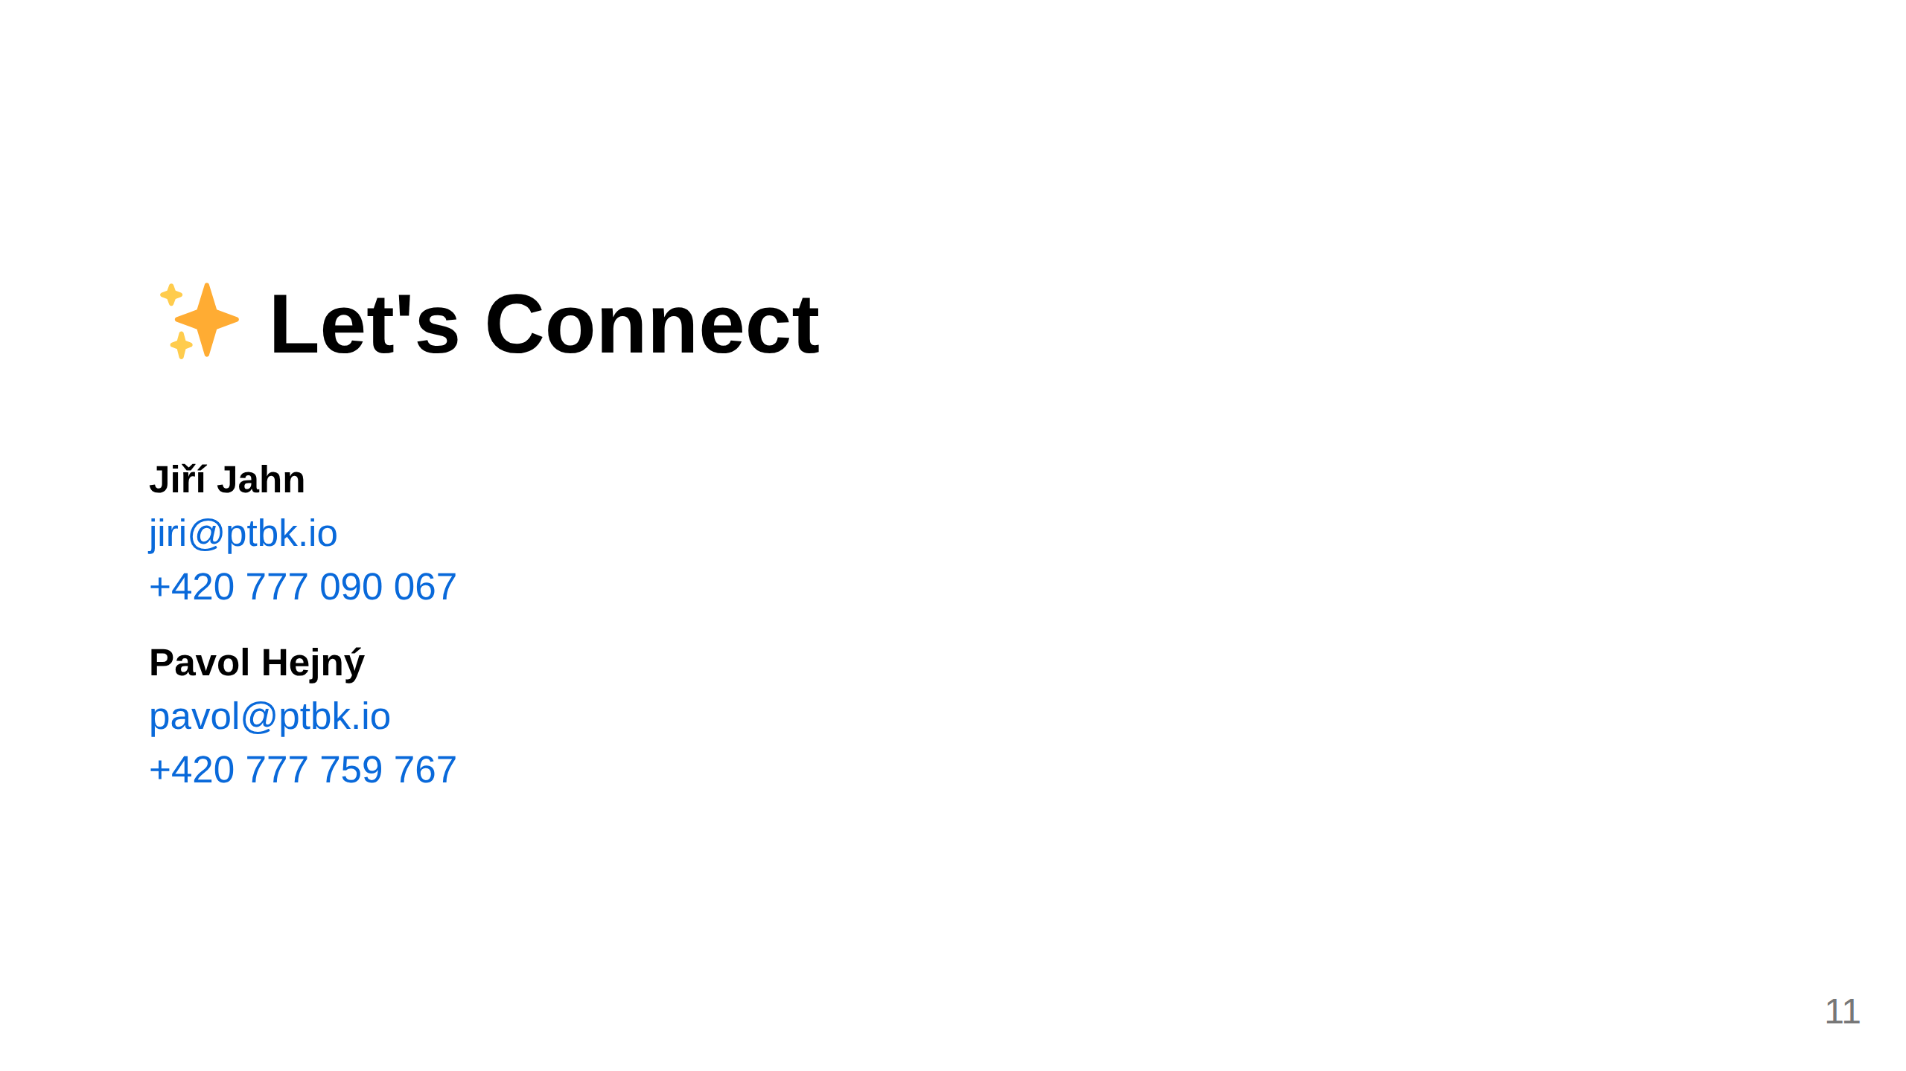
Notes:
Slide 8: Contact

