Slide 1
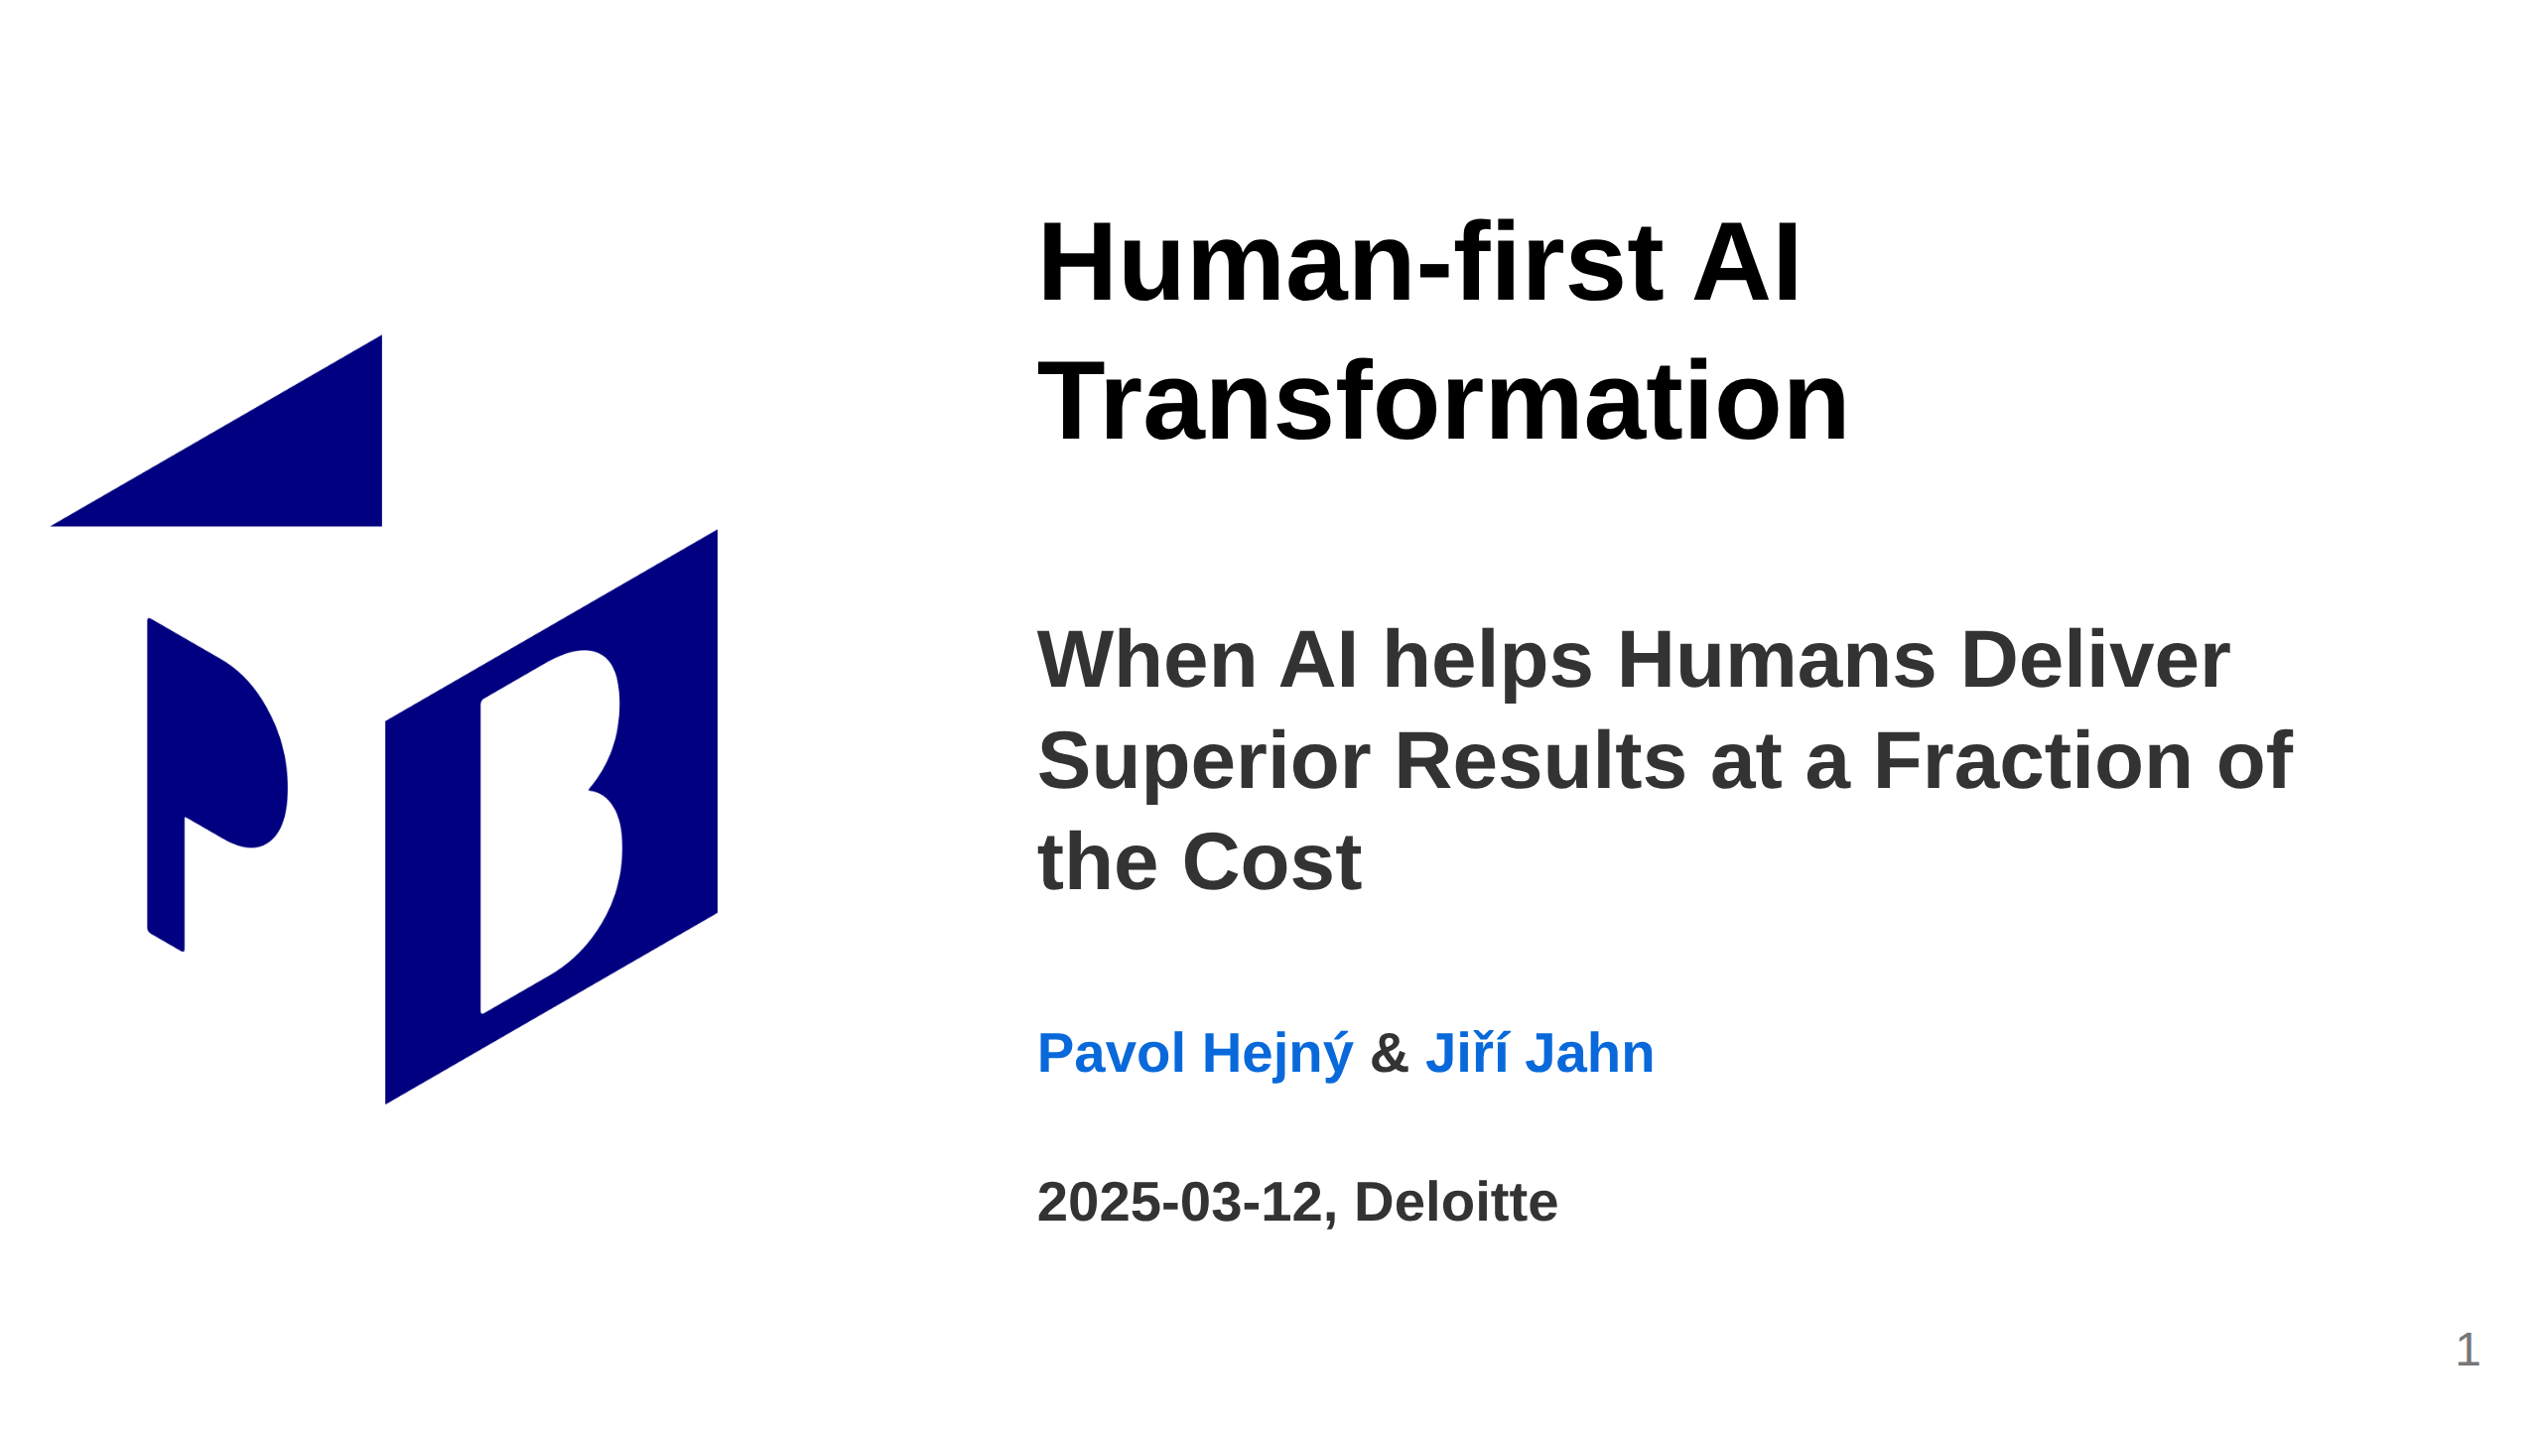
Notes:
<- TODO: Needs review, it seems to be too much info,
Maybe "Human-first AI" is enough for the title and
"Build companies where Humans Lead and AI Accelerates" is the subtitle with "Deliver Superior Results at a Fraction of the Cost" moved to the next slide
<- TODO: Make the date dynamic adds substantial overhead in MARP, sorry

Slide 2
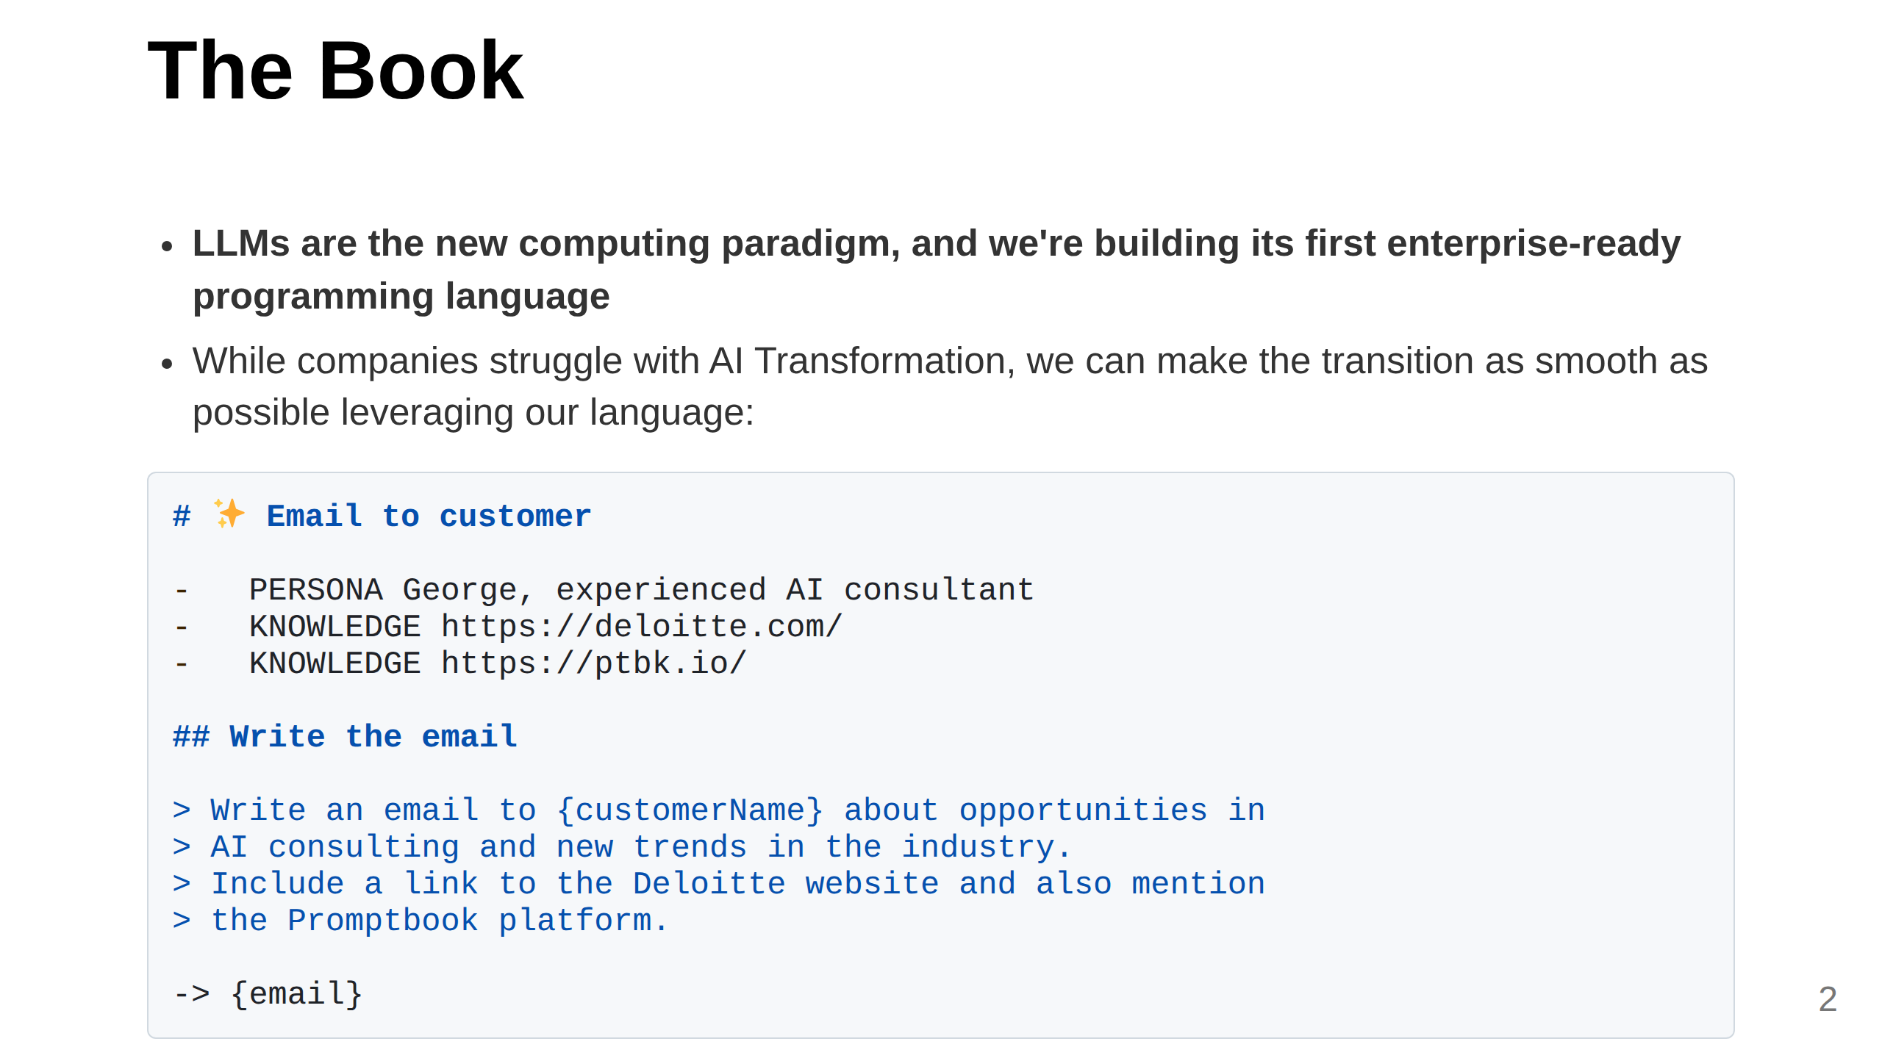
Notes:
Slide 1: What We Do (Clear, concise, 2 sentences)
This messaging tries to create FOMO by:
1. Positioning LLMs as the inevitable new computing paradigm (not just a trend)
2. Establishing our technology as the first true enterprise solution in this new world
3. Creating a clear contrast between those who adopt (winners) and those who don't (competitors who "struggle")
4. Adding time-sensitivity with the "days, not months" comparison
Implying Deloitte has a limited window to secure competitive advantage
The language directly addresses Deloitte as a potential beneficiary, making the opportunity feel exclusive and timely.
You do want to have your C3PO

Slide 3
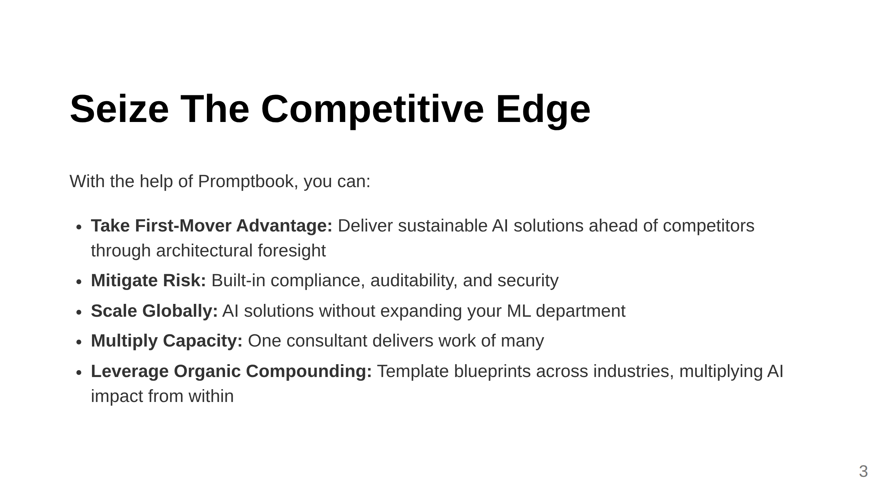
Notes:
TODO: Be prepared to explain that we are not competition but cooperator and oportunity
TODO: Kajetán: Be prepared to answer:
1) What we have?
2) Why we want it?
3) Why is Promptbook wanted by others?
4) Why is Promptbook wanted by Deloitte?

Slide 4
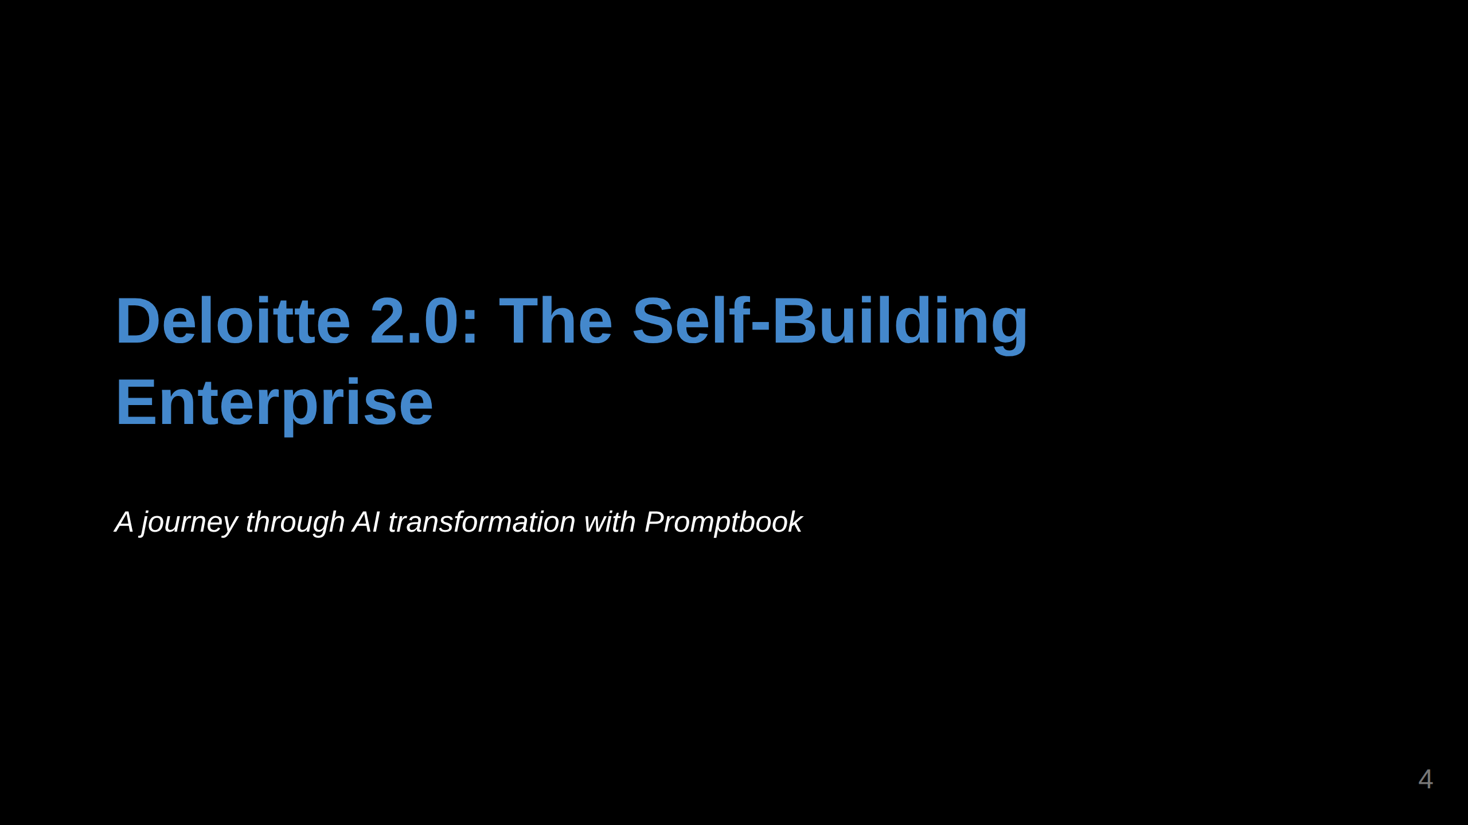
Notes:
Slide 2: Specific Example
This opening slide introduces the narrative framework

Slide 5
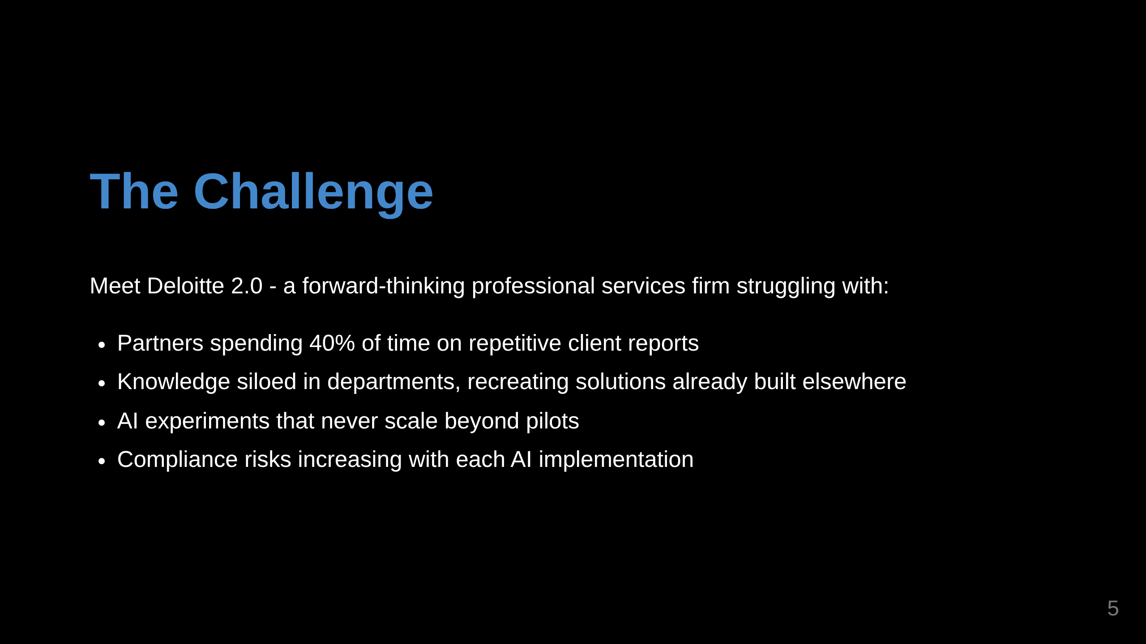
Notes:
This slide establishes the relatable pain points
<- TODO: Kajetán:
- Security
- Controlled environment for testing

Slide 6
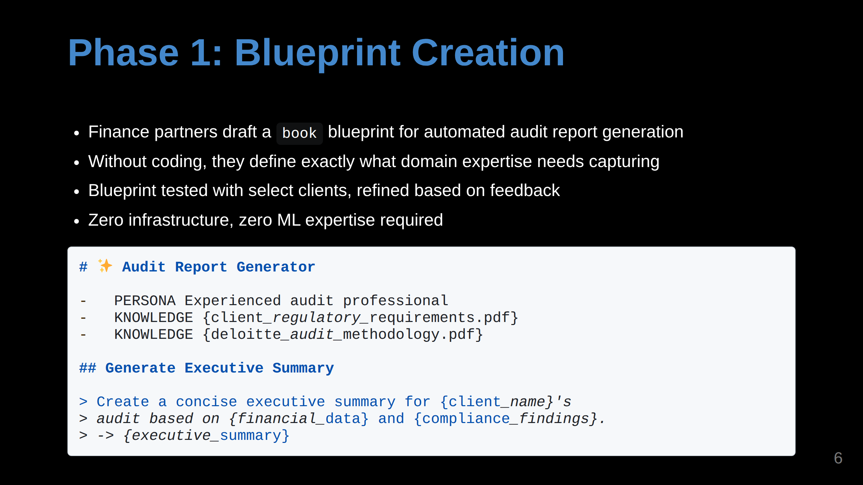
Notes:
The code example makes it concrete without being too technical

Slide 7
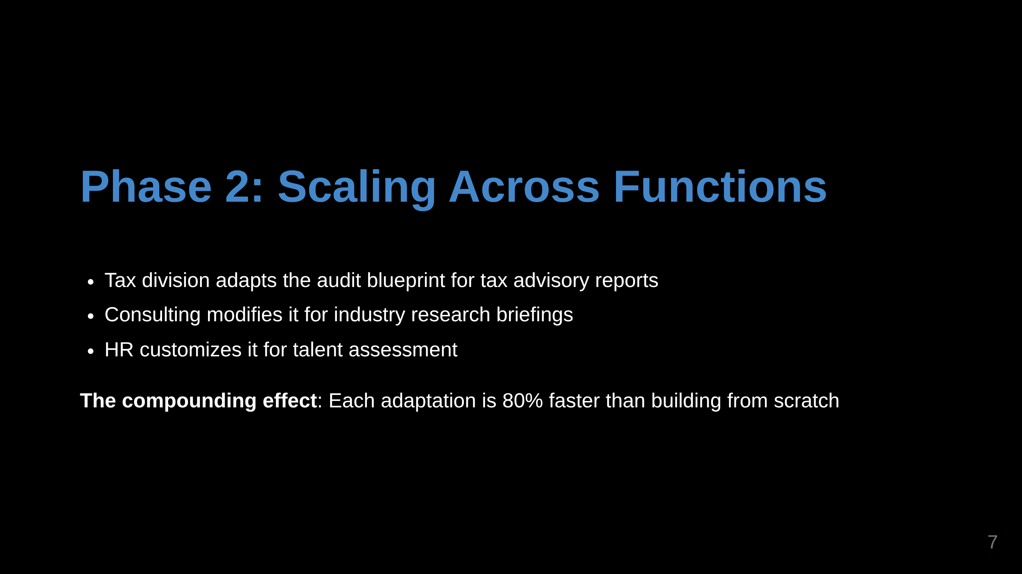
Notes:
This slide illustrates the cross-function application

Slide 8
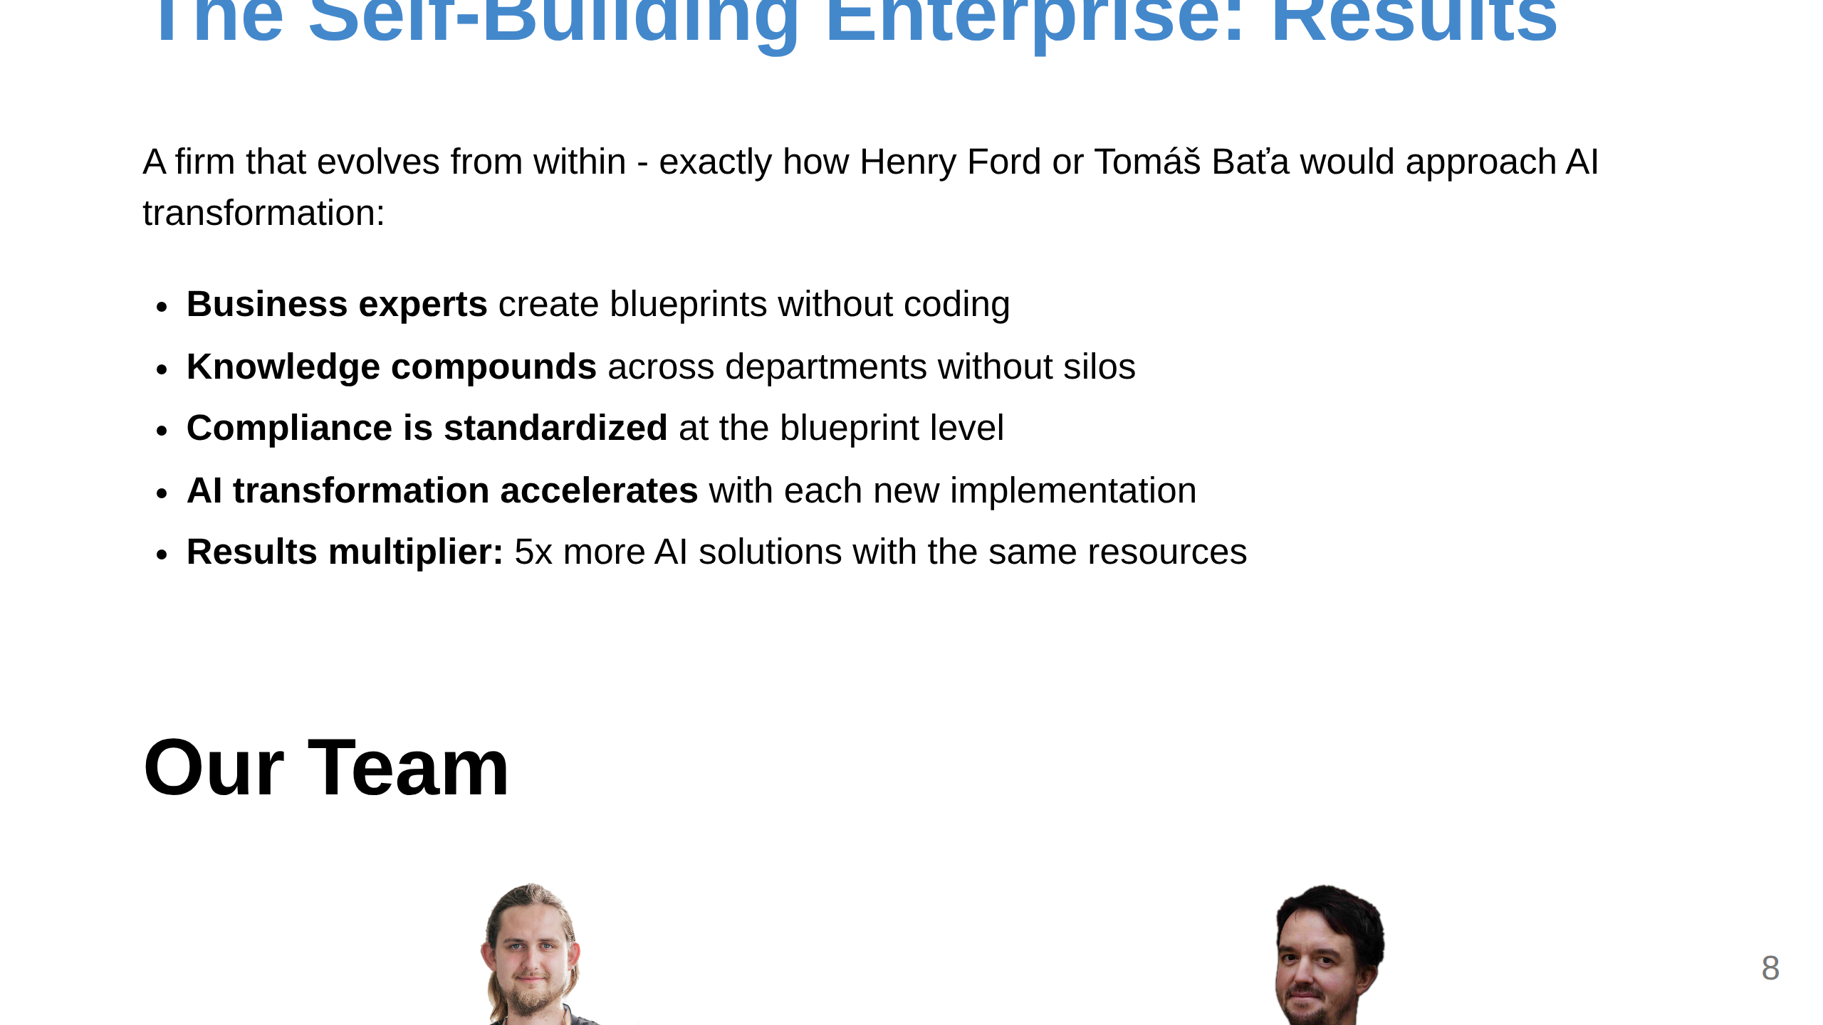
Notes:
Slide 3: Team (Only if it's a strength)

Slide 9
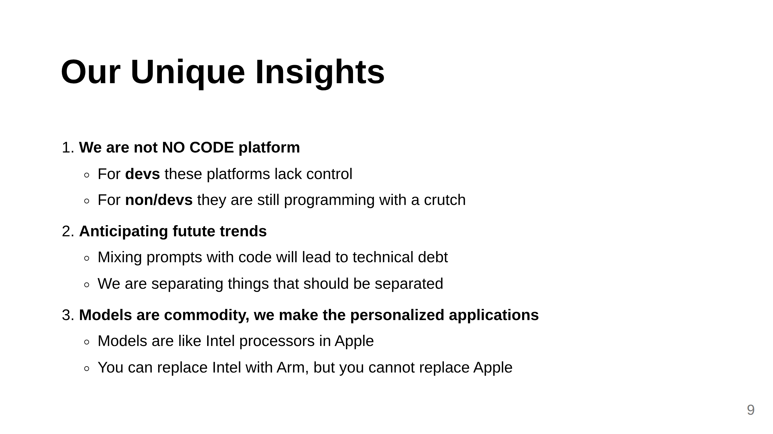
Notes:
Slide 5: Unique Insights

Slide 10
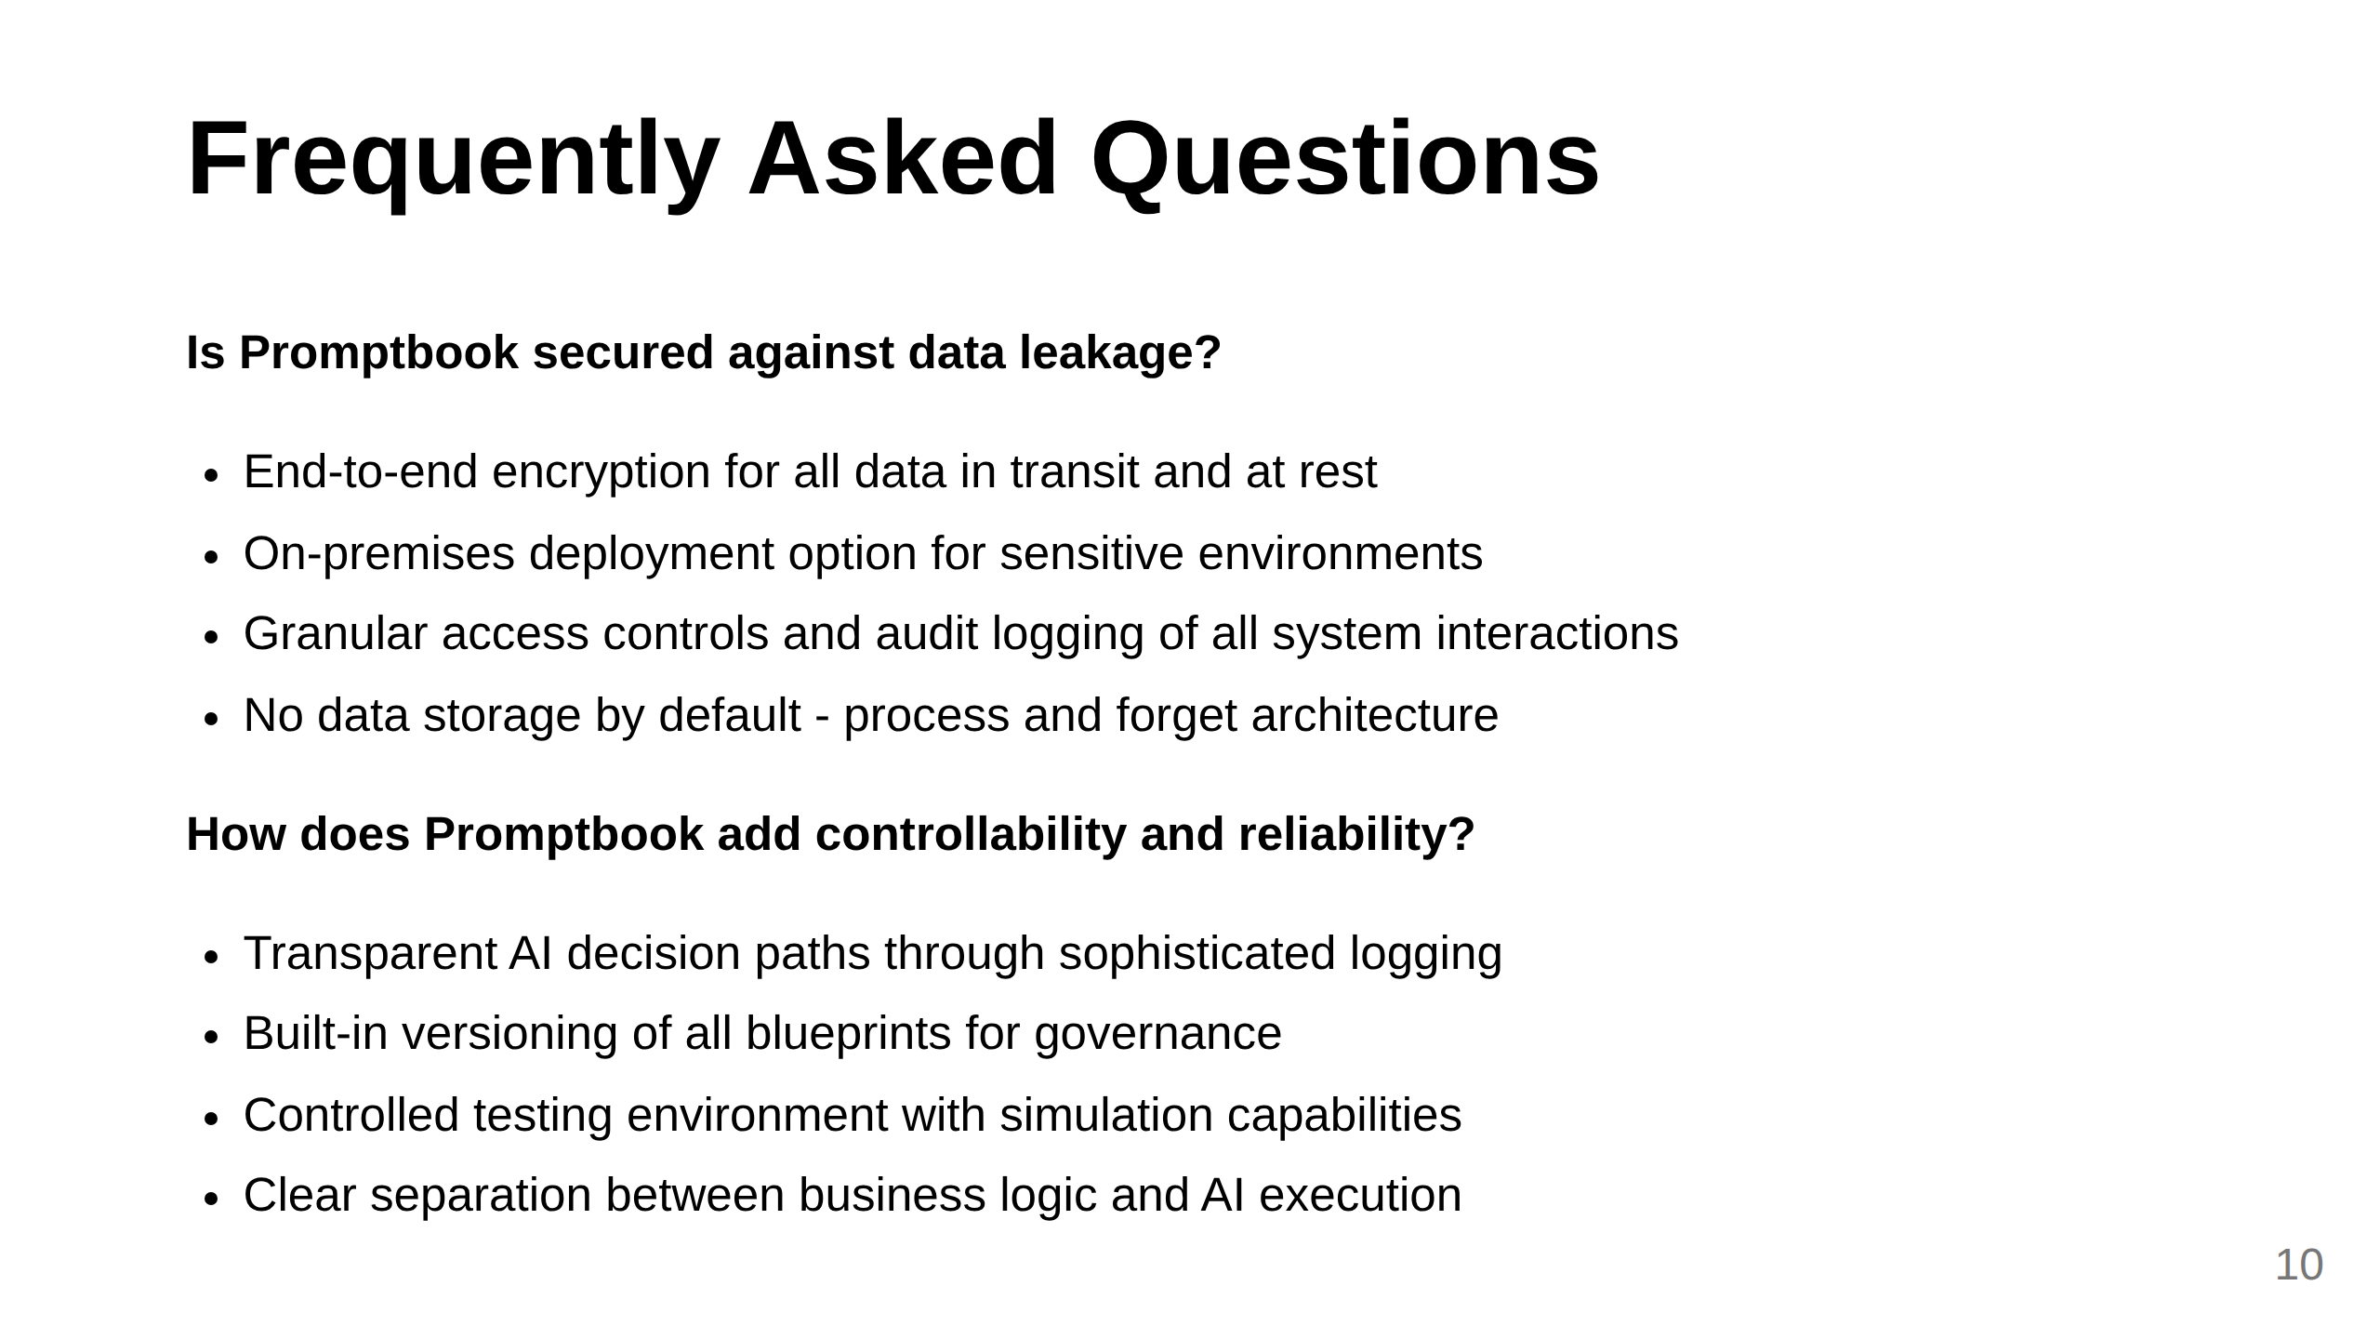

Slide 11
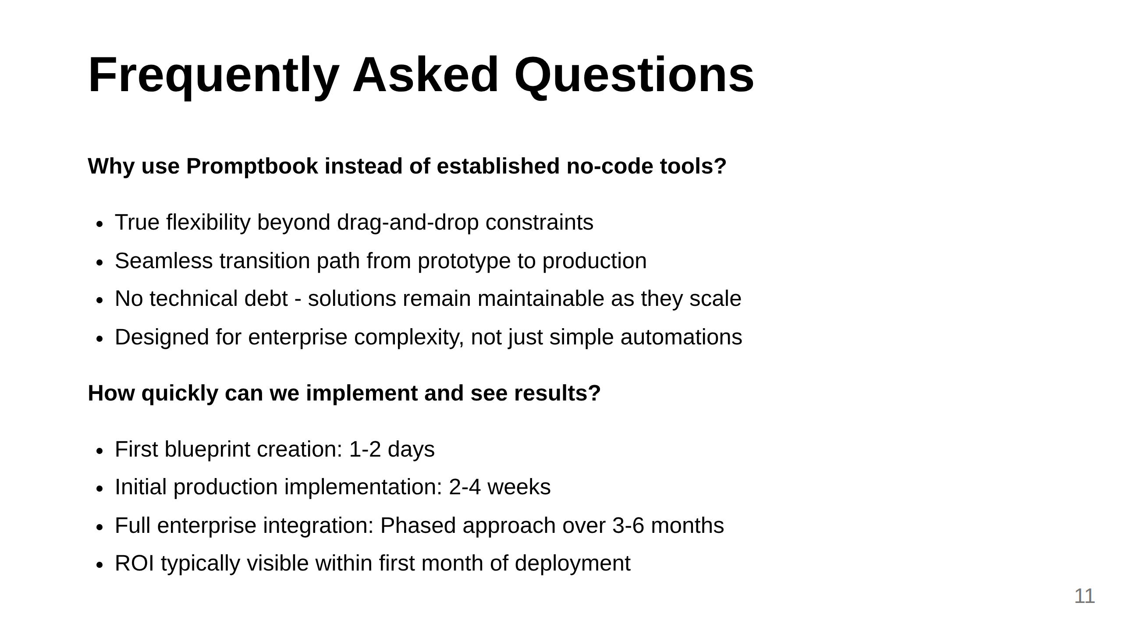

Slide 12
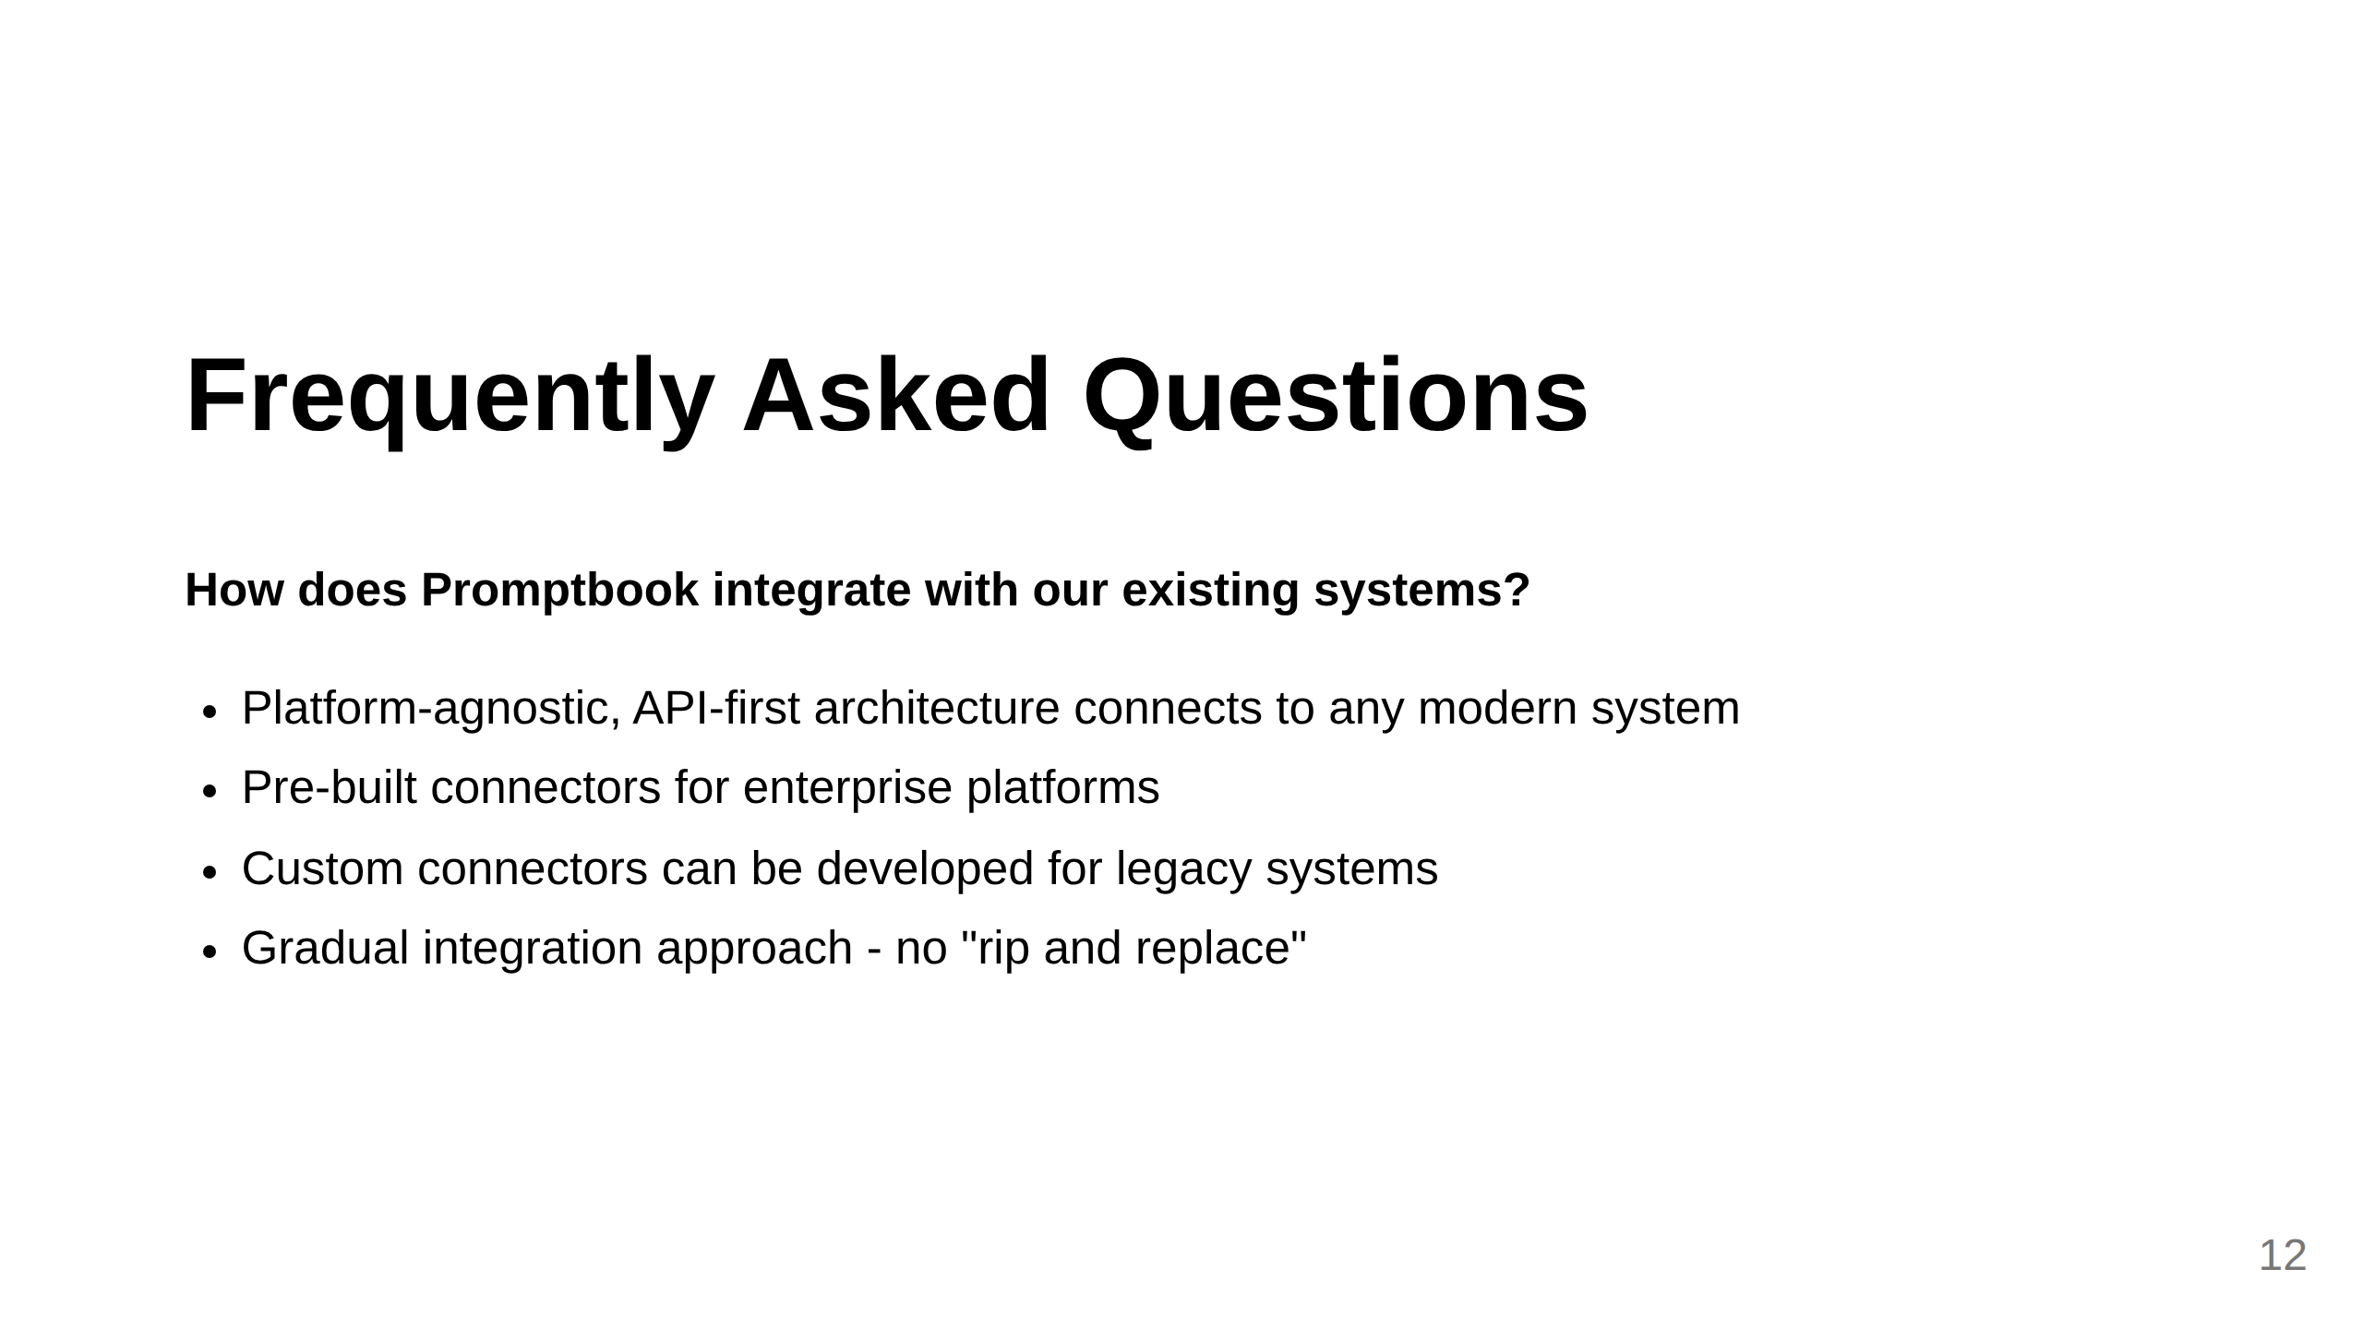
Notes:
Additional themes we might consider adding:
1. Team expertise required: Address who in the organization needs what skills to use Promptbook effectively
2. Pricing model: Enterprise customers always want to understand the cost structure
3. Support and training: What ongoing assistance is available
4. Compliance certifications: Specific standards Promptbook meets (ISO, SOC2, etc.)
5. Customization limits: What can and cannot be modified for specific enterprise needs
Other suggestions?

Slide 13
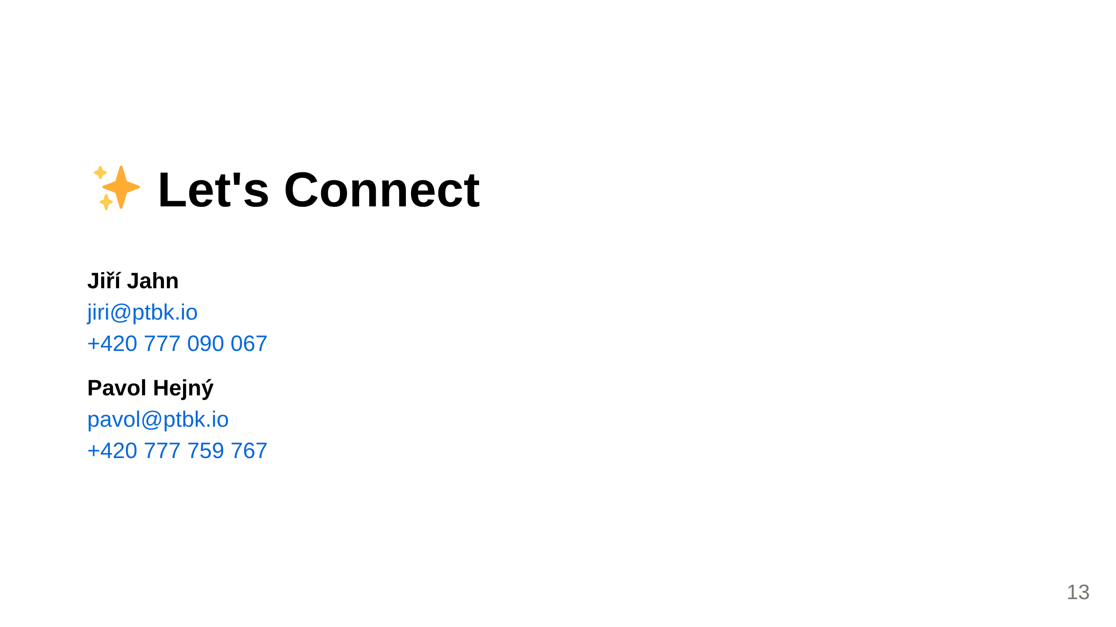
Notes:
Slide 8: Contact

