Slide 1
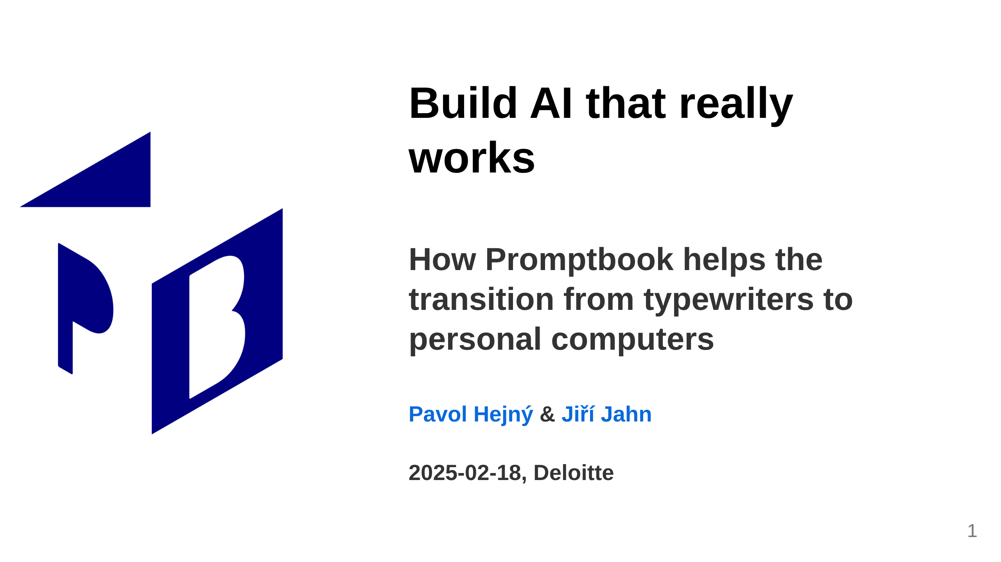
Notes:
<- TODO: Make the date dynamic

Slide 2
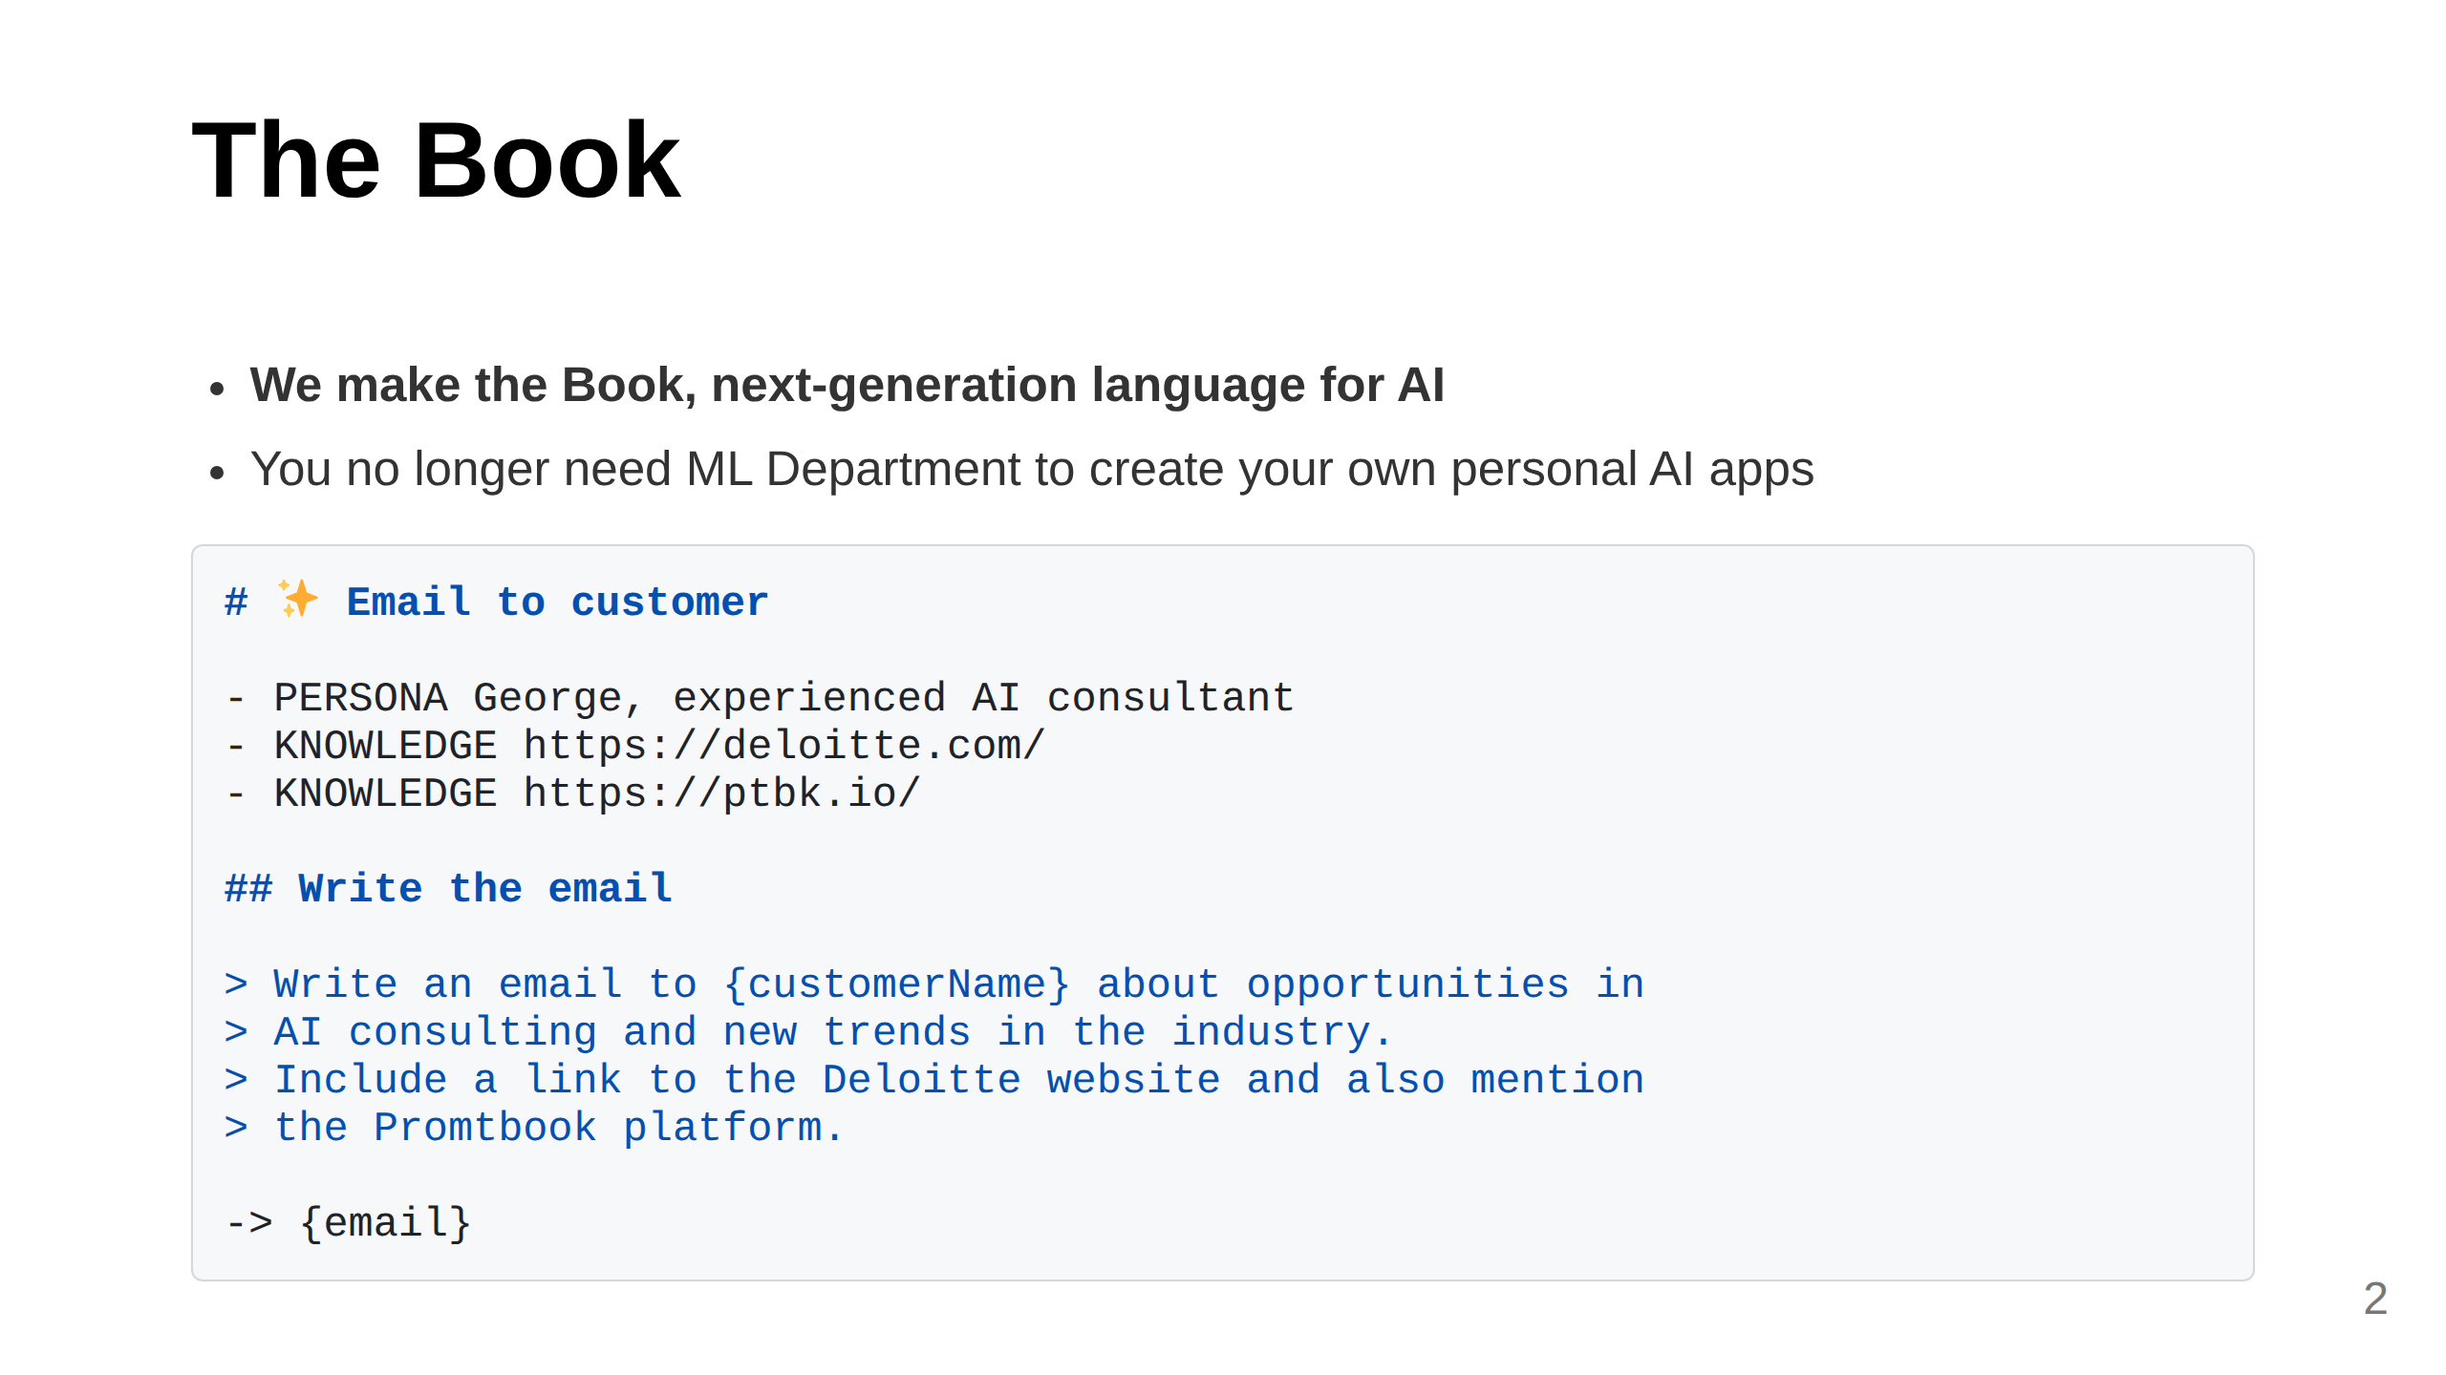
Notes:
Slide: What We Do (Clear, concise, 2 sentences) You do want to have your C3PO

Slide 3
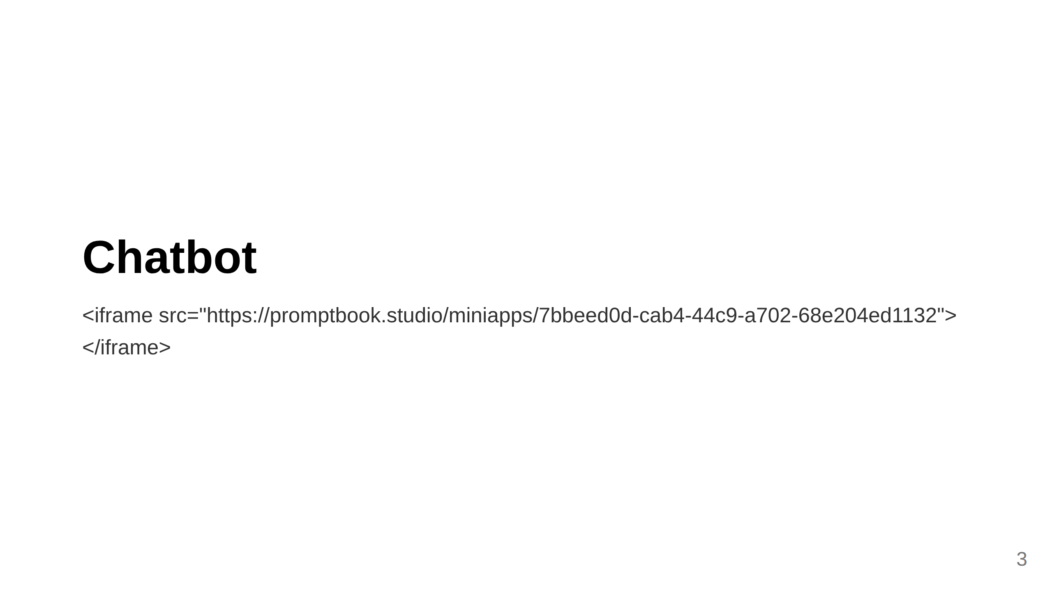
Notes:
Slide: Contact

Slide 4
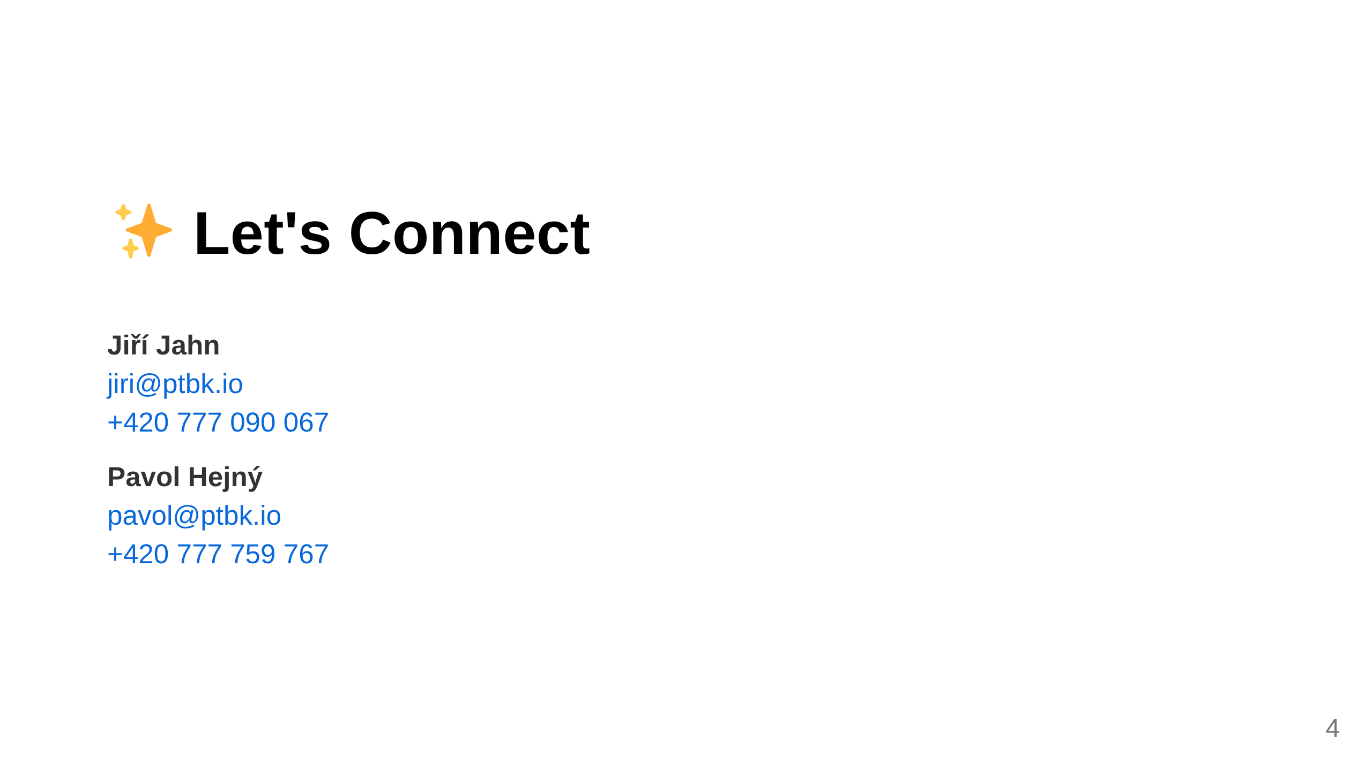
Notes:
Slide: Contact

