Slide 1


Slide 2
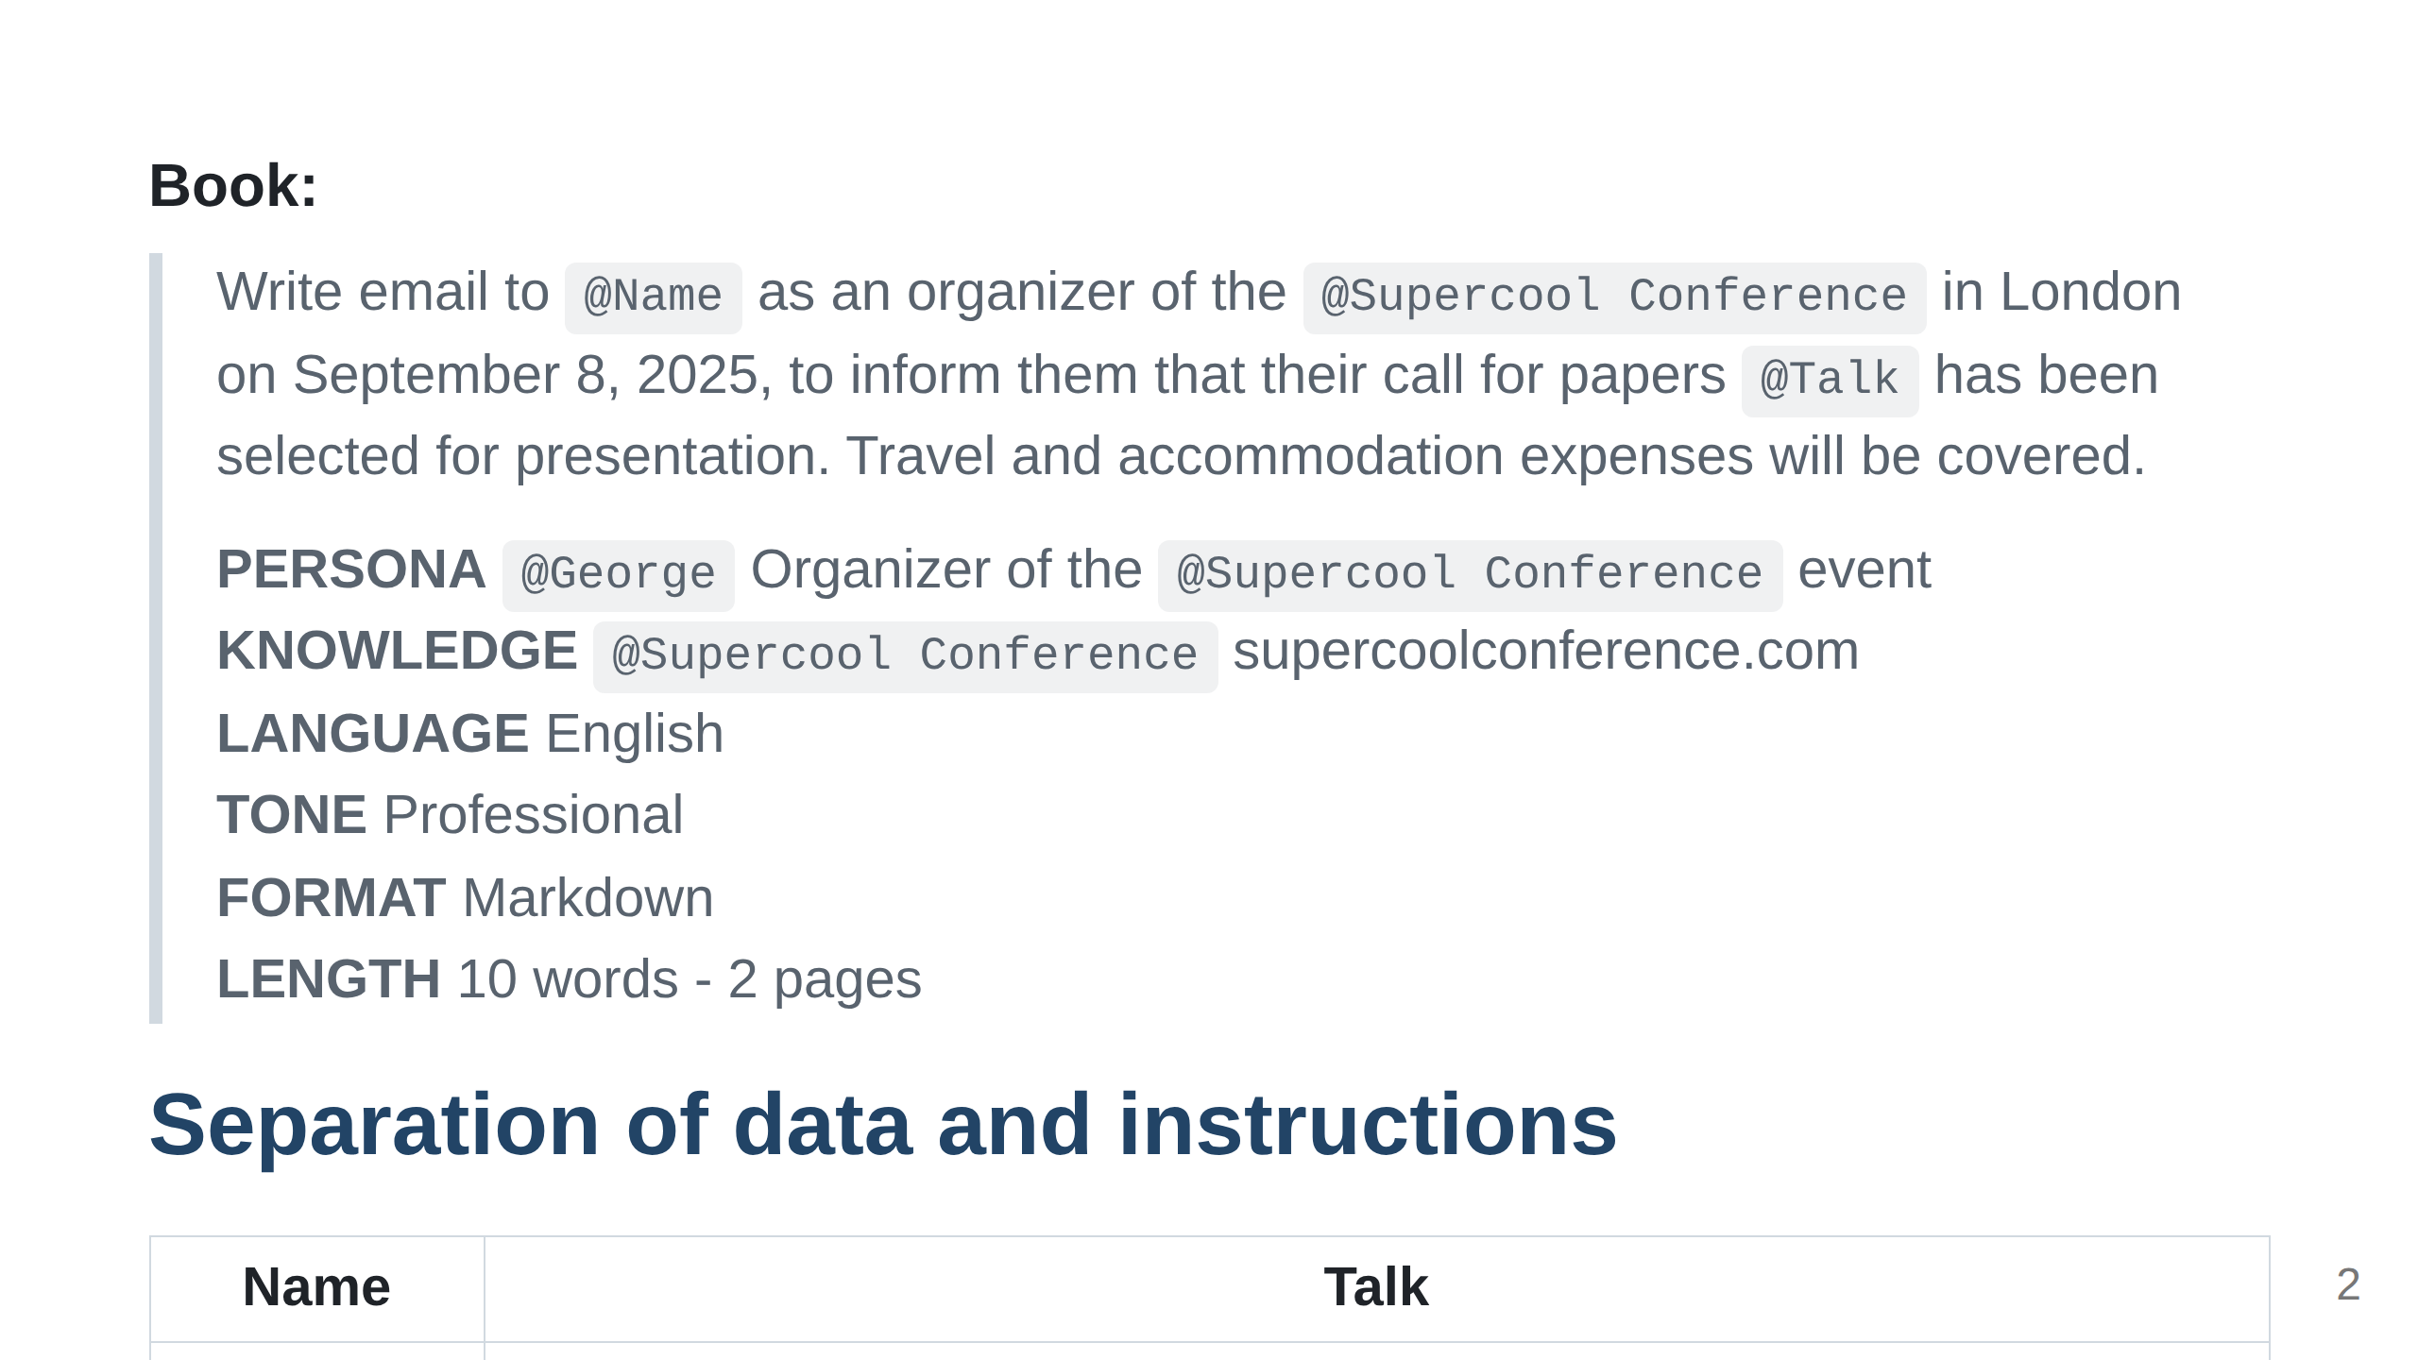

Slide 3
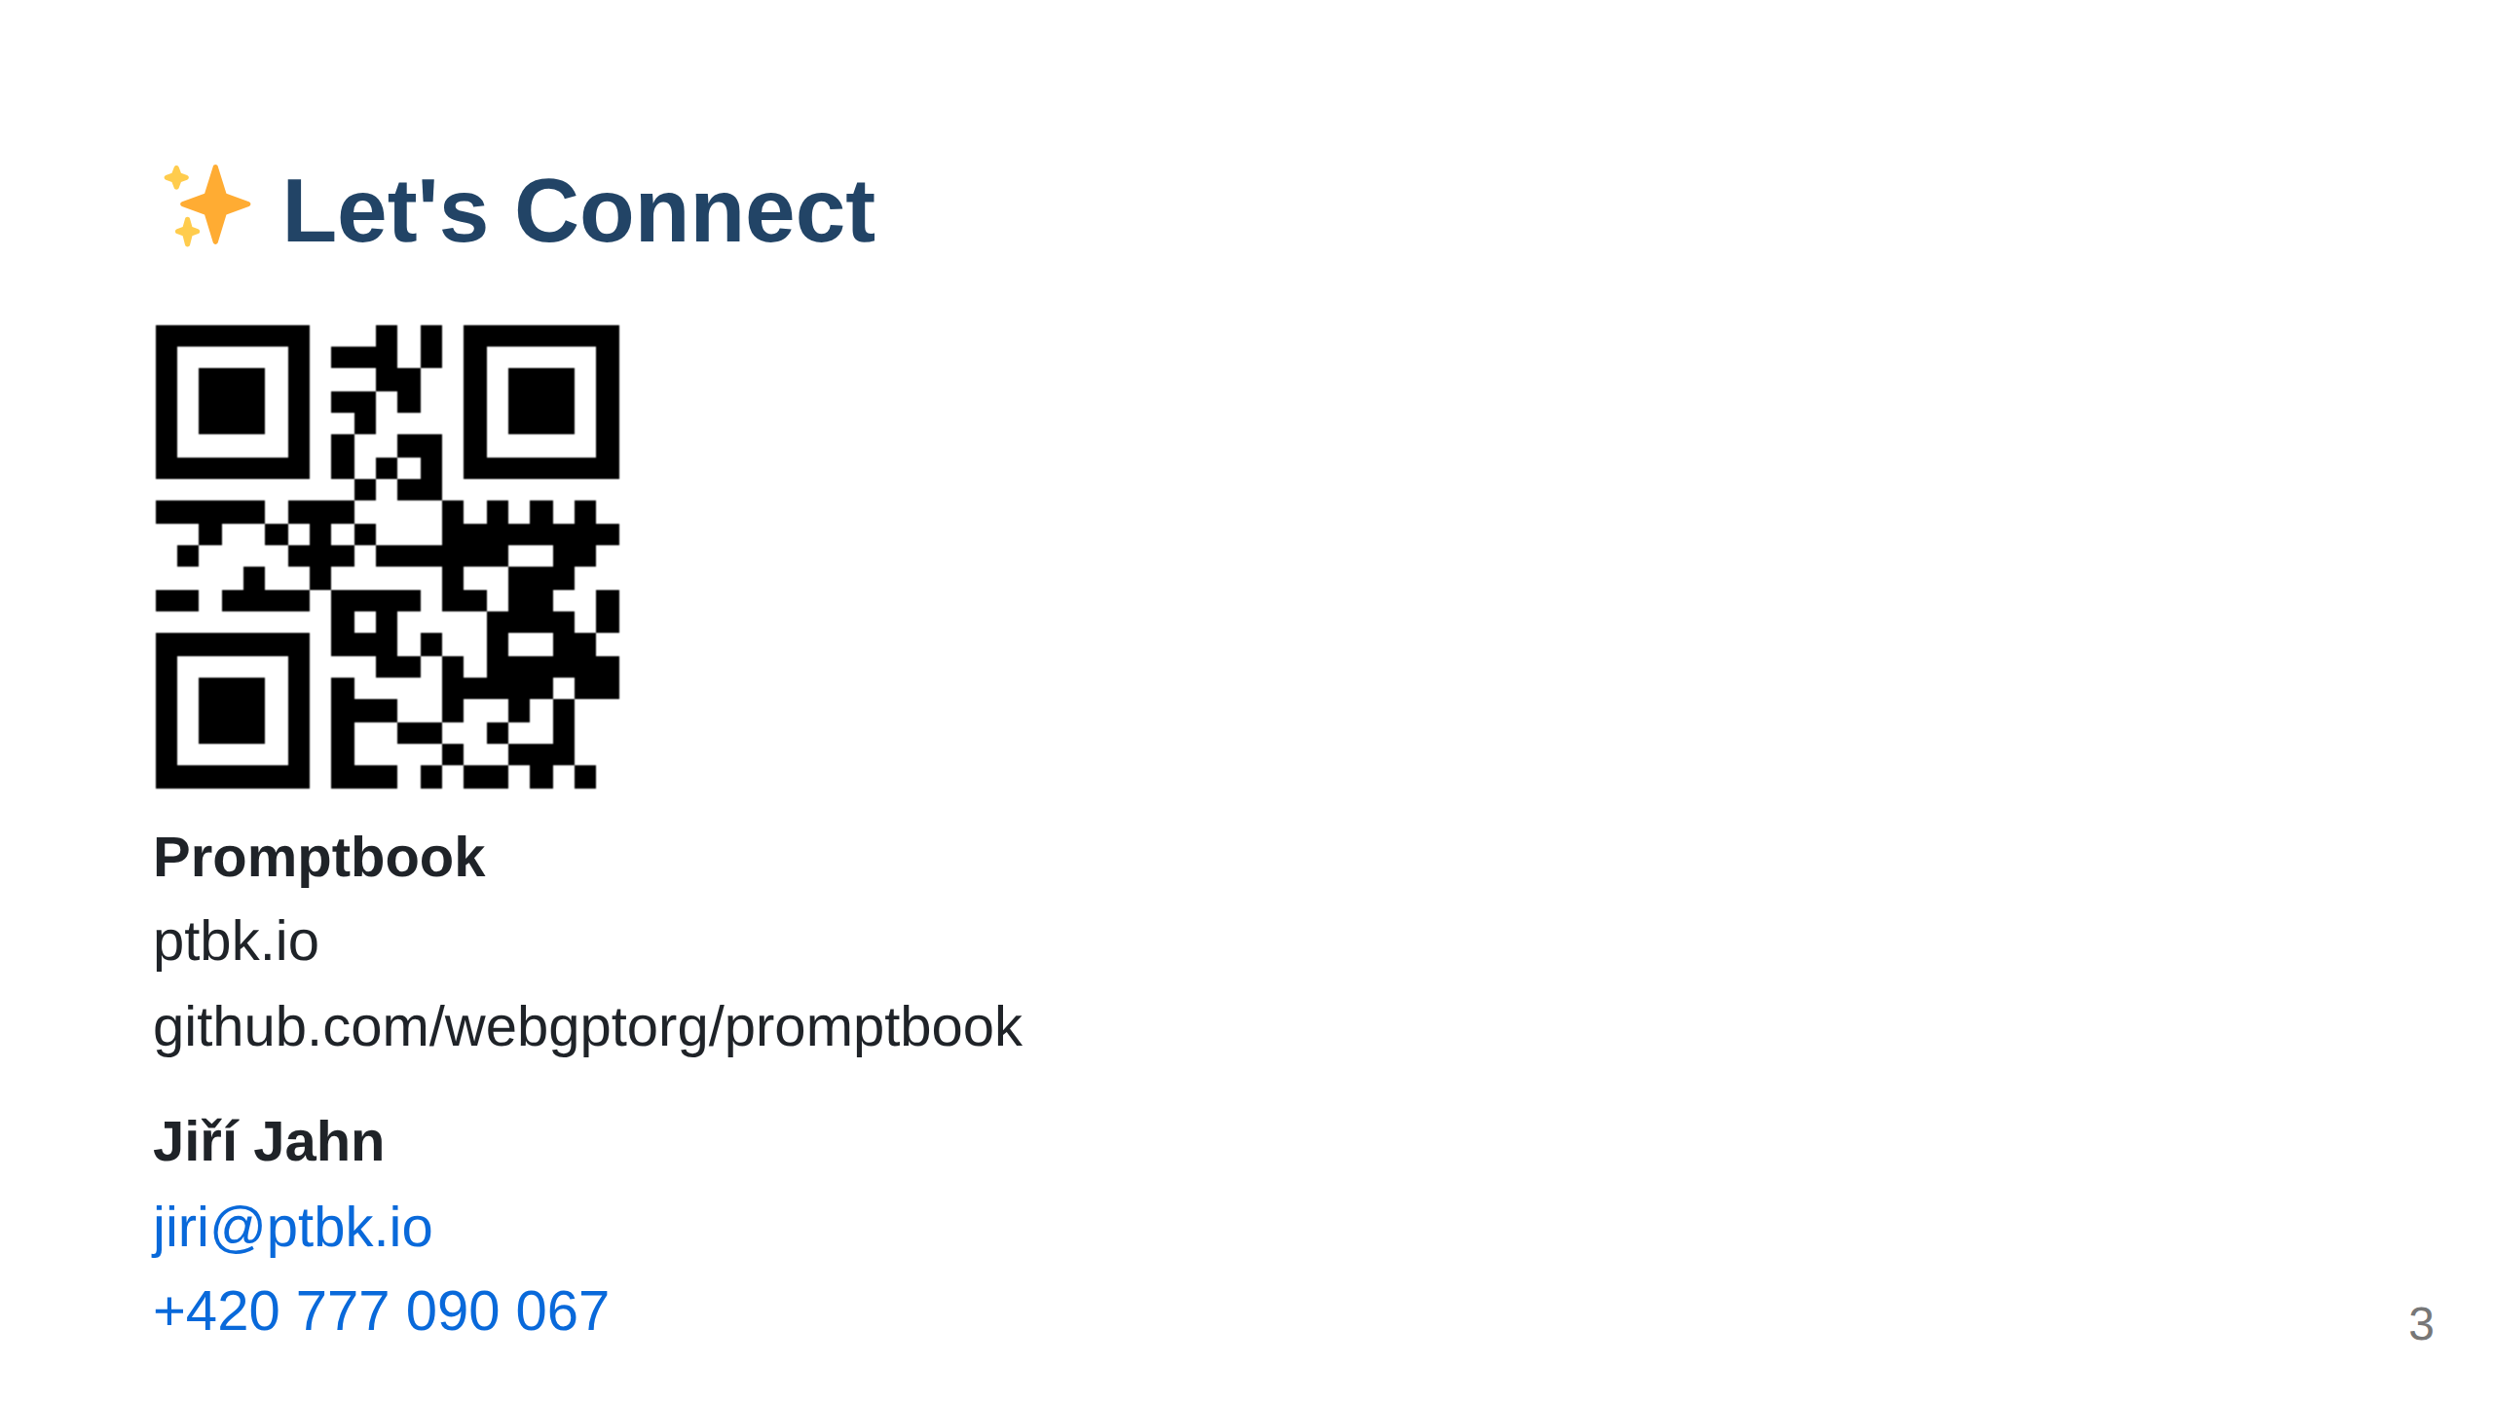
Notes:
Import ../_common/last-slide.md
⚠️ WARNING: This section was imported, make changes in source; any manual changes here will be overwritten
/Import ../_common/last-slide.md

