Slide 1


Slide 2
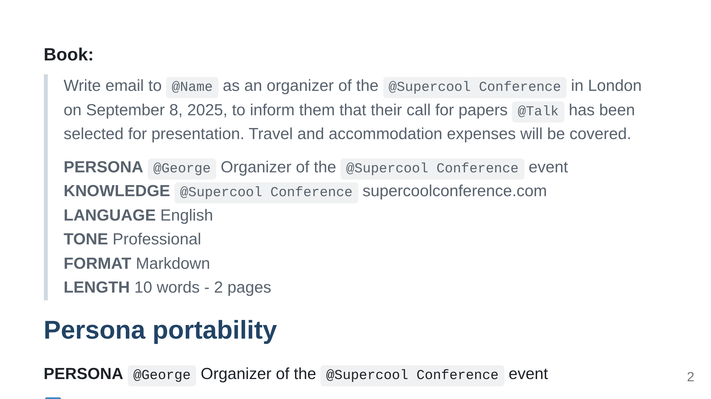

Slide 3
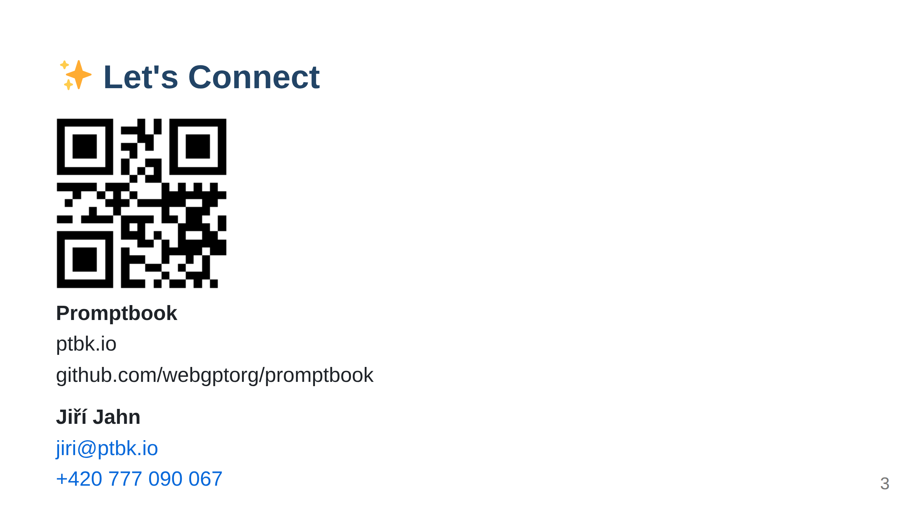
Notes:
Import ../_common/last-slide.md ⚠️ WARNING: This section was imported, make changes in source; any manual changes here will be overwritten /Import ../_common/last-slide.md

