Slide 1
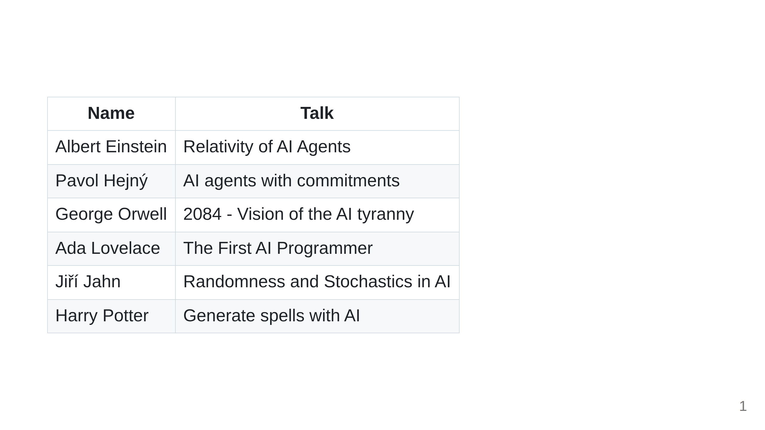

Slide 2
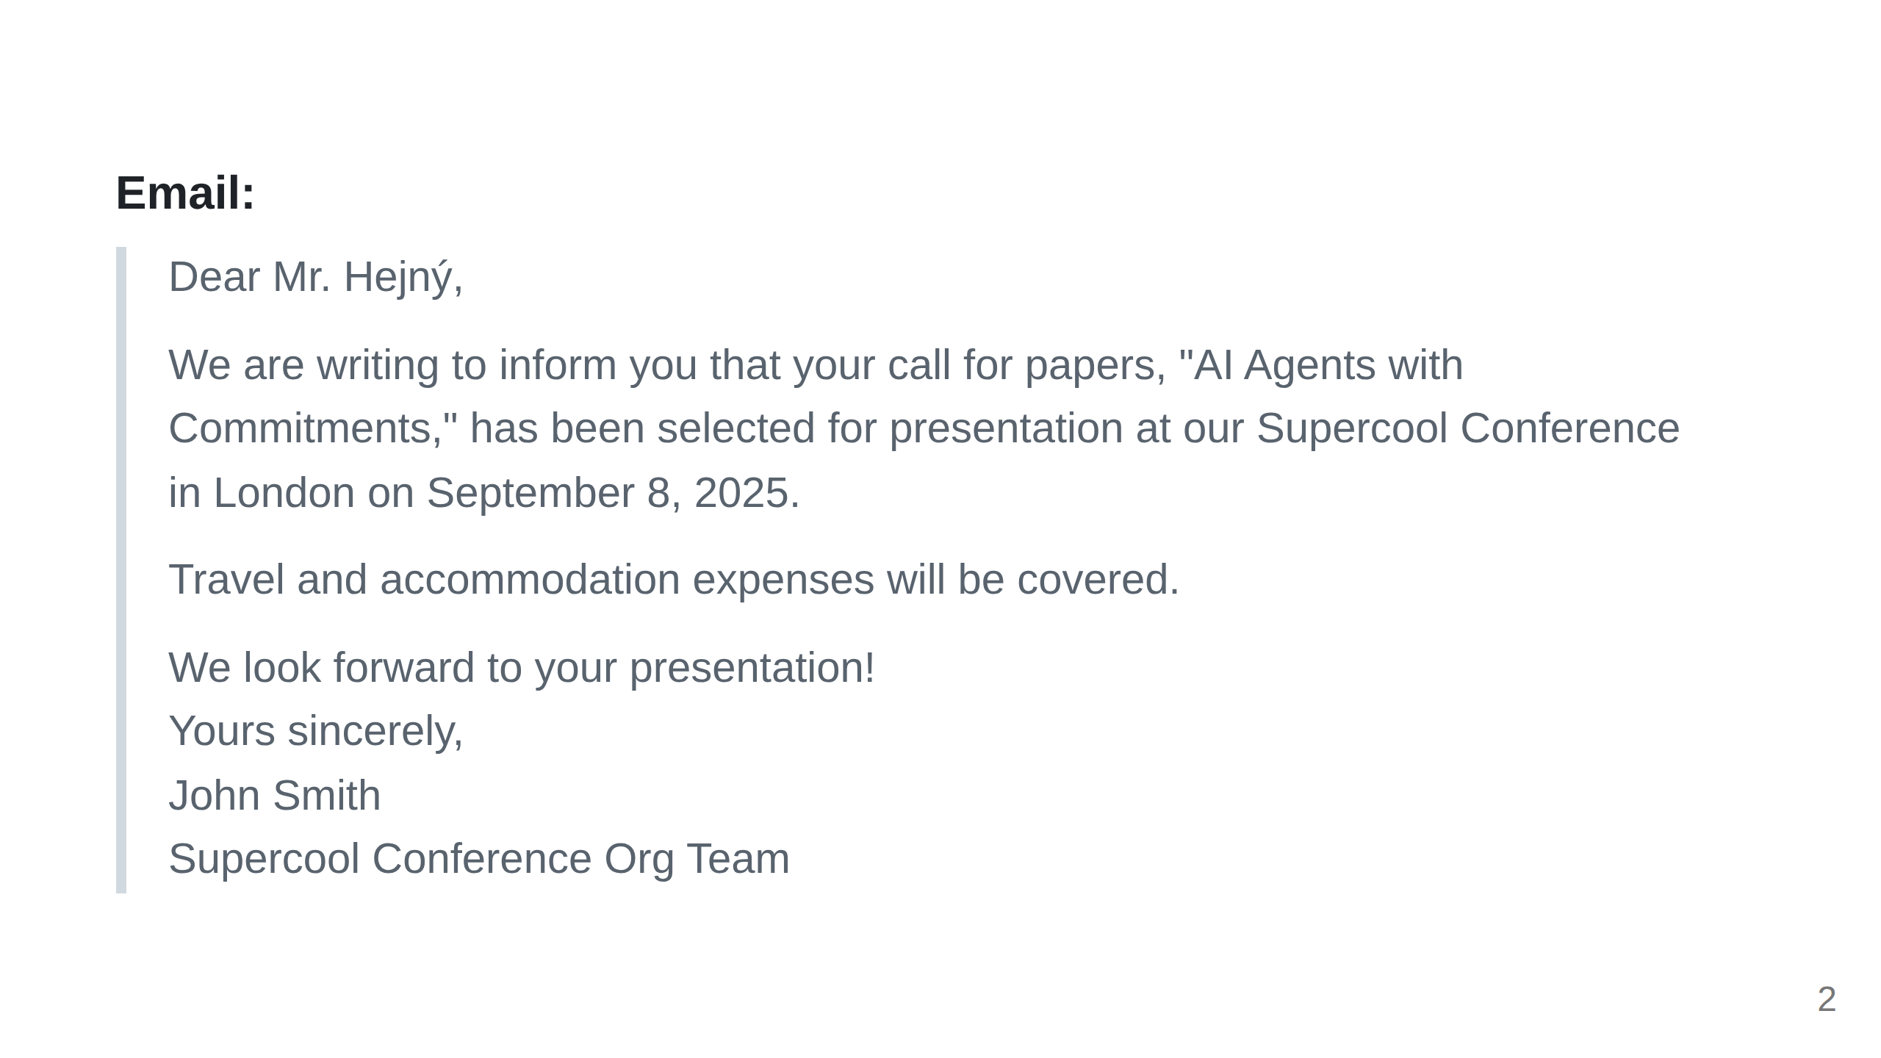

Slide 3
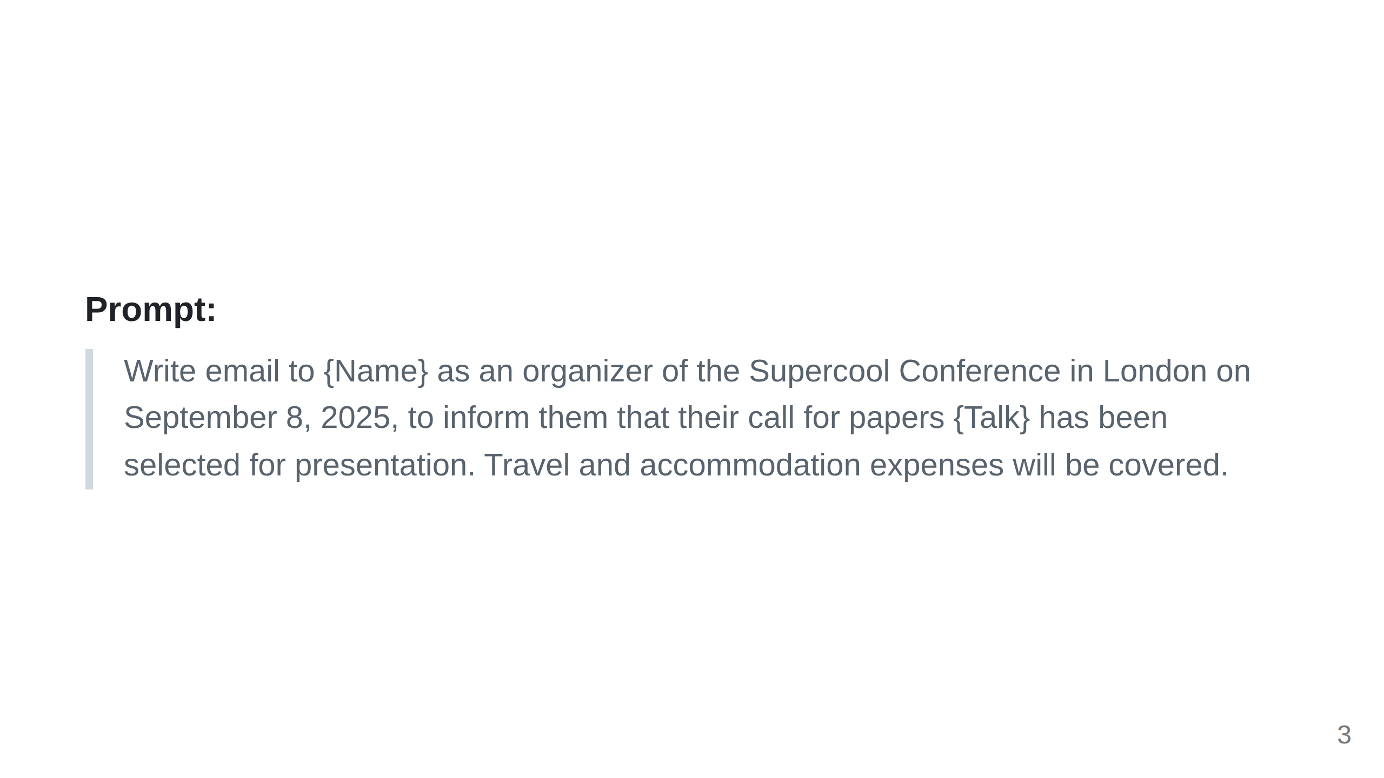

Slide 4
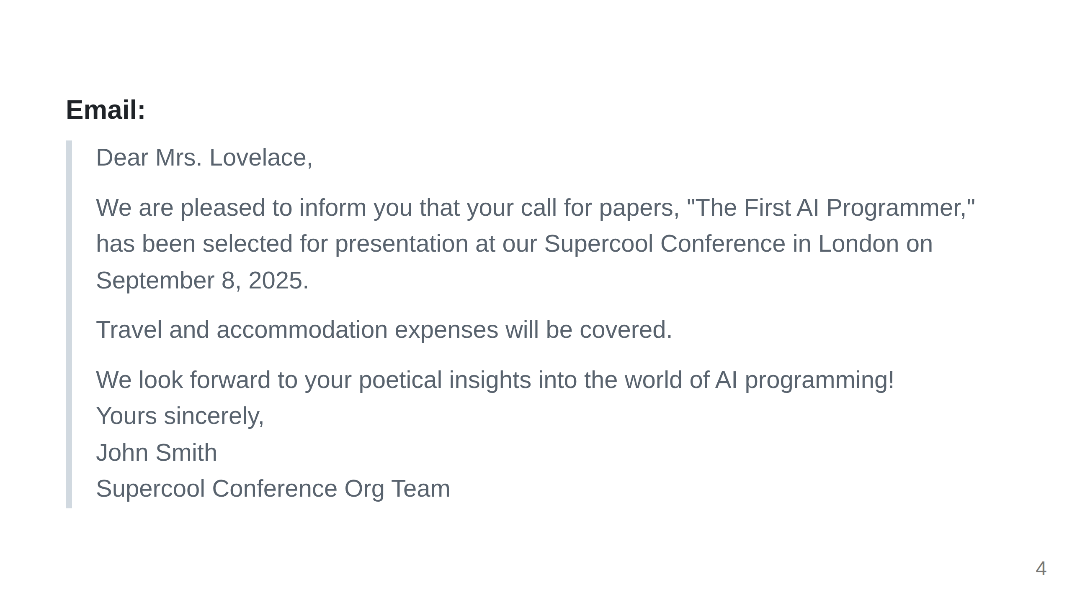

Slide 5
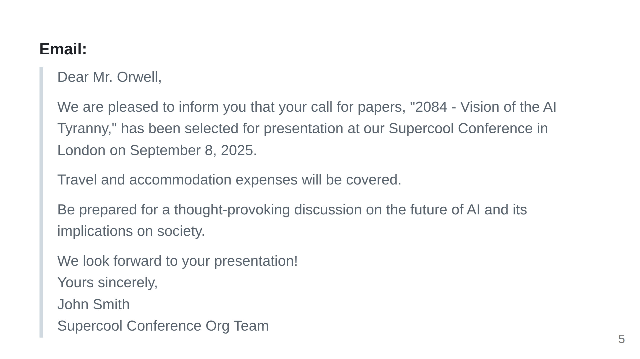

Slide 6
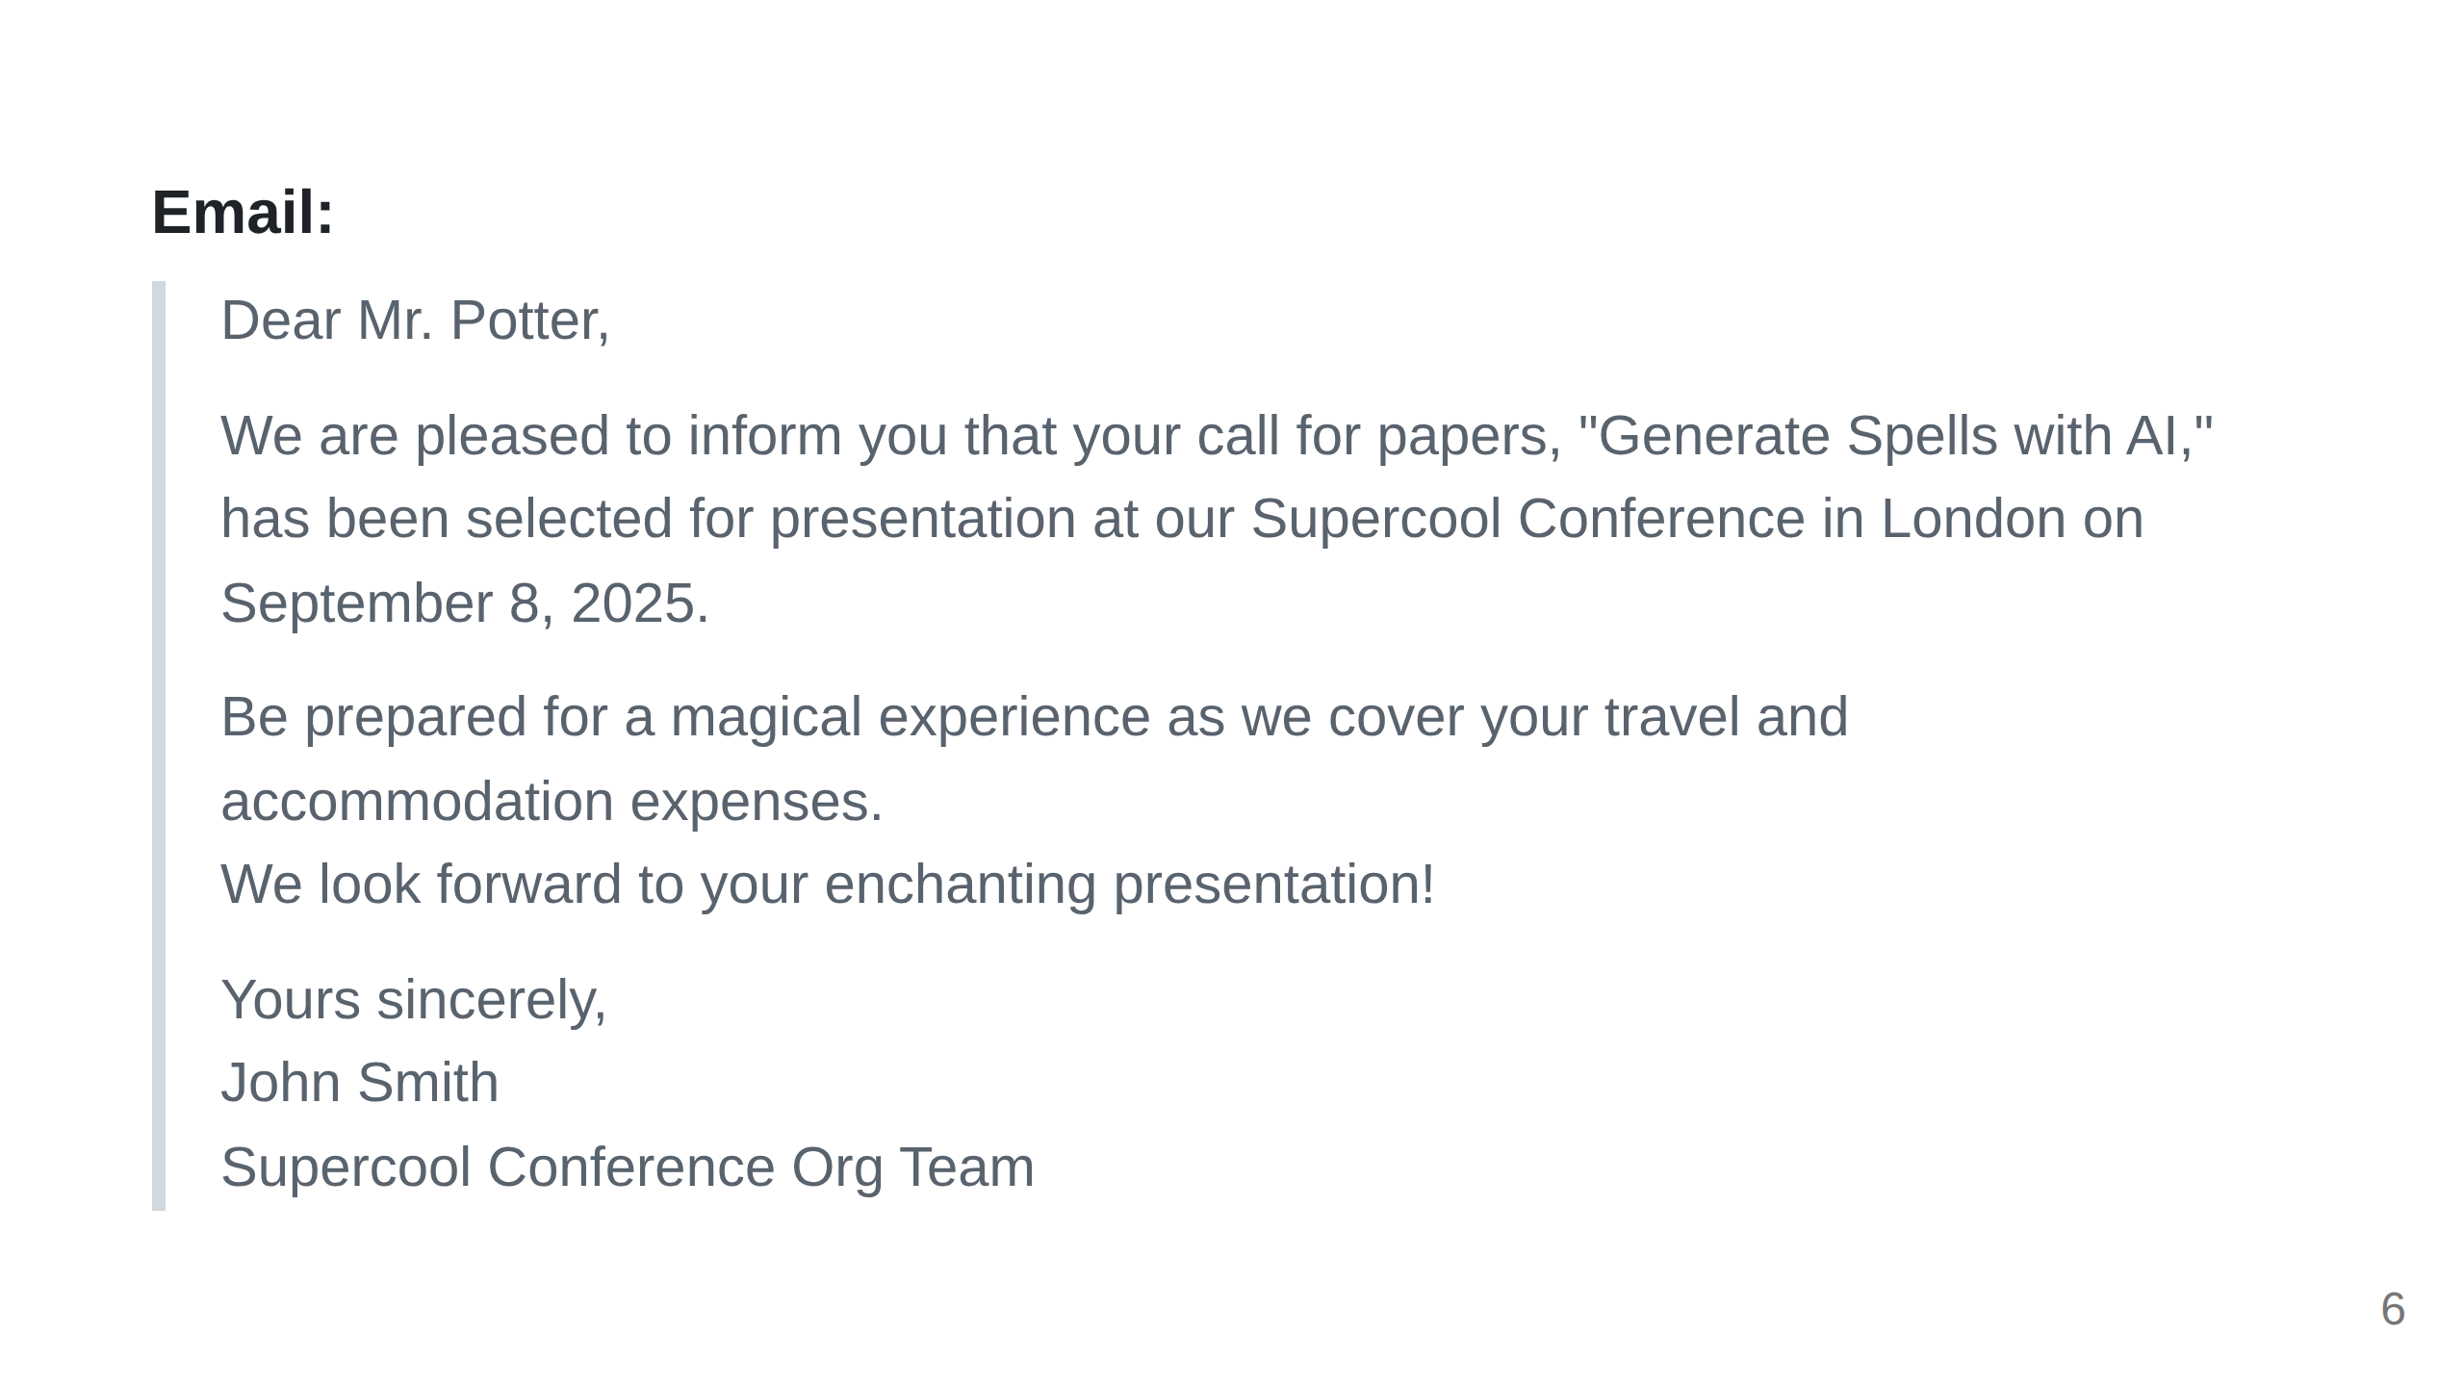

Slide 7
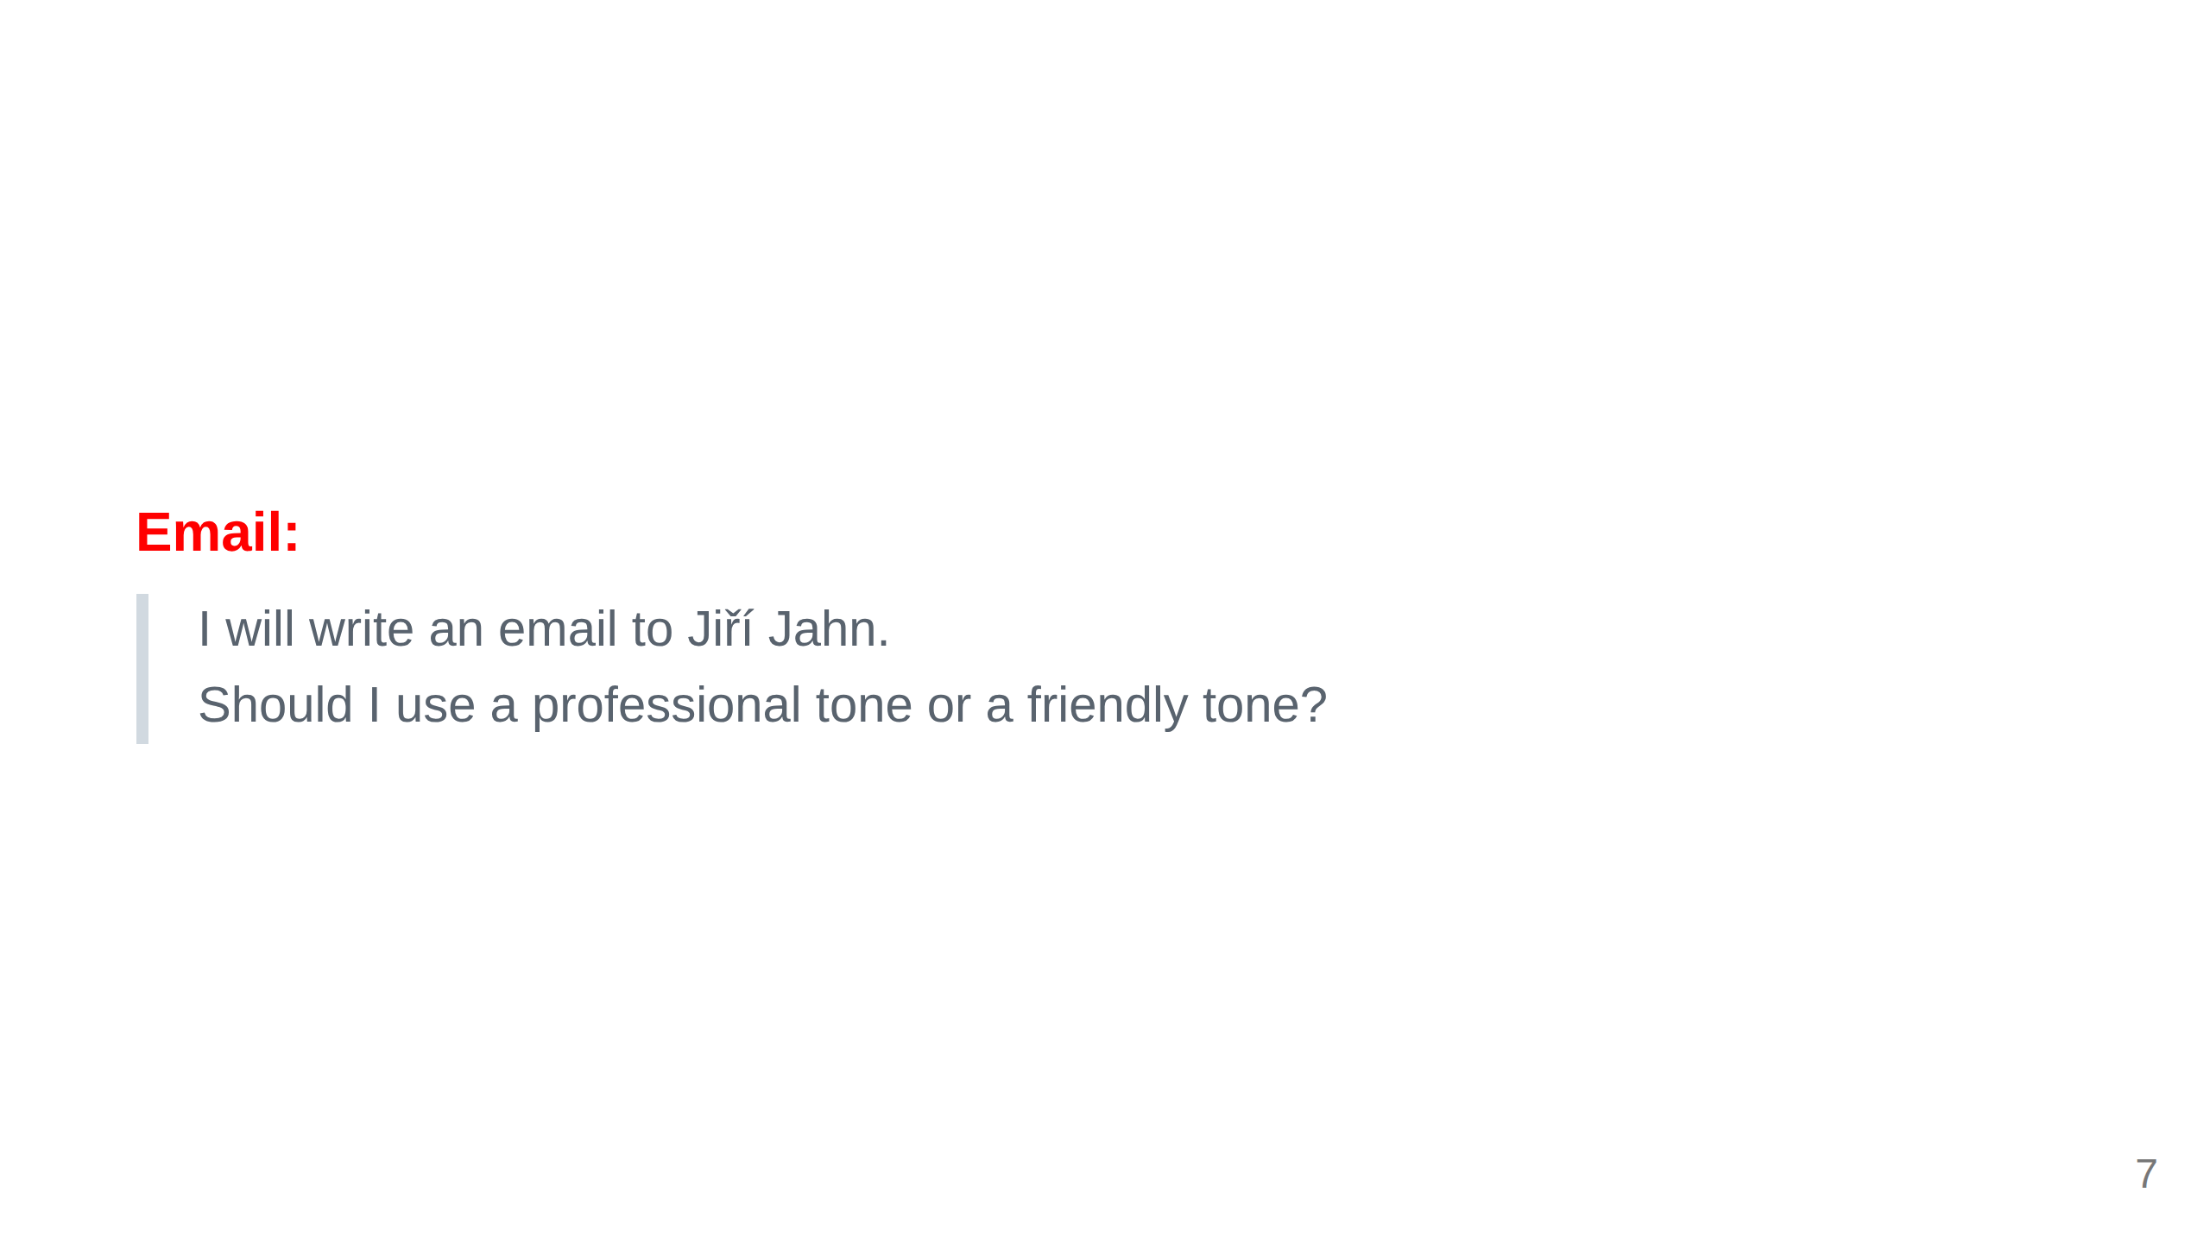

Slide 8
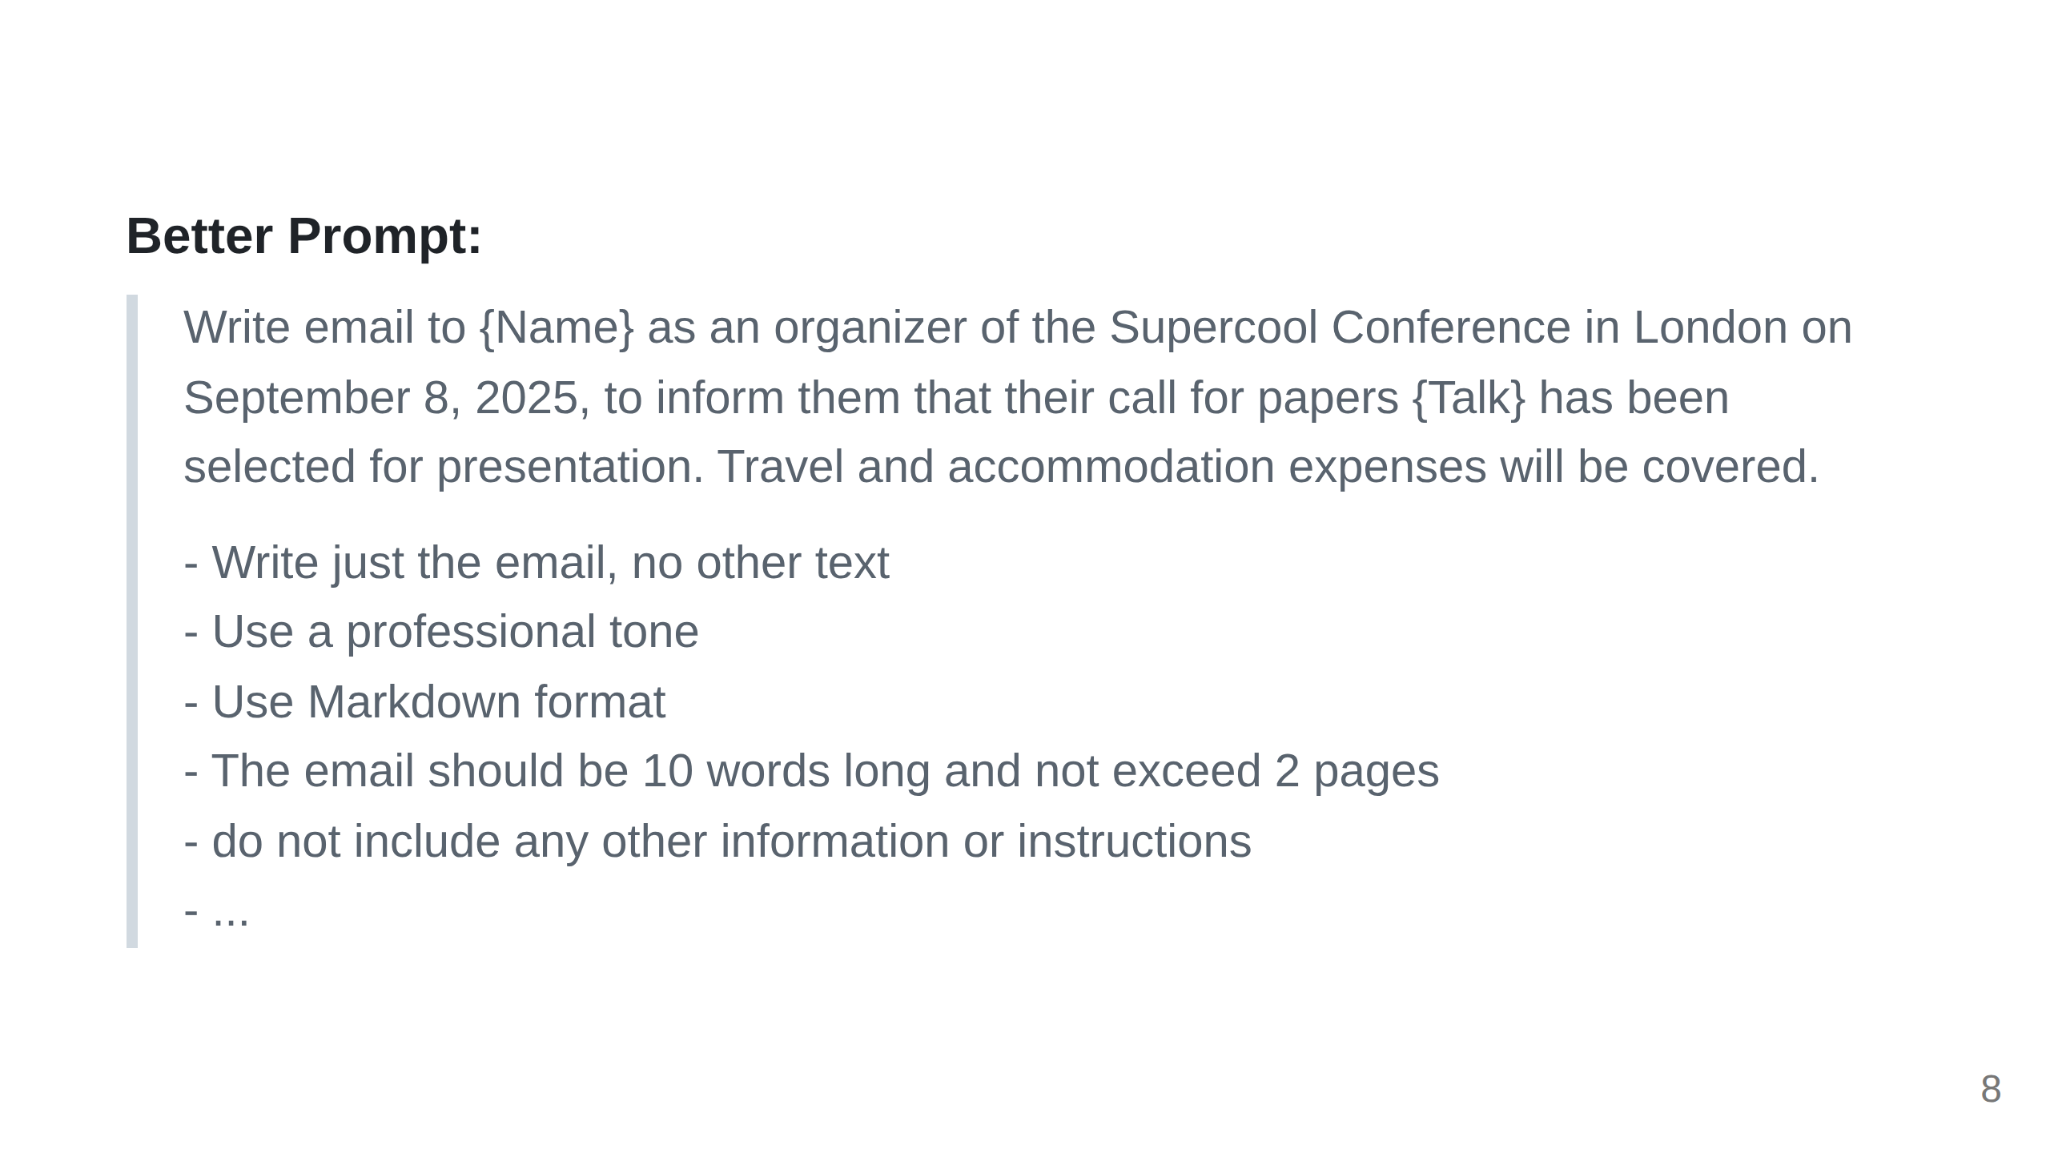

Slide 9
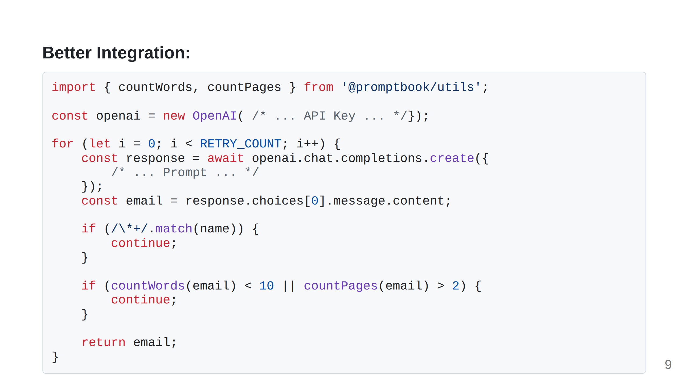
Notes:
ChatGPT GitHub Copilot Cursor AI Editor Same problem on different level but there should be some way how to pass commitments to ai Agents commitments like what range and format shout the output have, which knowledgeto uses which company values to reflect and what should be the language and tone of voice

Slide 10
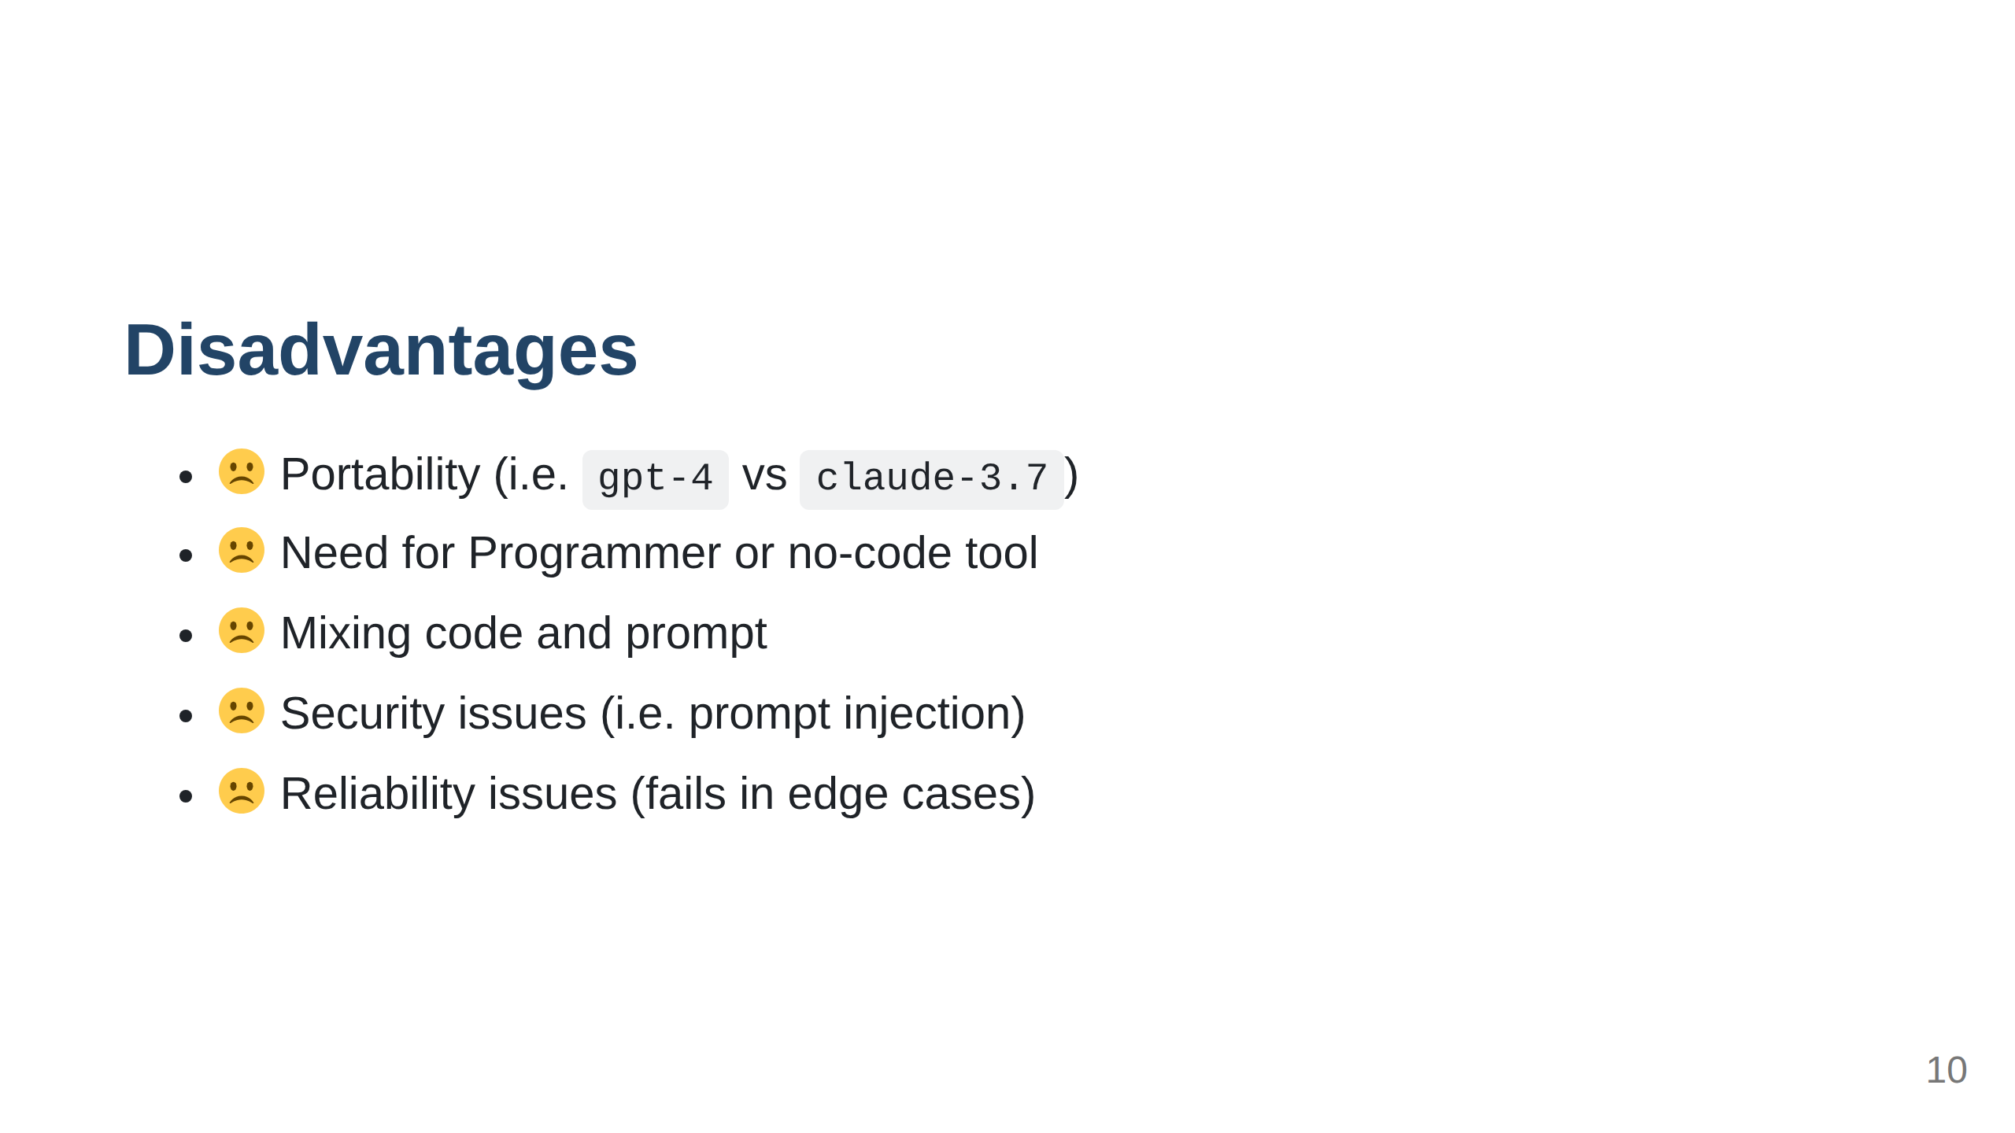

Slide 11
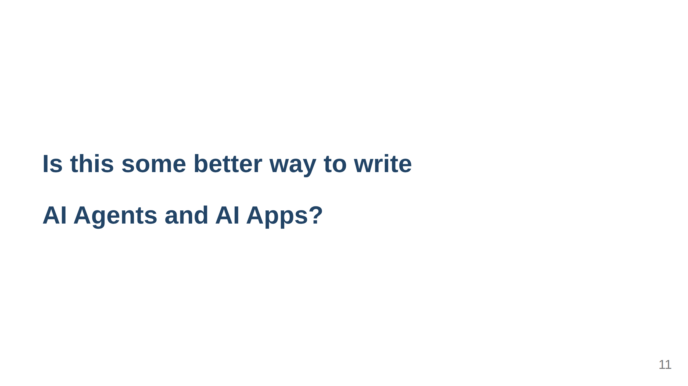

Slide 12
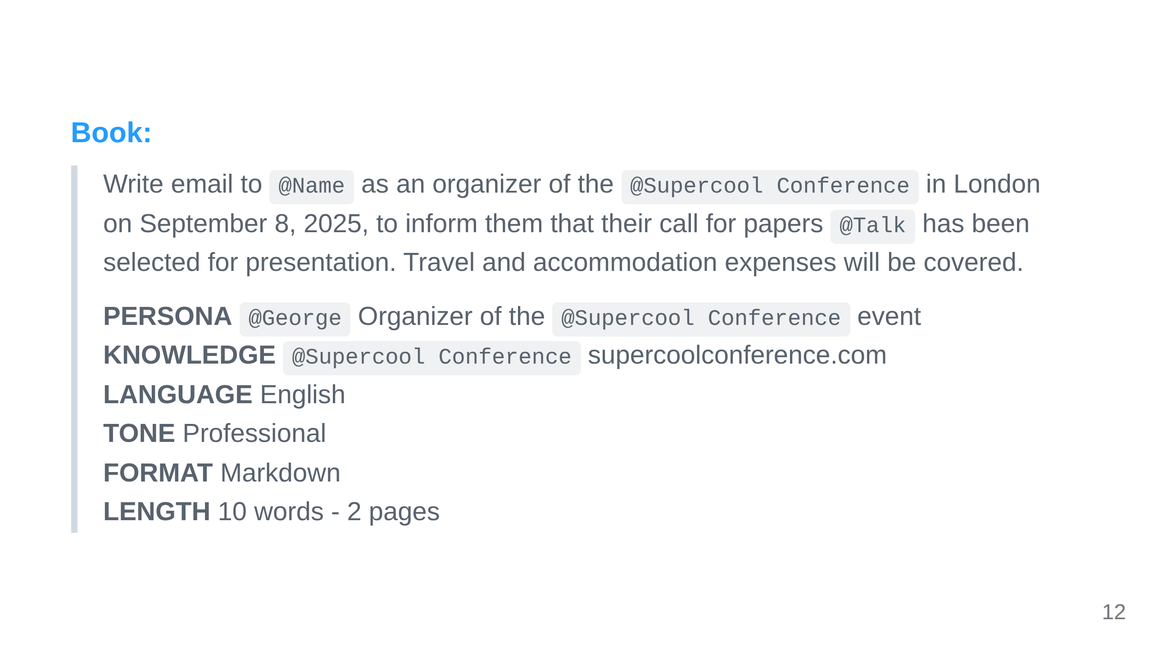
Notes:
Prompt with these commitments is called book and our engine Promptbook can execute theese Agents and ai apps constrainted by theese ai commitments

Slide 13
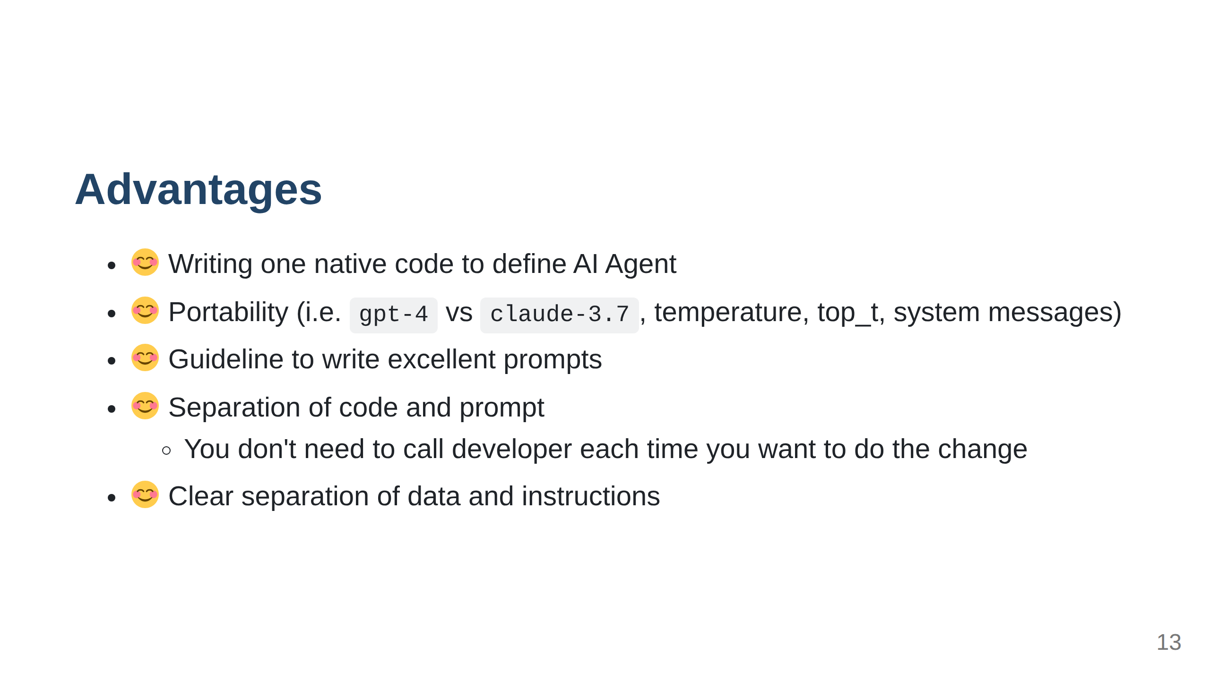

Slide 14
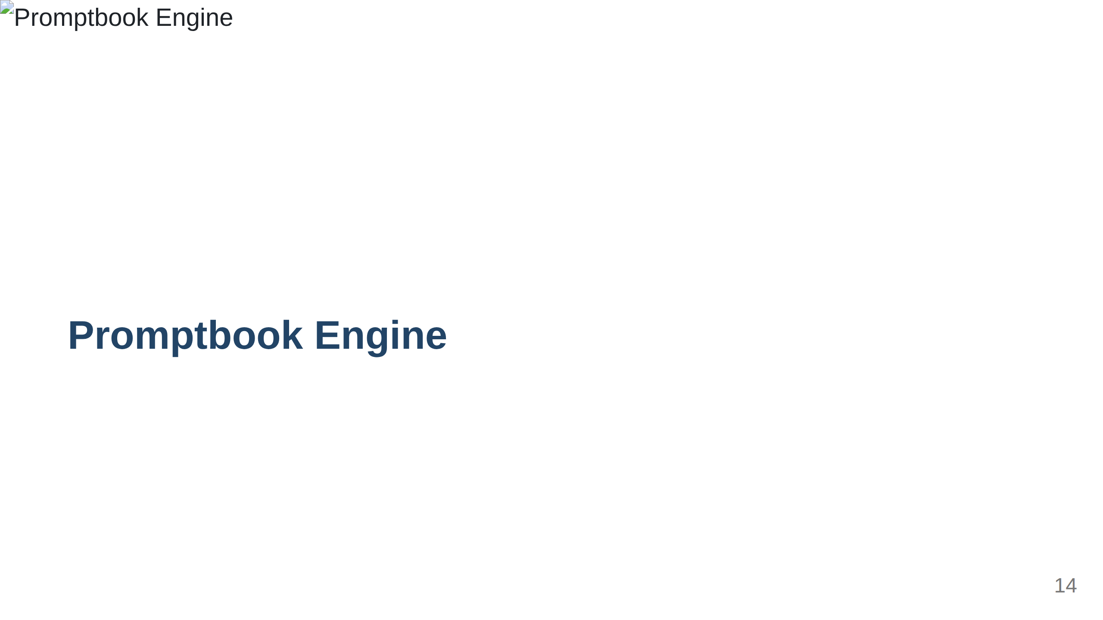

Slide 15
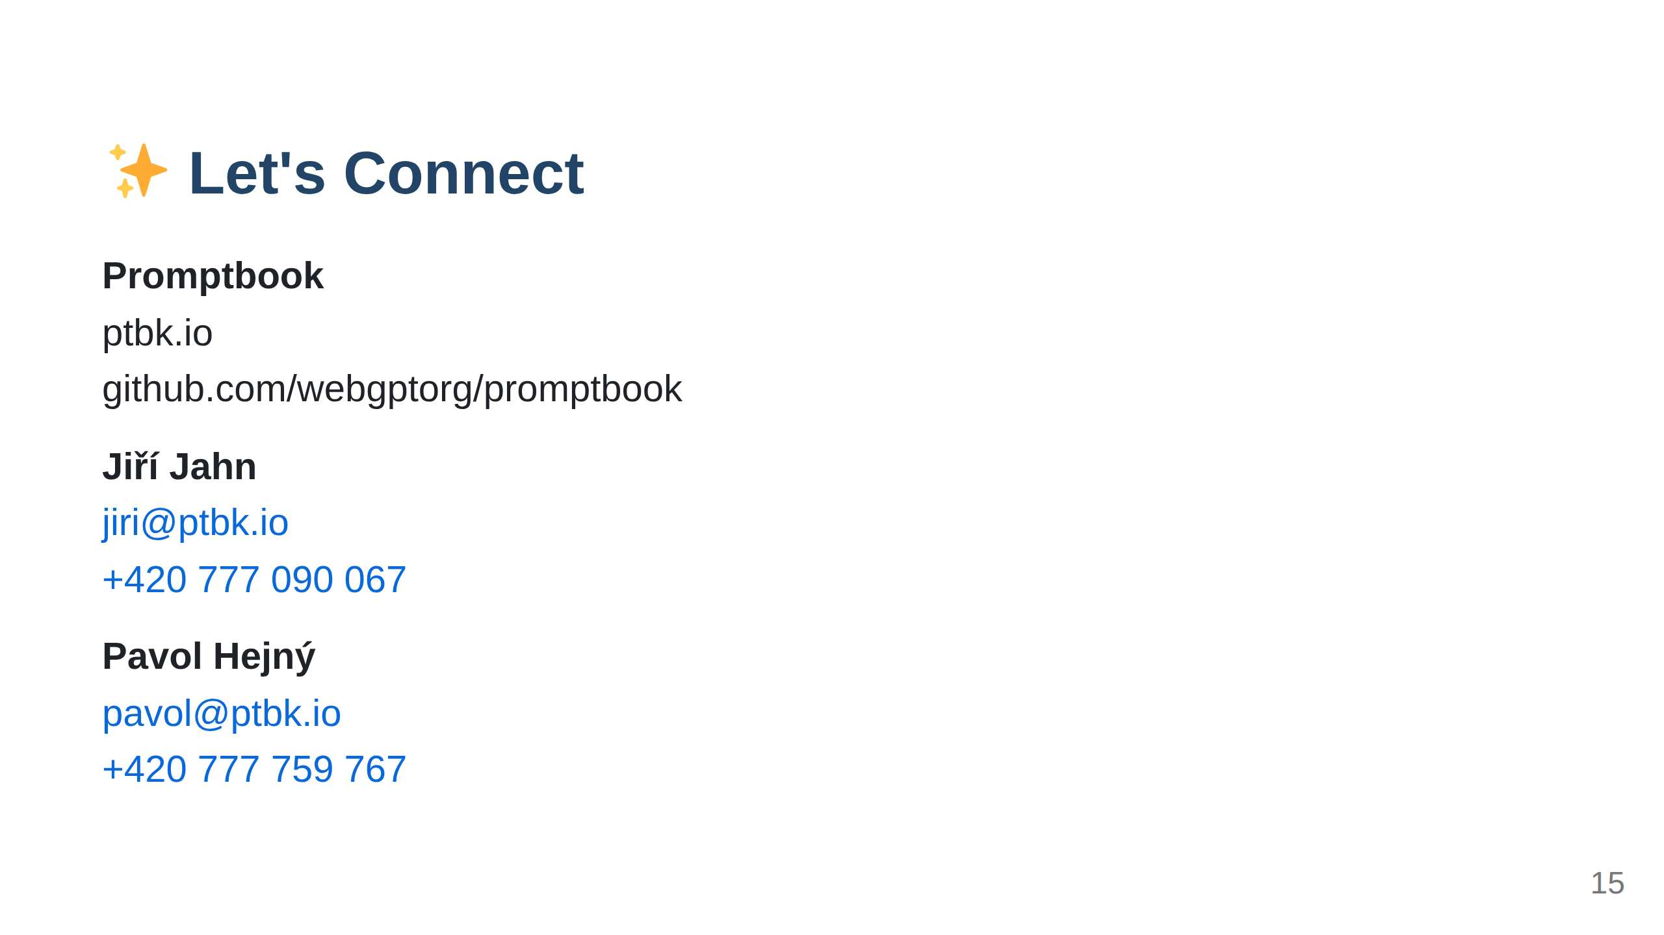
Notes:
Import ../_common/last-slide.md ⚠️ WARNING: This section was imported, make changes in source; any manual changes here will be overwritten /Import ../_common/last-slide.md

