Slide 1
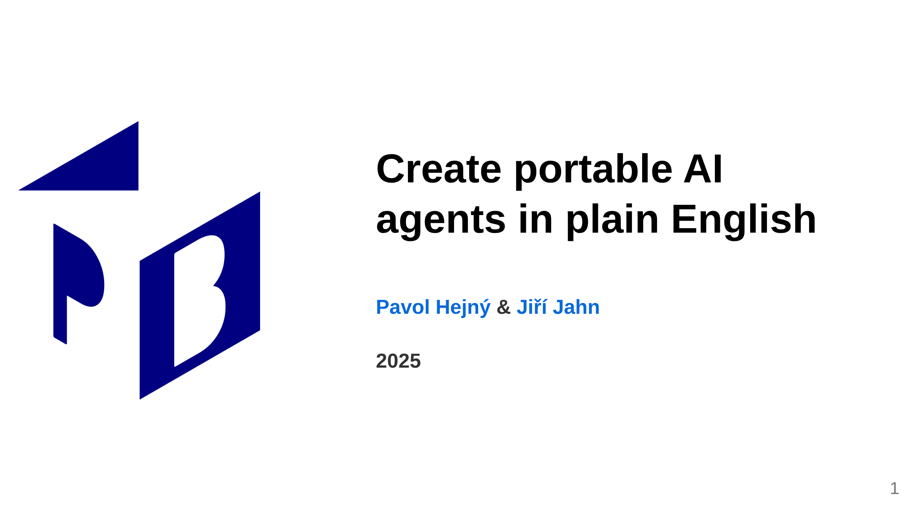
Notes:
<- TODO: Kajetán: More business, less technical

Slide 2
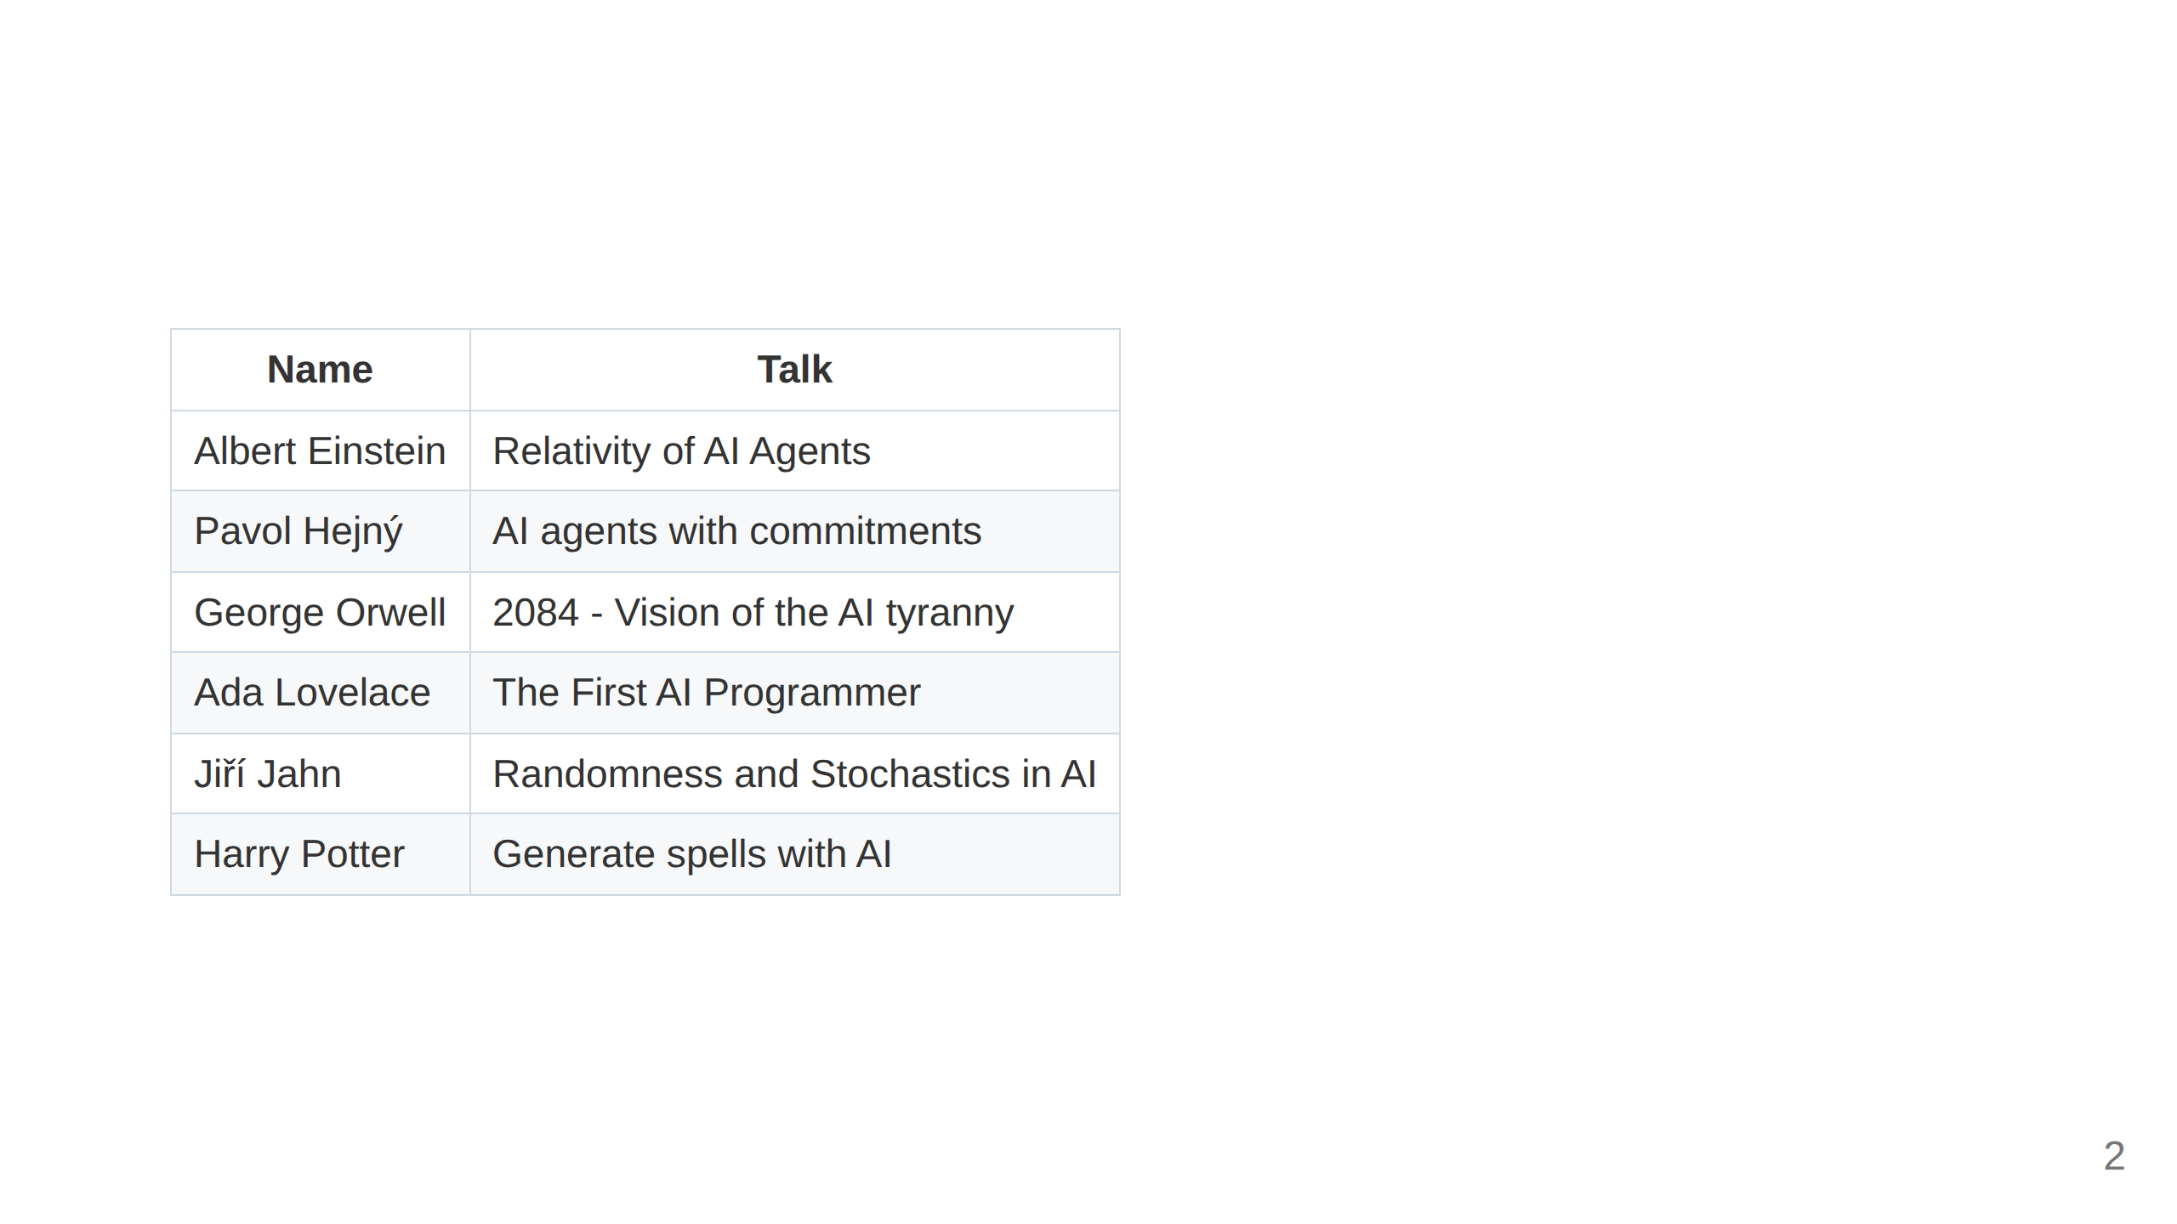

Slide 3
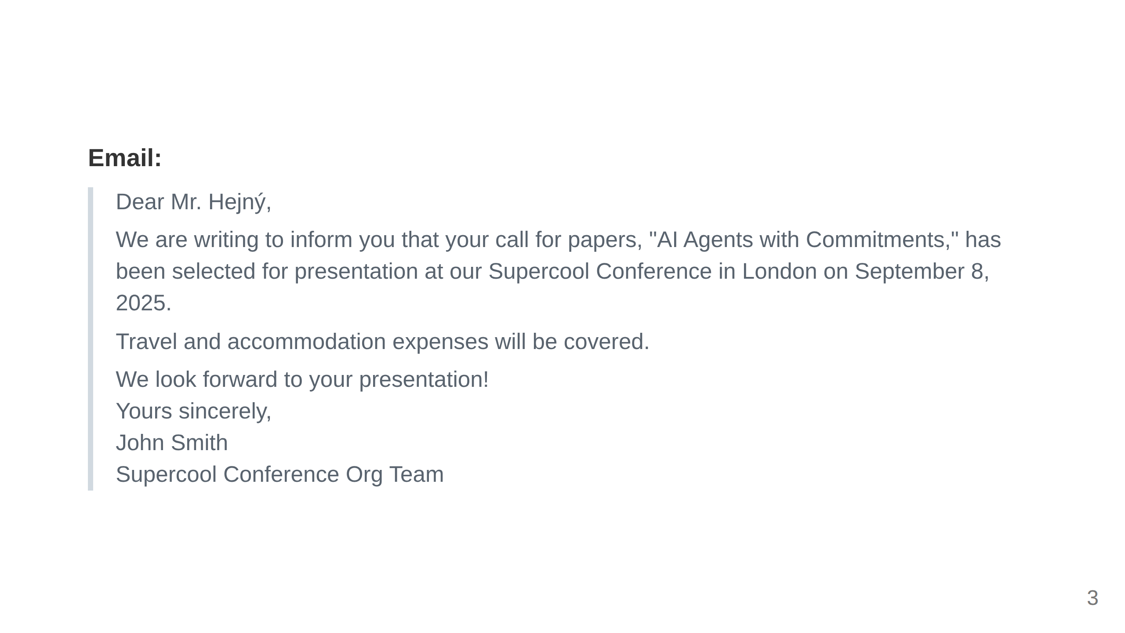

Slide 4
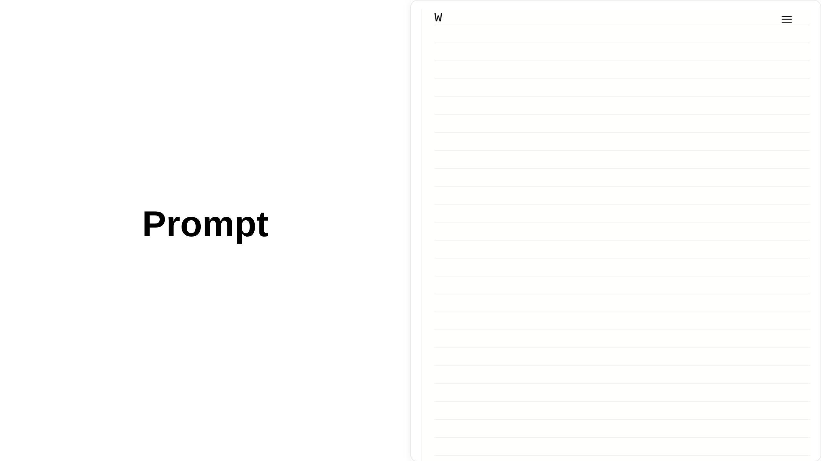
Notes:
<- TODO: !!! Do not render failed books, replace 1081 -> 1080

Slide 5
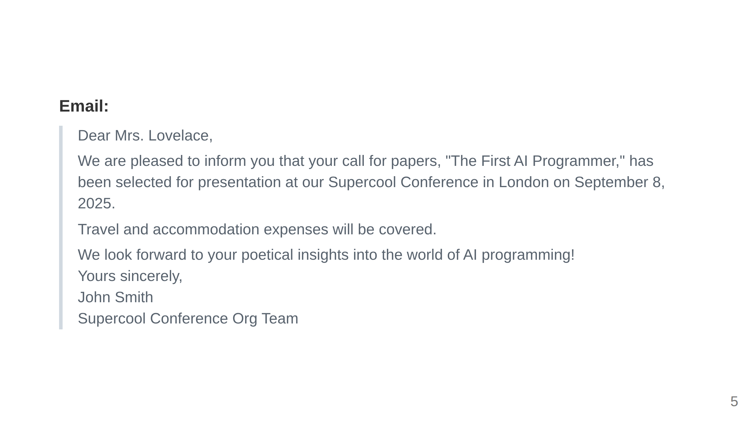

Slide 6
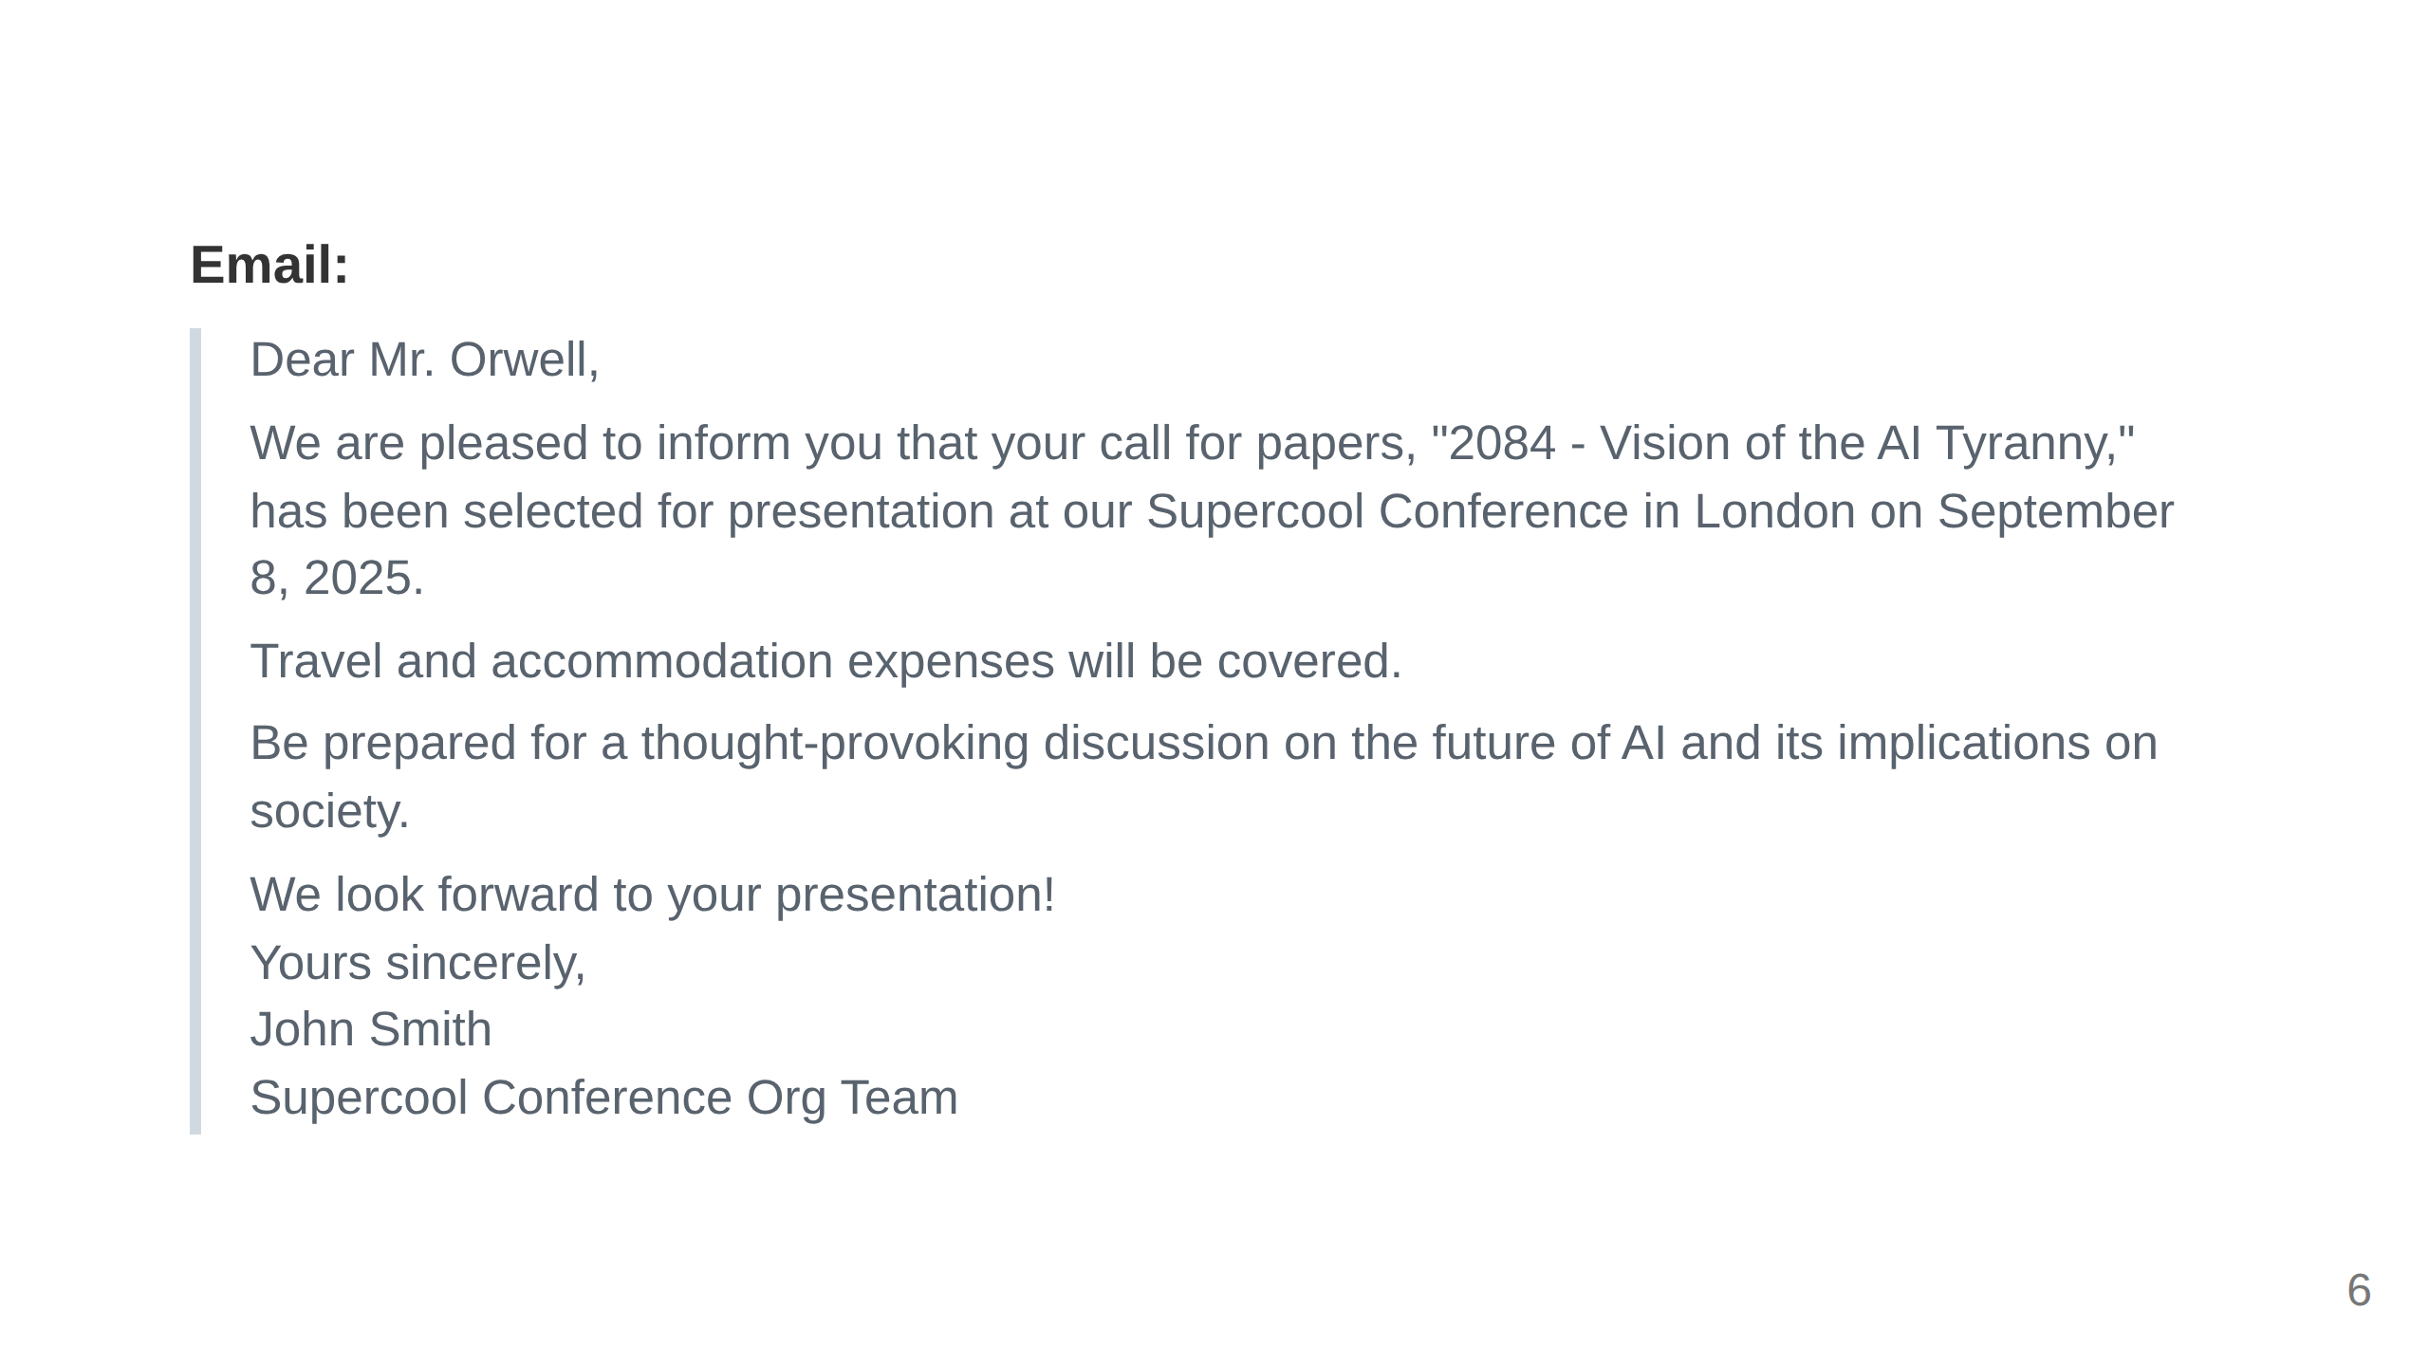

Slide 7
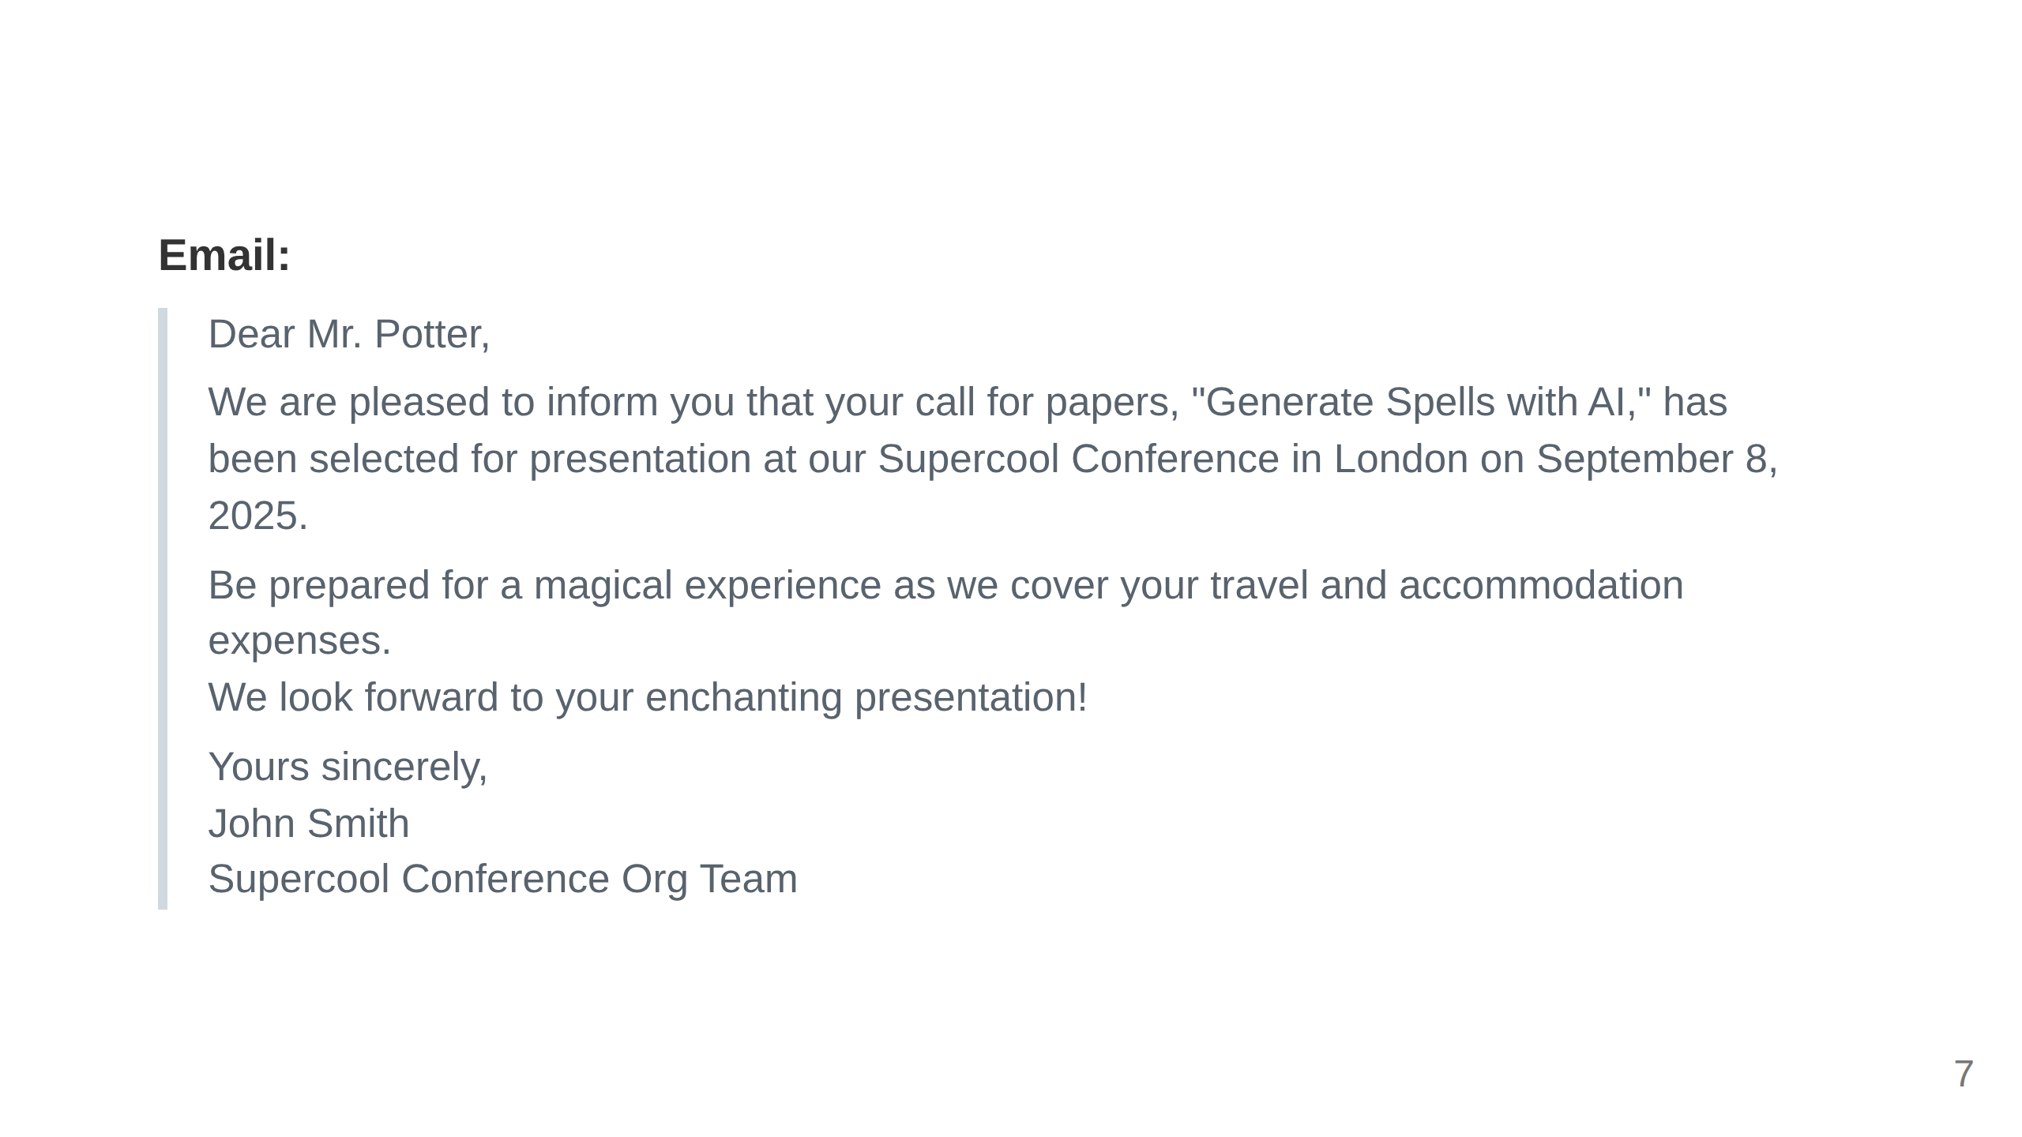

Slide 8
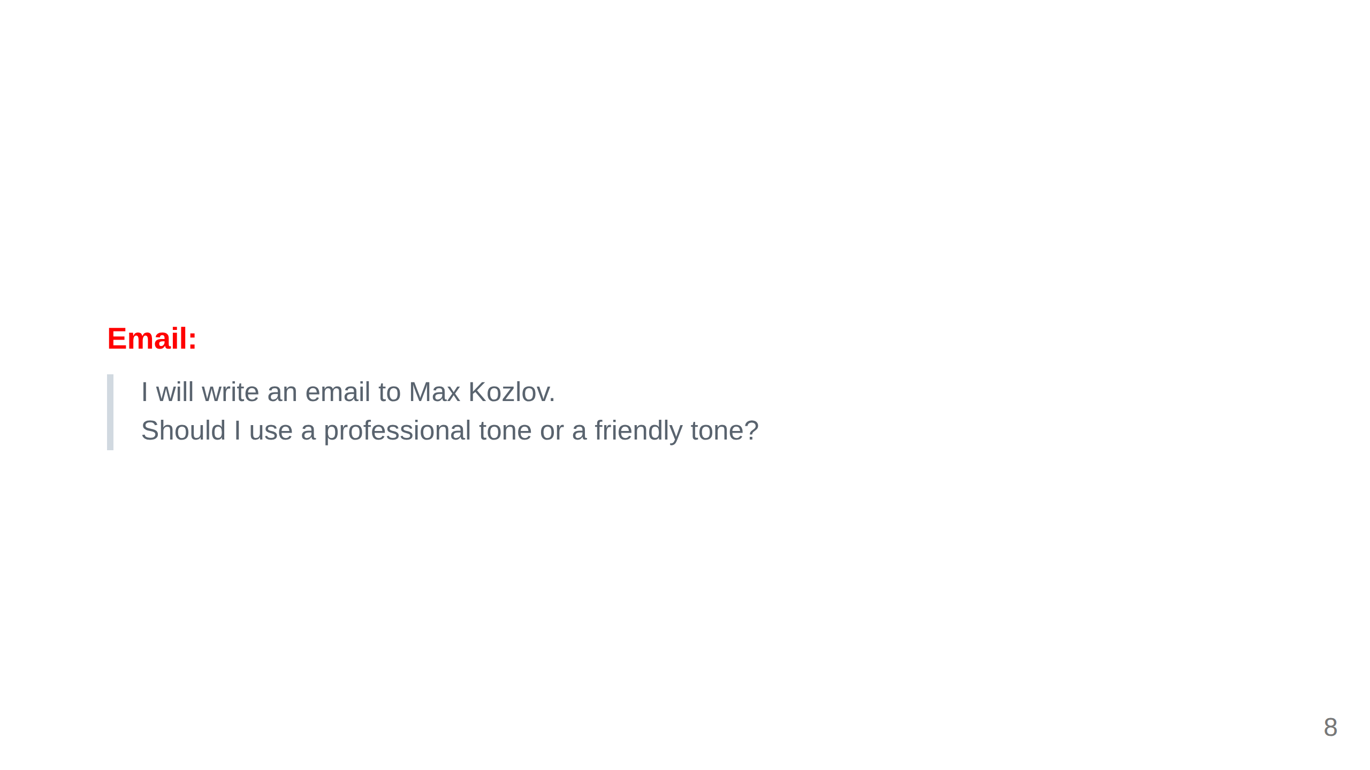

Slide 9
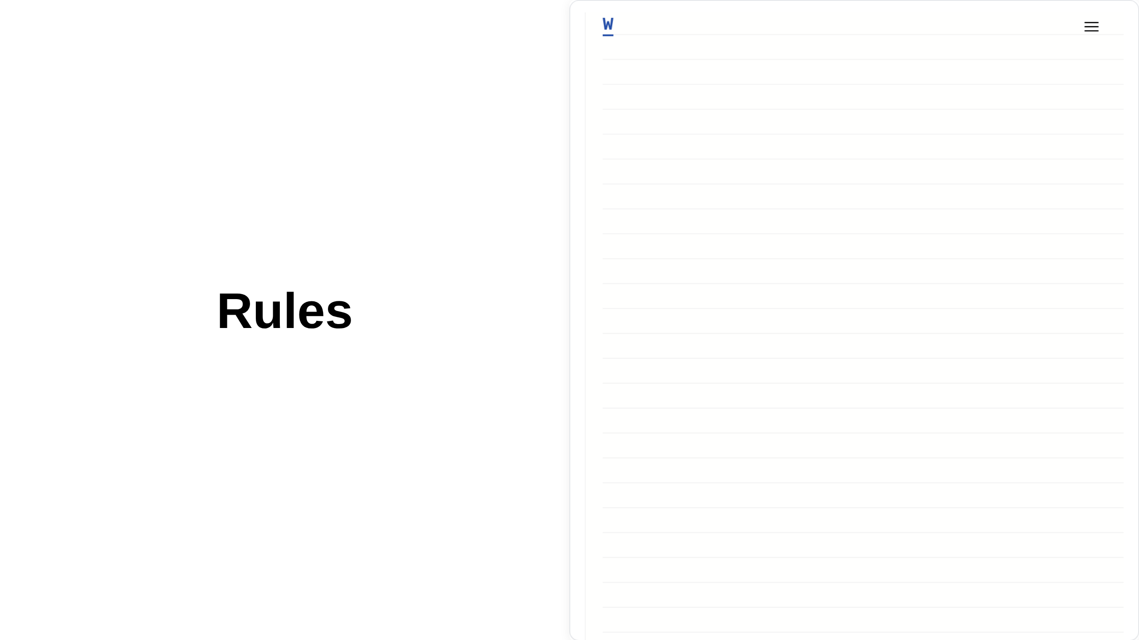

Slide 10
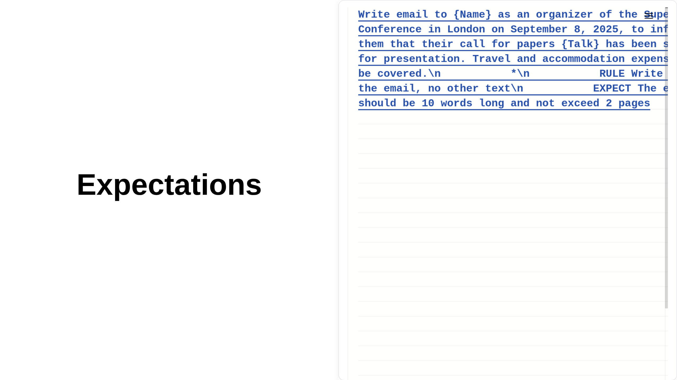

Slide 11
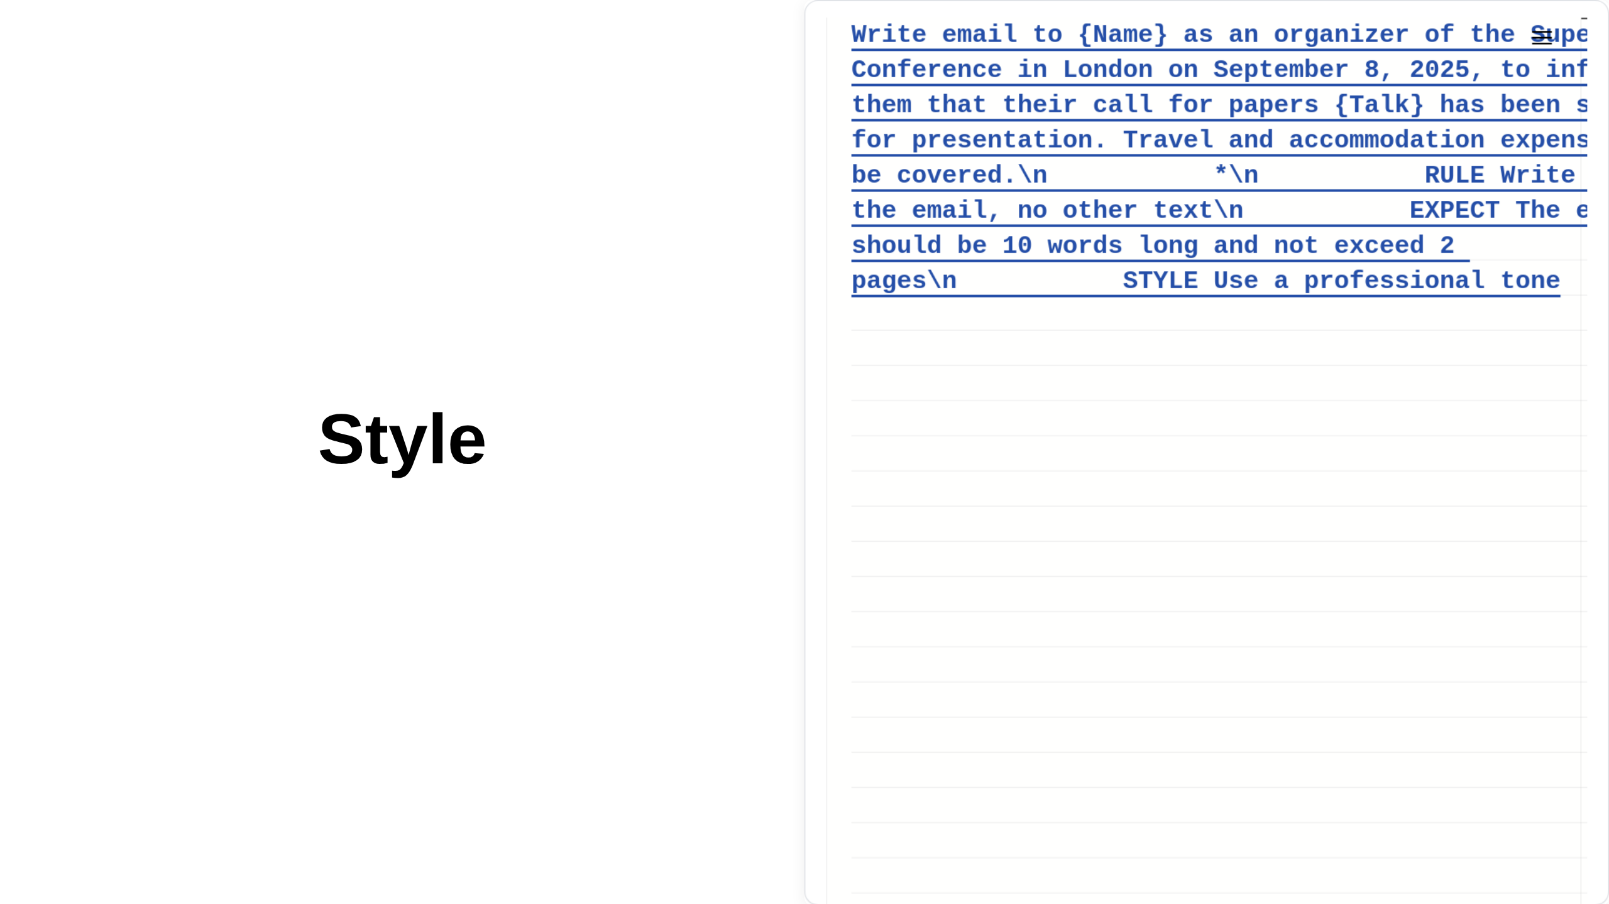

Slide 12
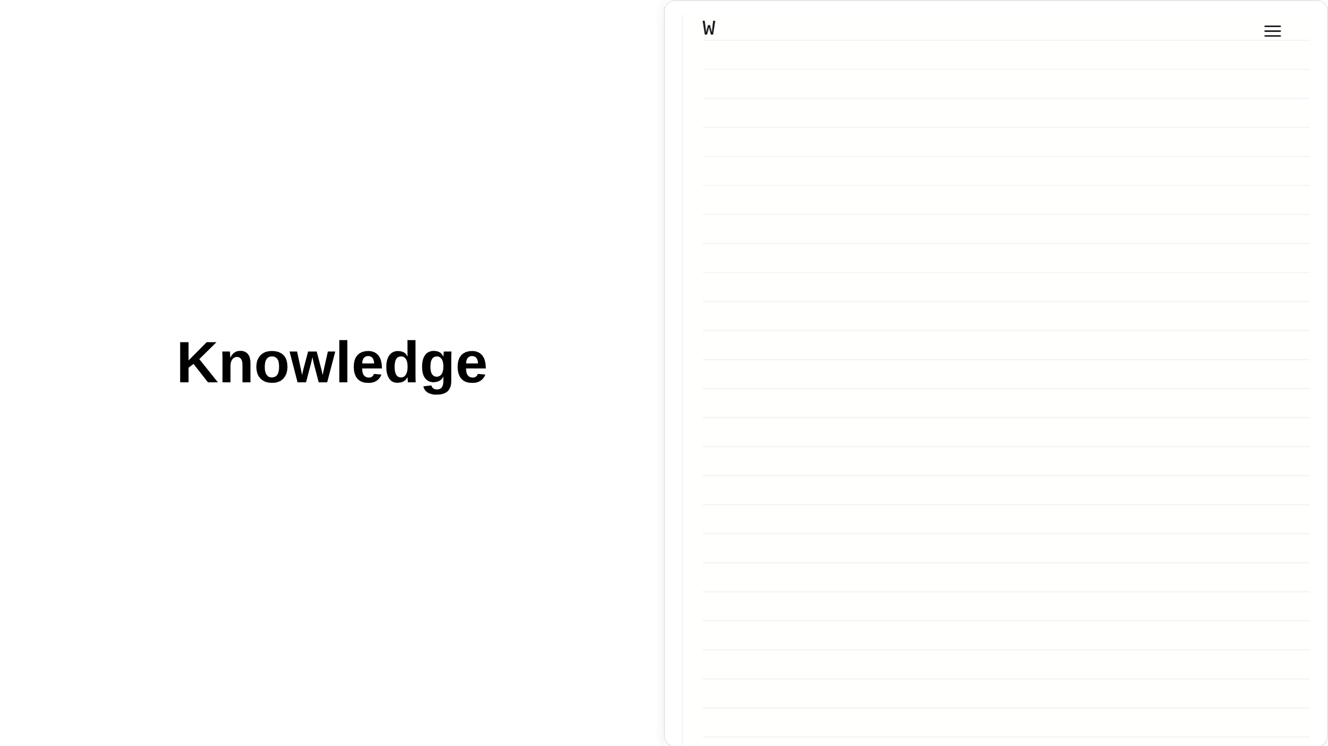

Slide 13
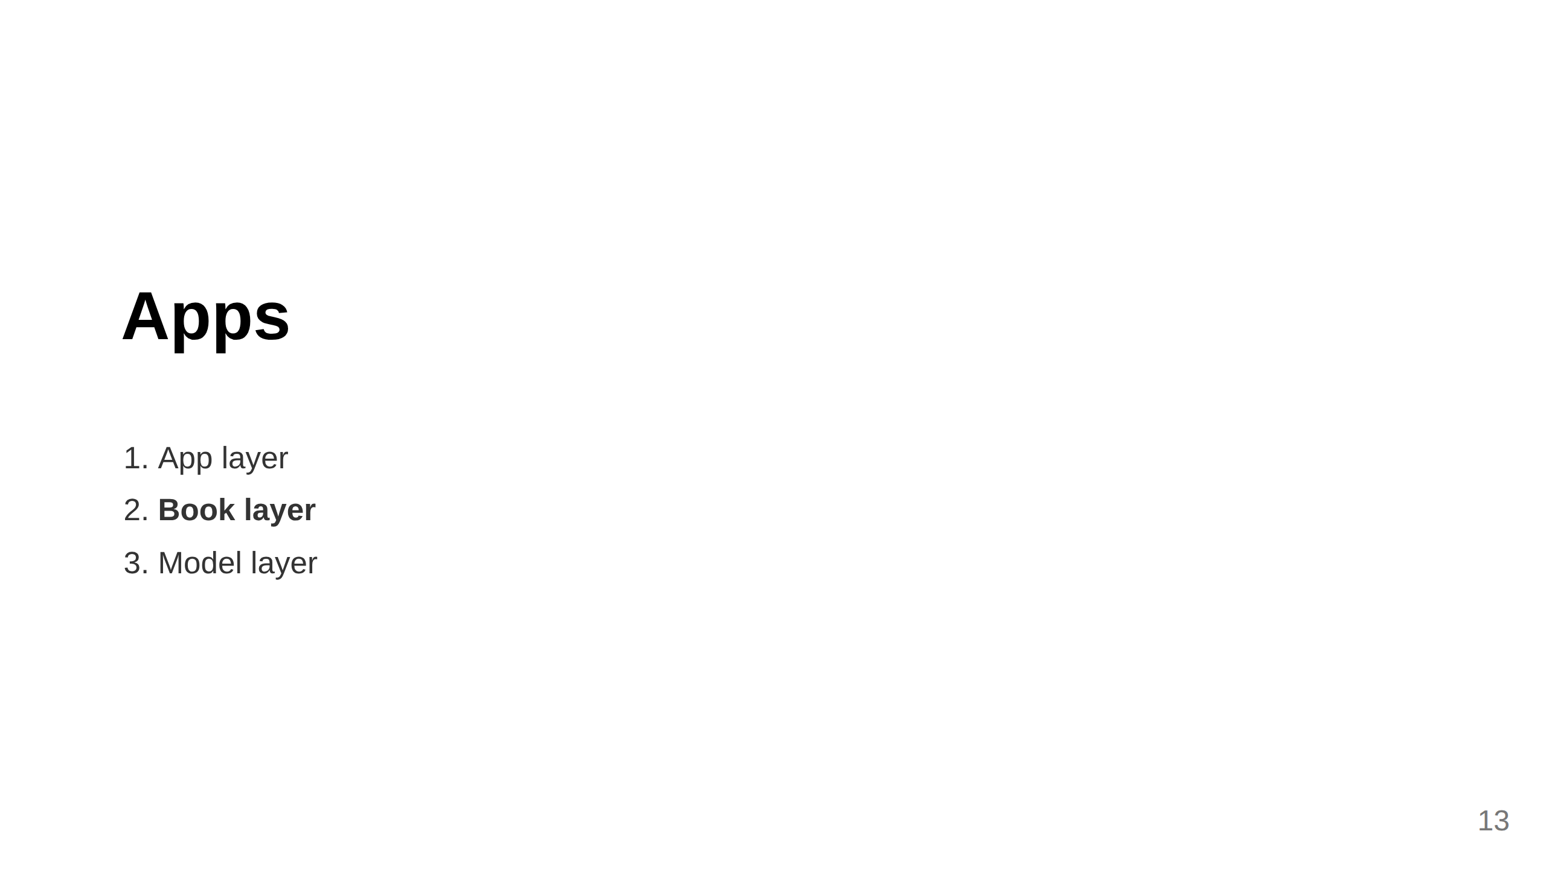

Slide 14
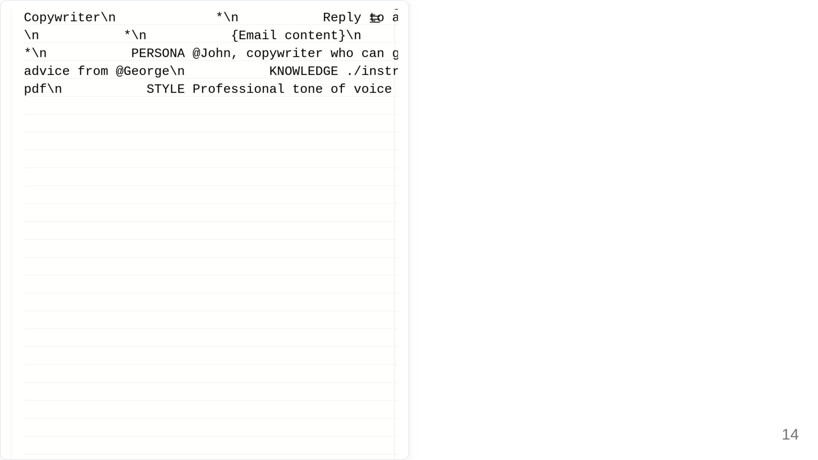

Slide 15
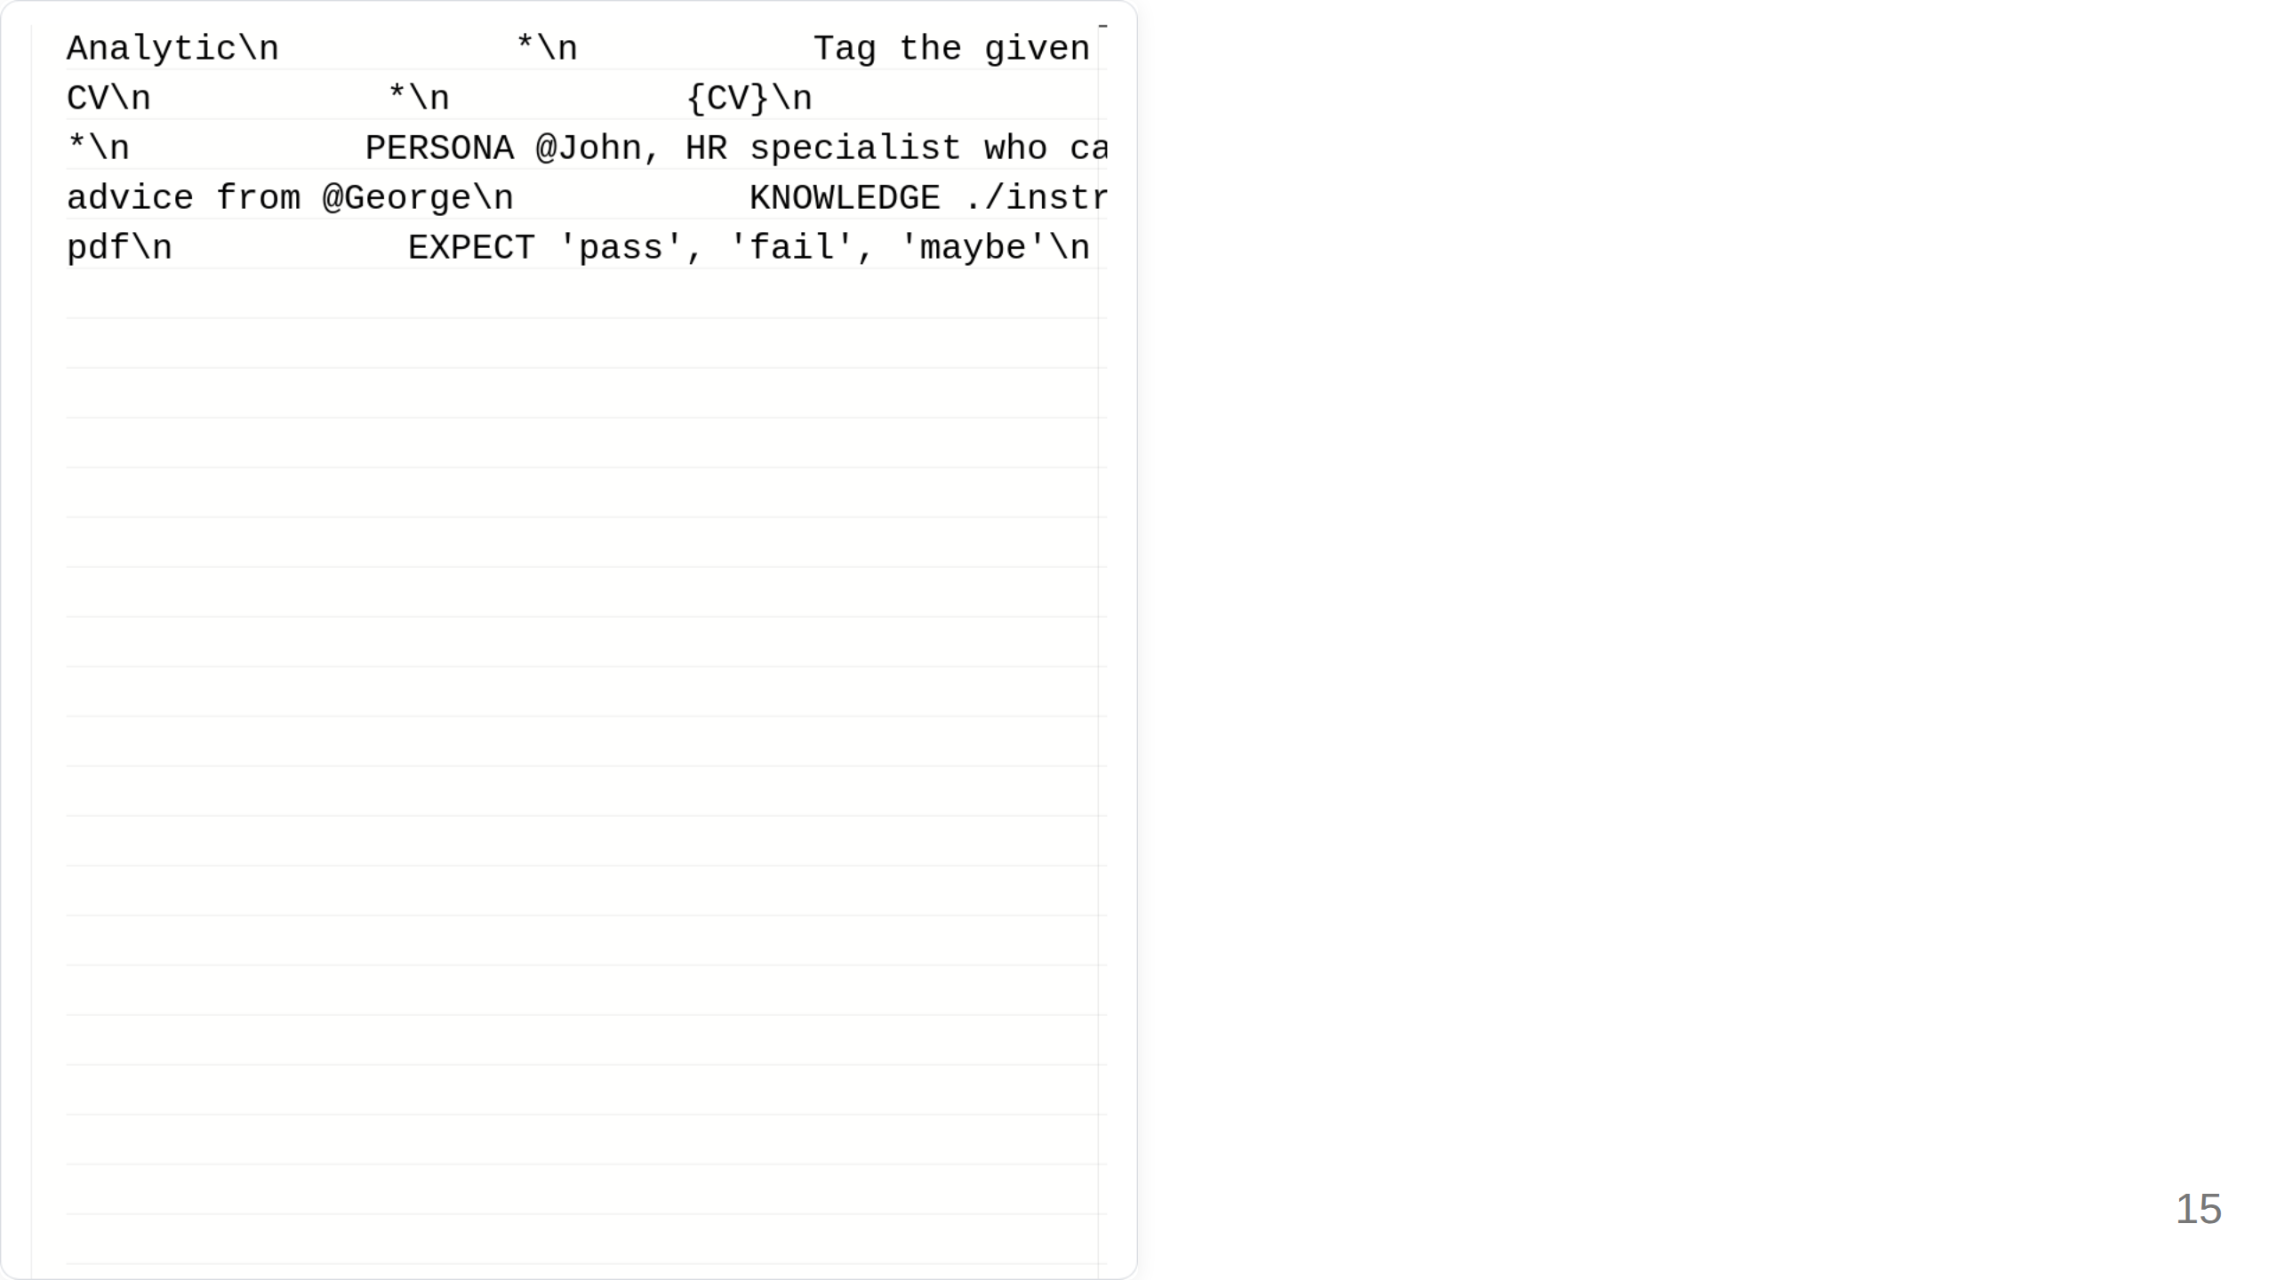

Slide 16
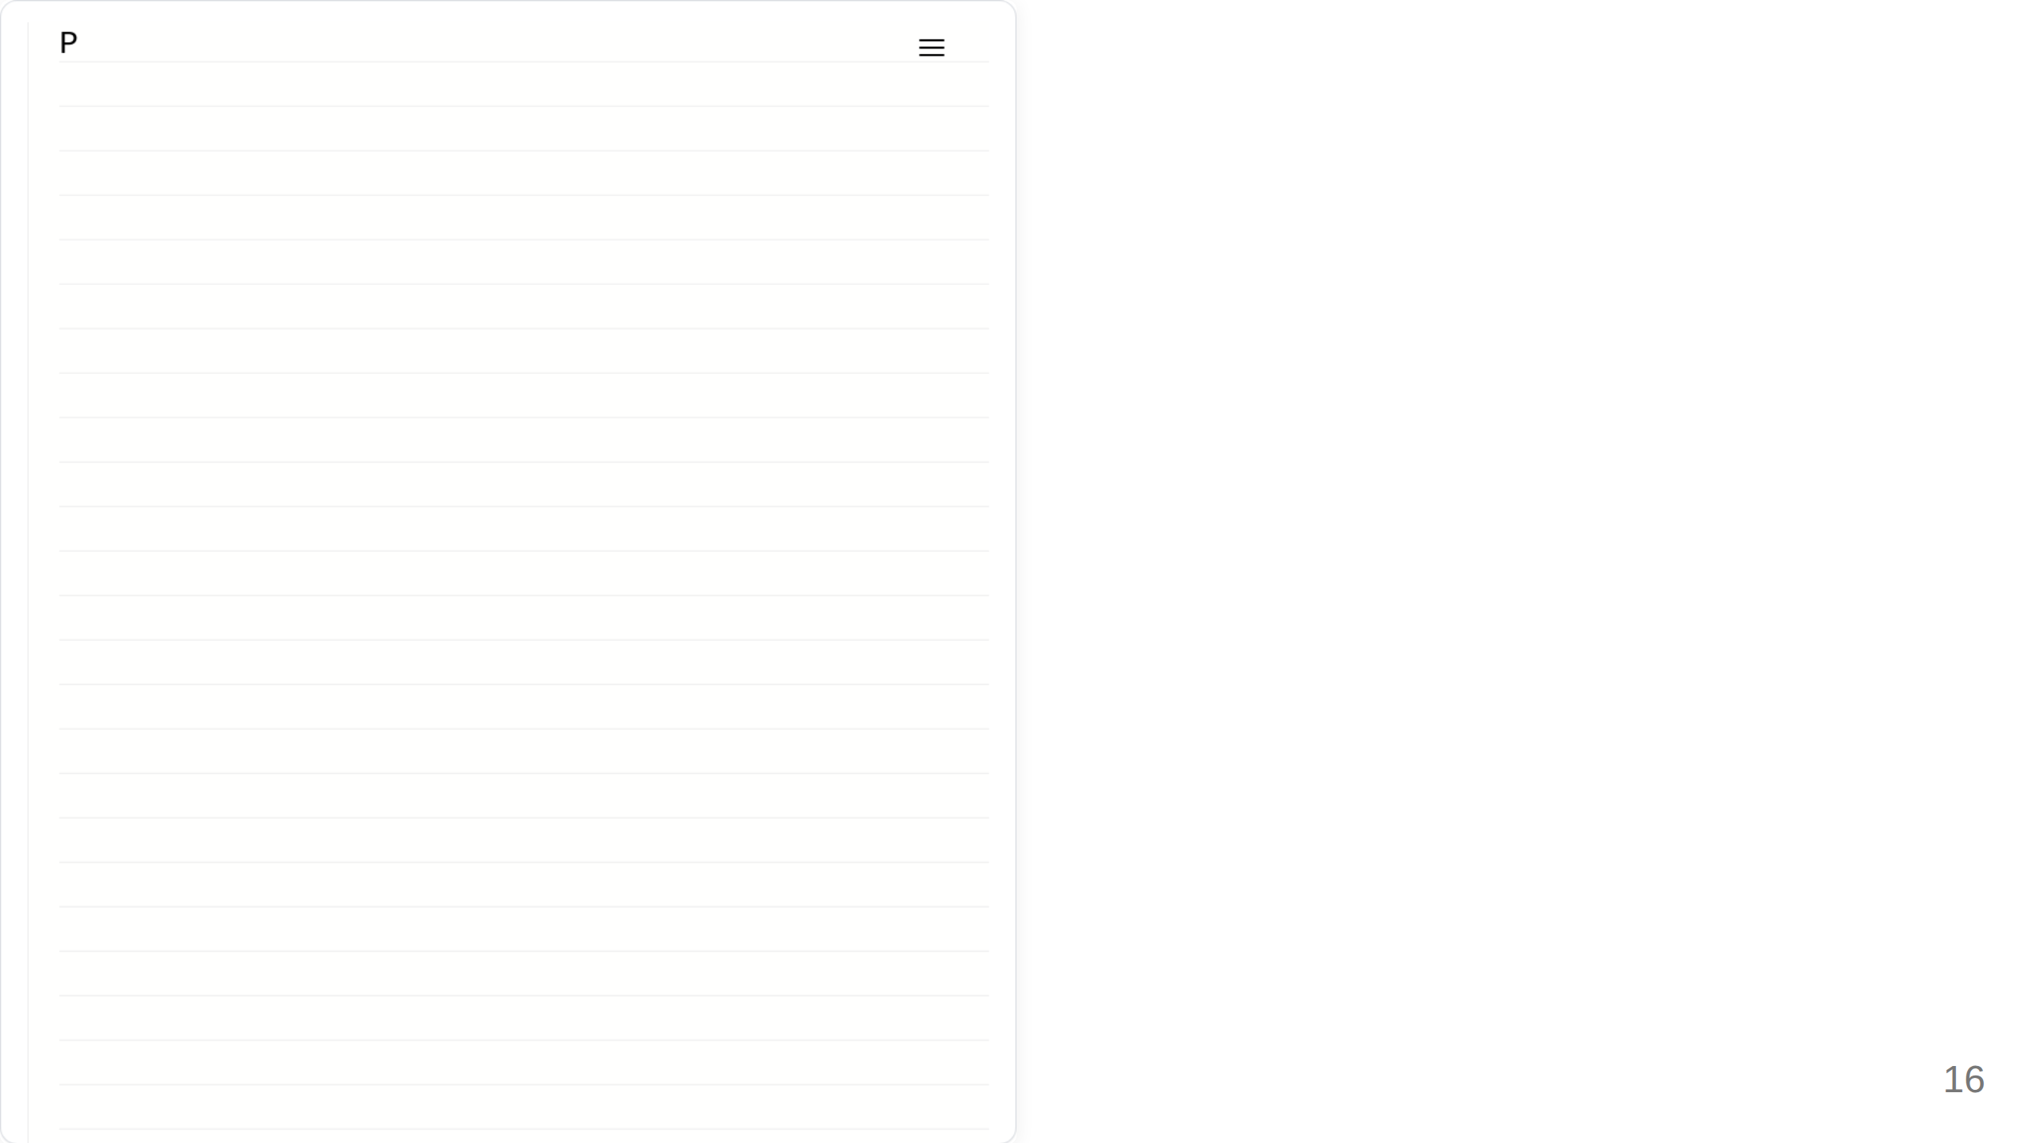

Slide 17
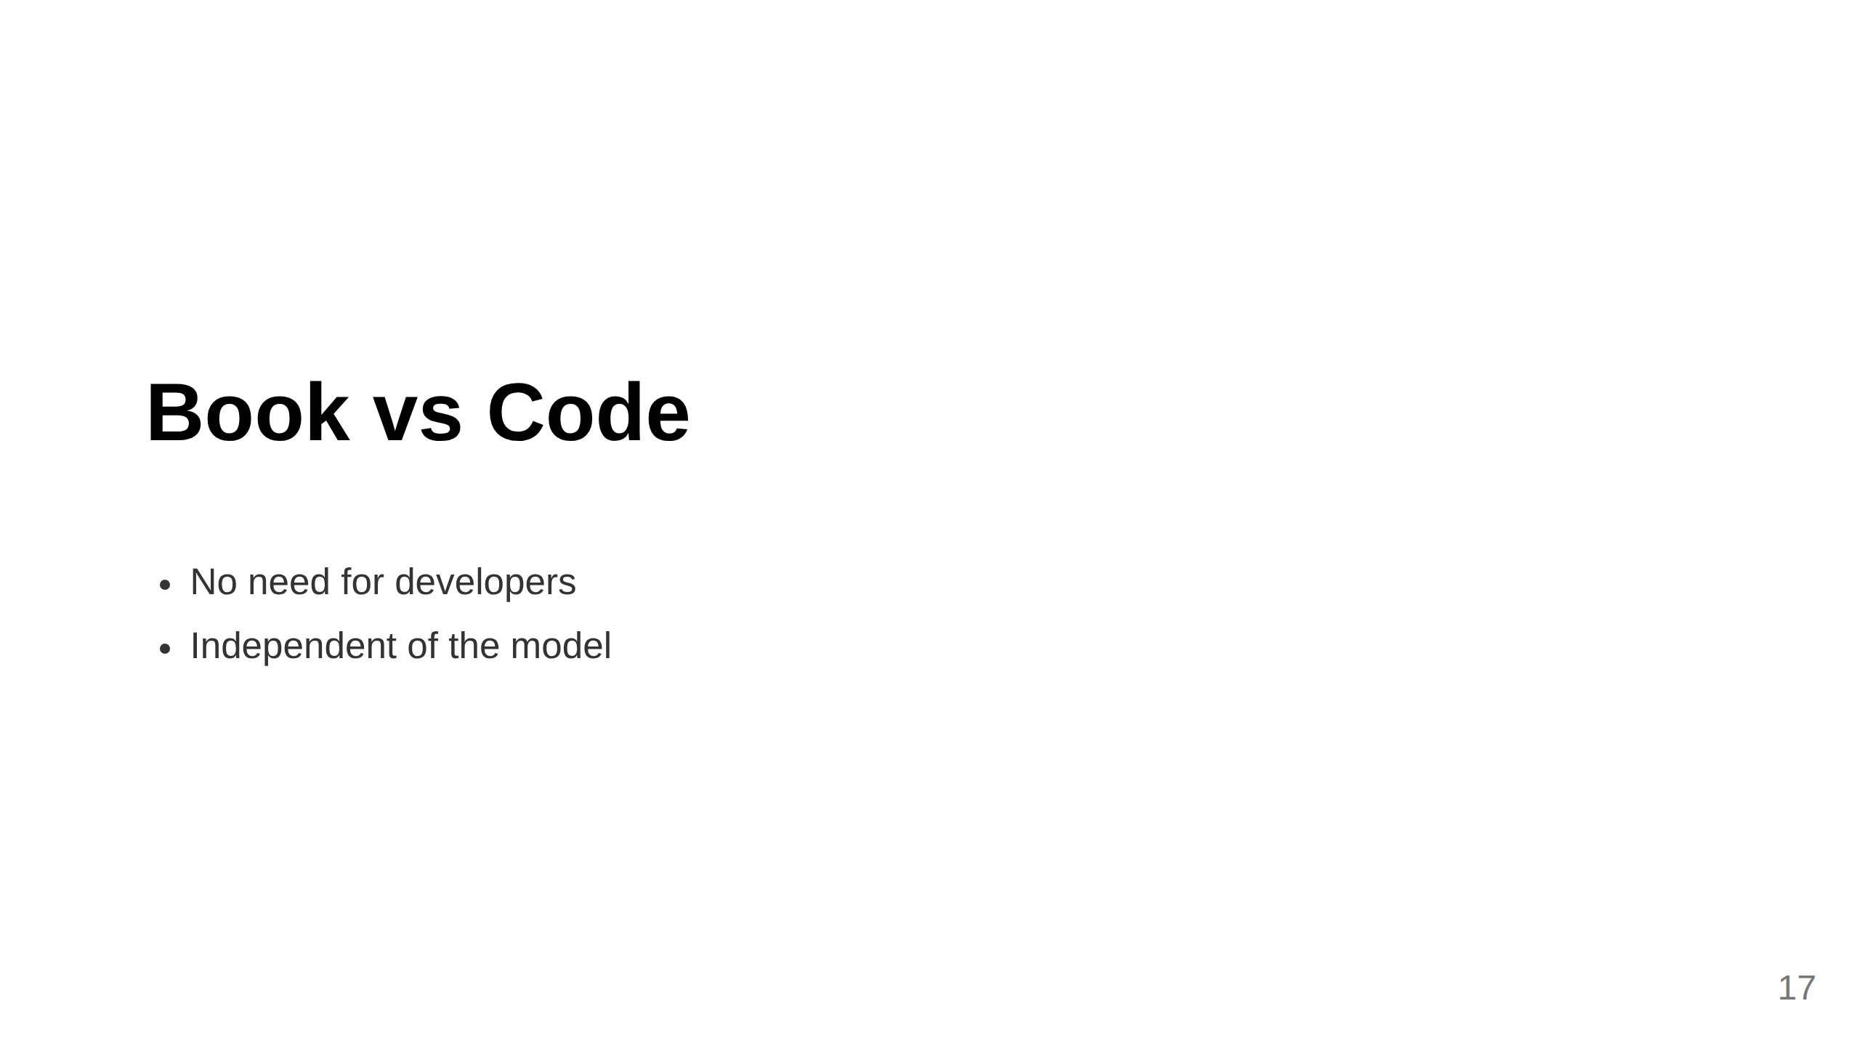

Slide 18
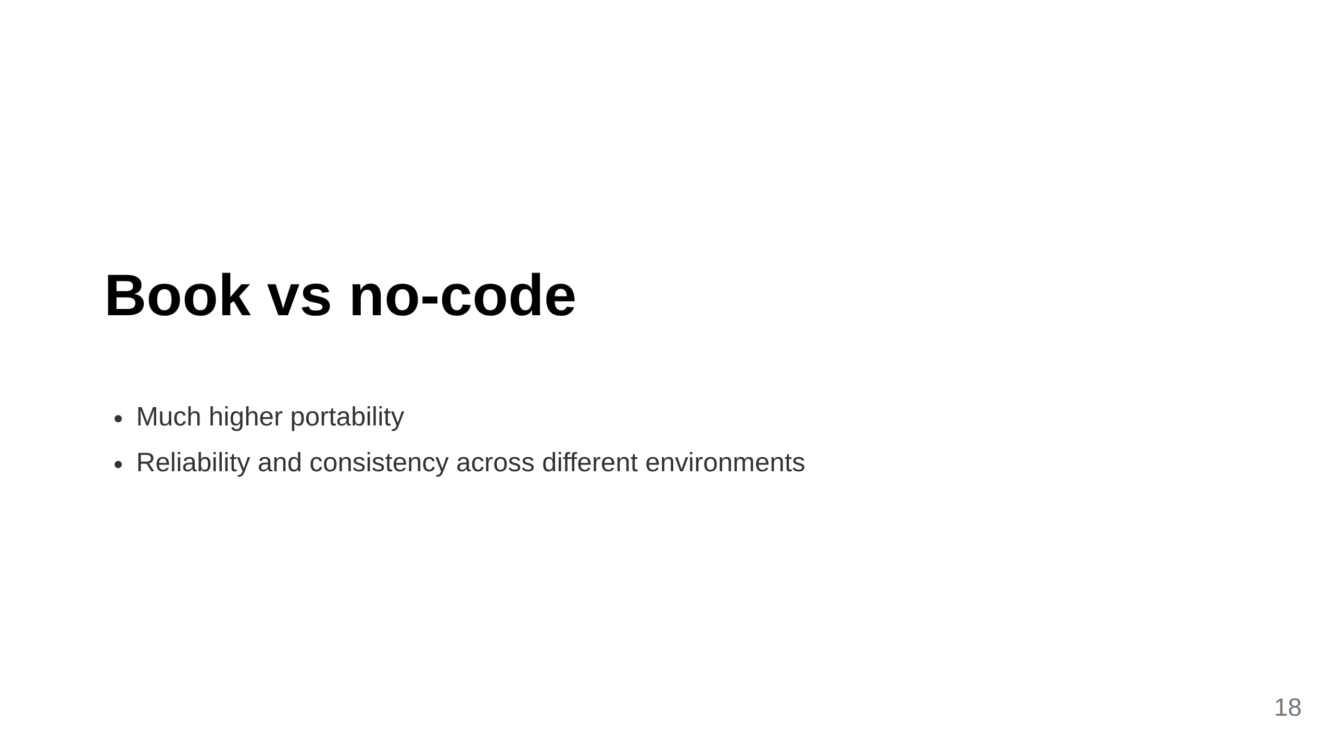

Slide 19
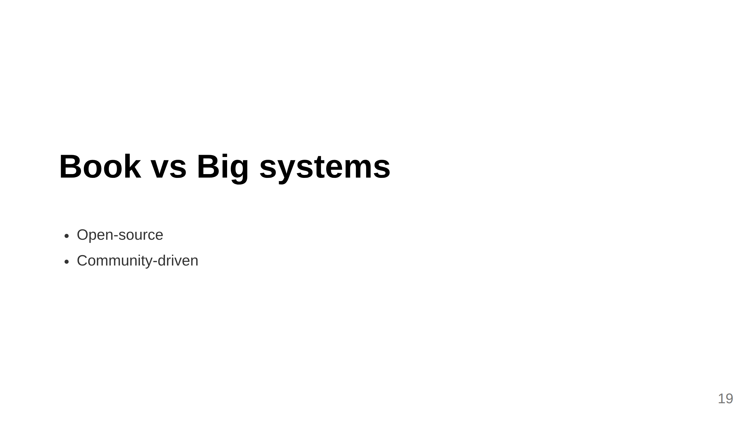

Slide 20
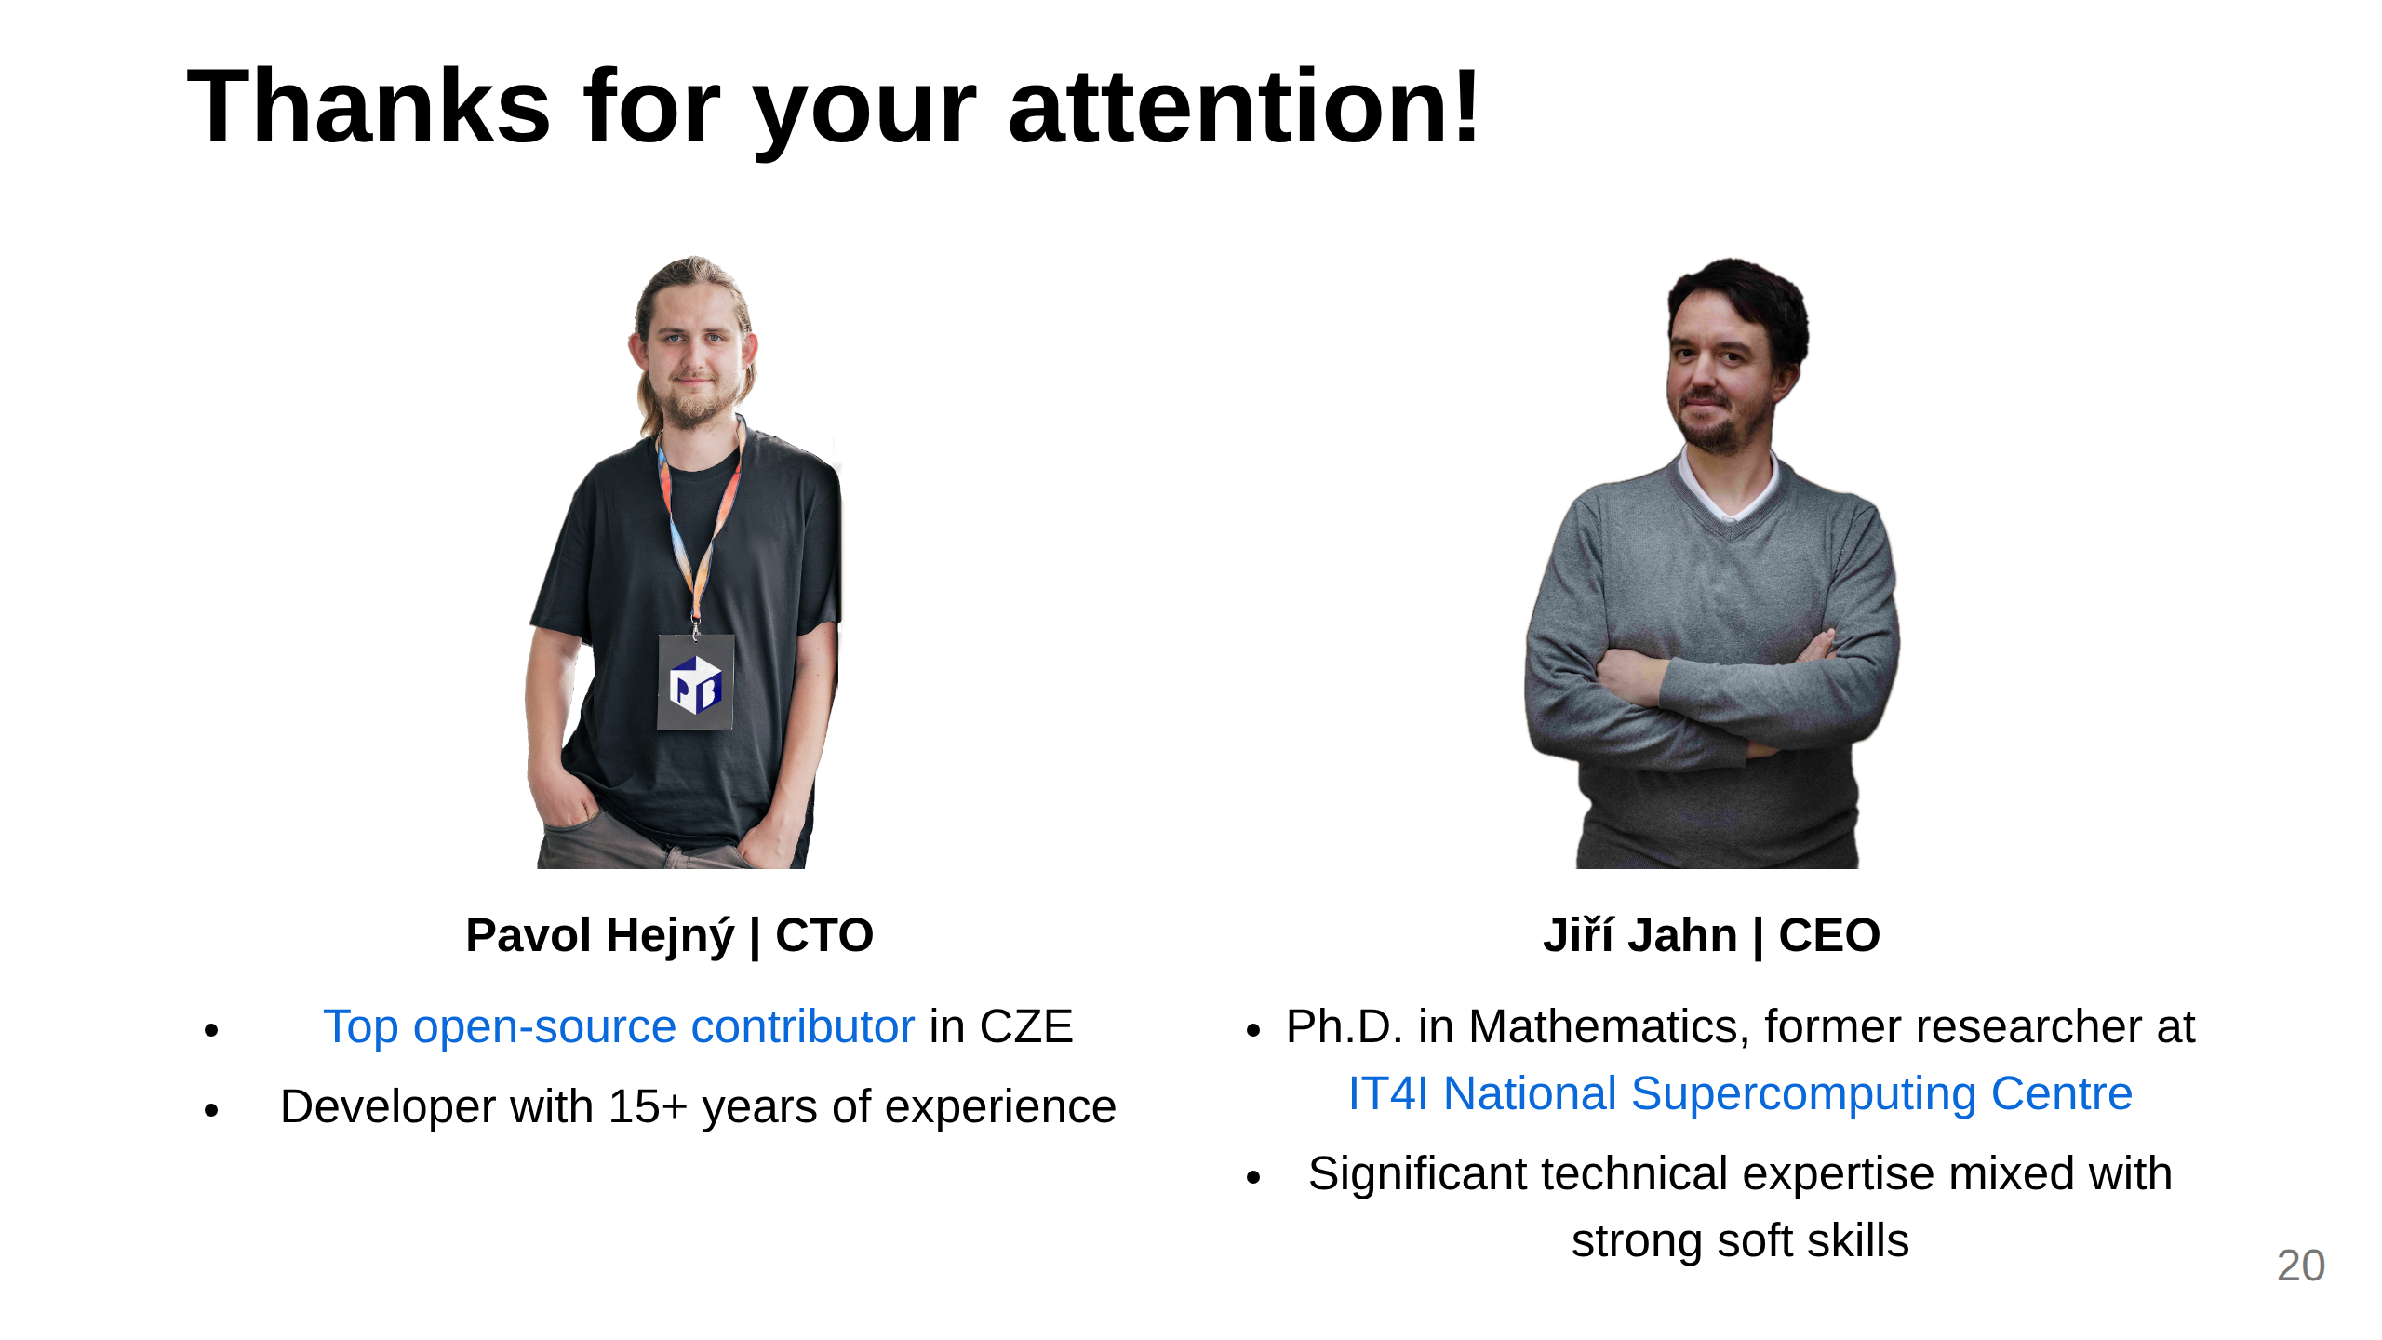
Notes:
- No need for developers - Create portable AI agents - guardrail for AI --- # What can book do? ## What who how --- <span class="commitment-slide-wwh">Who</span> <div class="split-slide-layout"> <div class="split-slide-left"> <h1>Persona<h1> </div> <div class="split-slide-right"> <img src="https://promptbook.studio/embed/book-preview.png?book= designer persona aaa &width=960&height=1080&variant=SINGLE&nonce=3 " /> </div> </div> --- <span class="commitment-slide-wwh">What</span> <div class="split-slide-layout"> <div class="split-slide-left"> <h1>Expectations</h1> </div> <div class="split-slide-right"> <img src="https://promptbook.studio/embed/book-preview.png?book= designer * persona aaa &width=960&height=1080&variant=SINGLE&nonce=3 " /> </div> </div> --- <span class="commitment-slide-wwh">How</span> <div class="split-slide-layout"> <div class="split-slide-left"> <h1>Knowledge<!-- and context-- ></h1> </div> <div class="split-slide-right"> <img src="https://promptbook.studio/embed/book-preview.png?book= designer persona aaa &width=960&height=1080&variant=SINGLE&nonce=3 " /> </div> </div> --- <span class="commitment-slide-wwh">What, How</span> <div class="split-slide-layout"> <div class="split-slide-left"> <h1>Action</h1> </div> <div class="split-slide-right"> <img src="https://promptbook.studio/embed/book-preview.png?book= designer persona aaa &width=960&height=1080&variant=SINGLE&nonce=3 " /> </div> </div> --- Slide 3: Team (Only if it's a strength)

Slide 21
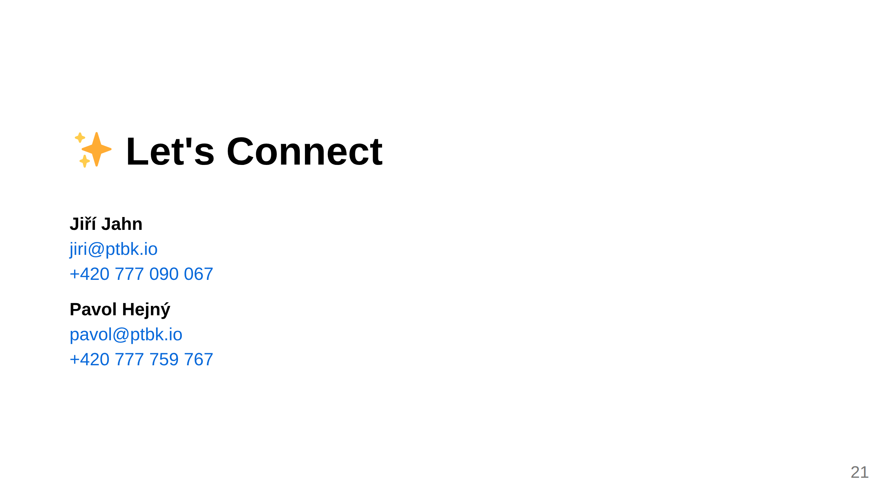
Notes:
Slide 8: Contact

